Slide 1
We are
together!

Slide 2
NAME
NAME
1
Acquaintance
2
Love
3
Together

Slide 3
Dear：
Write down your most beautiful memories
YY/MM/DD
Dear：
Write down your most beautiful memories
YY/MM/DD
Dear：
Write down your most beautiful memories
YY/MM/DD
Dear：
Write down your most beautiful memories
YY/MM/DD

Slide 4

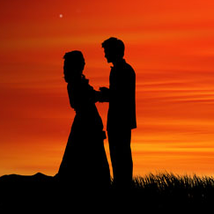
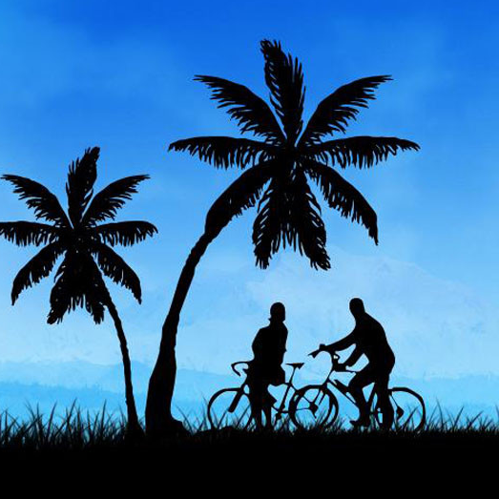
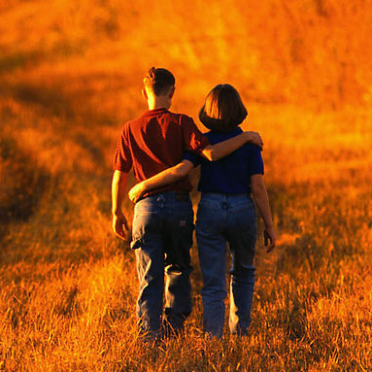
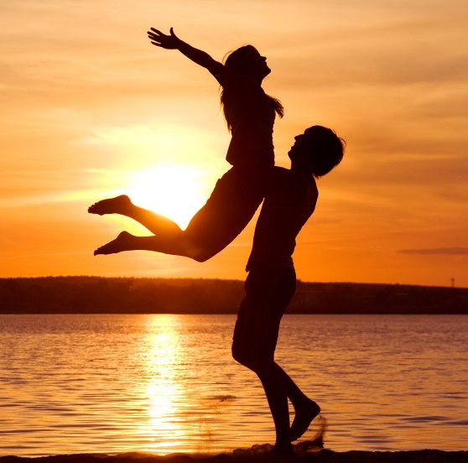
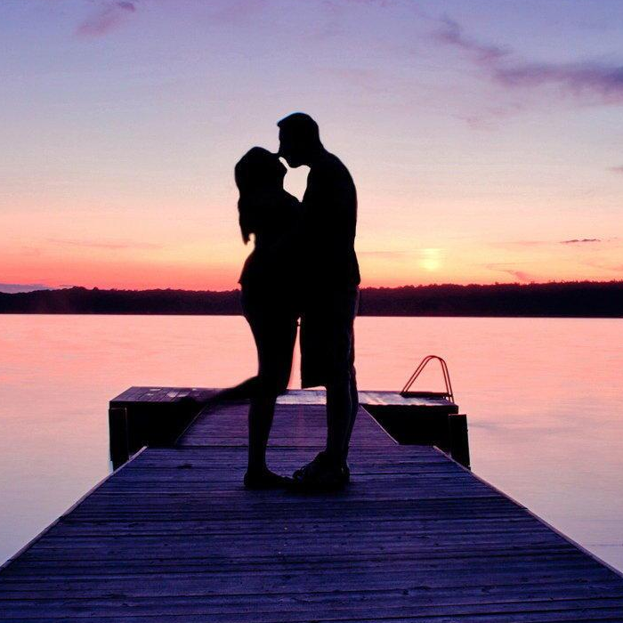
In those years, we pass through the road...

Slide 5
Dear girl:
Say you want to say to her...
Love you
BOY

Slide 6
Dear girl:
I think, in the future...
Love you
BOY

Slide 7
Baby, to my most loving you....

