Slide 1

Poem
我等着的清澈
I'm waiting for the pure, clear, waiting for me

Slide 2
Content
01
02
03
[ PART I ]
[ PART II ]
[ PART III ]
When the world went silent night
I'm still waiting
When the world went silent night
I'm still waiting
When the world went silent night
I'm still waiting

Slide 3
Part ~ ONE

Slide 4

Poem
仿佛一切都变得模糊 除了我等着的清澈
As if everything becomes blurred Besides I'm waiting for clear

Slide 5
Poem
When the world went silent night
I'm still waiting
When the world went silent night
I'm still waiting
When the world went silent night
I'm still waiting
System I
System II
System III

Slide 6
Part ~ Two

Slide 7
A
B
When the world went silent night
I'm still waiting
When the world went silent night
I'm still waiting
C
D
When the world went silent night
I'm still waiting
When the world went silent night
I'm still waiting

Slide 8
Poem
如果可以呈现每一个细节
If you can present every detail

Slide 9
A
B
C
40 %
60 %
100 %
When the world went silent night
I'm still waiting
When the world went silent night
I'm still waiting
When the world went silent night
I'm still waiting

Slide 10
Part ~ Three

Slide 11


Creative
创意改变生活
改变
When the world went silent night
I'm still waiting
02
01
Poem
03
创意
生活
When the world went silent night
I'm still waiting
When the world went silent night
I'm still waiting

Slide 12
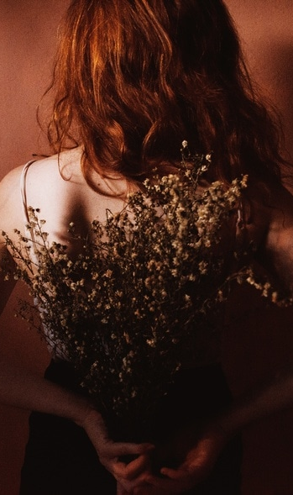
Design by 二三年
You make me become a river
flowing silently
你让我成为河流 、 静默地流淌

Slide 13
End
Design by 二三年

Slide 14

Design by 二三年
微博：@两三年_1945

