Slide 1
Design by:
DESIGNER
The Best Presentation Templates In The World

Slide 2

Best Presentation

Slide 3

Our Company:
ABOUT US
The Best Presentation Templates In The World
GO LIVE FOR THE HEALTHY
SEAS INITIATIVE!
If you wish to follow step by step our growing initiative for the sea, now you have every possible connection!
Blog: www.12345678.org
Twitter: @PPTSTORE_org
Facebook: Pptstore
We will share every step of our initiative with all communities and we will discuss interesting news on marine conservation, ghost fishing, recycling and sustainable brands.
Best Presentation
03

Slide 4


Our Company:
ABOUT US
The Best Presentation Templates In The World
Beijing
Beijing
80%
Beijing
Beijing
Find out about the endless applications of the bulk continuous filaments (BCF) and nylon textile filaments (NTF) we produce.
Beijing
Best Presentation
04

Slide 5
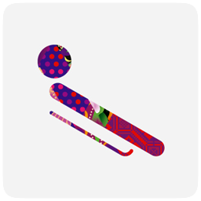




Our Company:
ABOUT US
The Best Presentation Templates In The World
MARS DU
JOHN LI
LYHN ZE
CHAR SU
JACK HA
Creative director
Creative director
Creative director
Creative director
Creative director
Before the end of the year, there was still time for the third prize given to Aquafil. As in others occasion, the prize was bestowed for the efforts towards innovation and sustainability of its products.
Before the end of the year, there was still time for the third prize given to Aquafil. As in others occasion, the prize was bestowed for the efforts towards innovation and sustainability of its products.
Before the end of the year, there was still time for the third prize given to Aquafil. As in others occasion, the prize was bestowed for the efforts towards innovation and sustainability of its products.
Before the end of the year, there was still time for the third prize given to Aquafil. As in others occasion, the prize was bestowed for the efforts towards innovation and sustainability of its products.
Before the end of the year, there was still time for the third prize given to Aquafil. As in others occasion, the prize was bestowed for the efforts towards innovation and sustainability of its products.
Best Presentation
05

Slide 6



Our Company:
ABOUT US
The Best Presentation Templates In The World
80%
LATEST PRIZE TO CELEBRATE
END OF 2014
uxaqua's expertise makes it a major player in this sector, and the ideal partner for project management teams during the detailed design and engineering study phases: treatment of LSS water, waterproofing of major works, PMMA glazing, underwater scenery and lighting.
Best Presentation
06

Slide 7
Our Company:
ABOUT US
The Best Presentation Templates In The World
80%
2008~2009
year
uxaqua's expertise makes it a major player in this sector, and the ideal partner for project management teams during the detailed design and engineering study phases: treatment of LSS water, waterproofing of major works, PMMA glazing, underwater scenery and lighting.
60%
2008~2009
year
uxaqua's expertise makes it a major player in this sector, and the ideal partner for project management teams during the detailed design and engineering study phases: treatment of LSS water, waterproofing of major works, PMMA glazing, underwater scenery and lighting.
40%
2008~2009
year
uxaqua's expertise makes it a major player in this sector, and the ideal partner for project management teams during the detailed design and engineering study phases: treatment of LSS water, waterproofing of major works, PMMA glazing, underwater scenery and lighting.
Best Presentation
07

Slide 8

Our Company:
ABOUT US
The Best Presentation Templates In The World
MILLION TONS ANNUAL TEXTILE GLOBAL PRODUCTION 2010
OF FIBERS CONSUMED IN 2012
ARE MANMADE FIBERS
GLOBAL TEXTILE AND APPAREL WASTE
ON GLOBAL PRODUCTION
MILLION TONS ANNUAL TEXTILE GLOBAL PRODUCTION 2010
An expert in the programming of Museums-Aquariums, our project leader and consultant ensures that all the help required is given to project managers / clients during the preliminary studies; in this way, the conditions in which aquarium projects are created can be improved right from the start.
An expert in the programming of Museums-Aquariums, our project leader and consultant ensures that all the help required is given to project managers / clients during the preliminary studies; in this way, the conditions in which aquarium projects are created can be improved right from the start.
An expert in the programming of Museums-Aquariums, our project leader and consultant ensures that all the help required is given to project managers / clients during the preliminary studies; in this way, the conditions in which aquarium projects are created can be improved right from the start.
An expert in the programming of Museums-Aquariums, our project leader and consultant ensures that all the help required is given to project managers / clients during the preliminary studies; in this way, the conditions in which aquarium projects are created can be improved right from the start.
Best Presentation
08

Slide 9
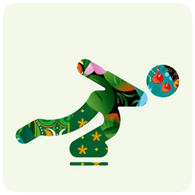

Our Company:
ABOUT US
The Best Presentation Templates In The World
GO LIVE FOR THE HEALTHY
SEAS INITIATIVE!
The colors are vivid and with stylish pattern. For man, women or junior, all these training swimsuits are made with regenerated ECONYL® nylon yarn and therefore the material (80% ECONYL® and 20% Lycra) is called Waterfeel x-life ECO. women or junior, all these training swimsuits are made with regenerated ECONYL® nylon yarn and therefore the material (80% ECONYL® and 20% Lycra) is called Waterfeel x-life ECO.
Best Presentation
09

Slide 10

Our Company:
ABOUT US
The Best Presentation Templates In The World
GO LIVE FOR THE HEALTHY
SEAS INITIATIVE!
GO LIVE FOR THE HEALTHY
SEAS INITIATIVE!
The colors are vivid and with stylish pattern. For man, women or junior, all these training swimsuits are made with regenerated ECONYL® nylon yarn and therefore the material (80% ECONYL® and 20% Lycra) is called Waterfeel x-life ECO. women or junior, all these training swimsuits are made with regenerated ECONYL® nylon yarn and therefore the material (80% ECONYL® and 20% Lycra) is called Waterfeel x-life ECO.
The colors are vivid and with stylish pattern. For man, women or junior, all these training swimsuits are made with regenerated ECONYL® nylon yarn and therefore the material (80% ECONYL® and 20% Lycra) is called Waterfeel x-life ECO. women or junior, all these training swimsuits are made with regenerated ECONYL® nylon yarn and therefore the material (80% ECONYL® and 20% Lycra) is called Waterfeel x-life ECO.
Best Presentation
10

Slide 11
Our Company:
ABOUT US
The Best Presentation Templates In The World
500$
500$
500$
200
500$
500$
100
0
100
200
300
400
Best Presentation
11

Slide 12
Our Company:
ABOUT US
The Best Presentation Templates In The World
UP 50%
To £5.33Billion
UP 60%
To £5.33Billion
UP 20%
To £5.33Billion
UP 90%
To £5.33Billion
Best Presentation
12

Slide 13
Our Company:
ABOUT US
The Best Presentation Templates In The World
Intelligence flows back into machines
PHYSICAL AND HUMAN NETWORKS
Services are designed with a “Cloud First” mindset with a failsafe implementation
RESTful APIs are designed using best practices
Services are designed with a “Cloud First” mindset with a failsafe implementation
RESTful APIs are designed using best practices
Extraction and storage of proprietary machine data stream
Machine-based algorithms and data analysis
Services are designed with a “Cloud First” mindset with a failsafe implementation
RESTful APIs are designed using best practices
Services are designed with a “Cloud First” mindset with a failsafe implementation
RESTful APIs are designed using best practices
Best Presentation
13

Slide 14




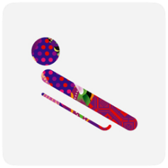

Our Company:
ABOUT US
The Best Presentation Templates In The World
Machine-based algorithms and data analysis
Each device is a connected device
Each device is a cache - device loss/recreation is a non-event
Device state (apps & users) is stored in a cloud (default is SkyDrive)
App & User state is transparently accessible from any device
A device does not have to have a user interface or even users (sensors, etc.)
Best Presentation
14
REMOTE AND CENTRALIZED DATA VISUALIZATION

Slide 15
Intelligence flows back into machines
Intelligence flows back into machines
Extraction and storage of proprietary machine data stream
PHYSICAL AND HUMAN NETWORKS
INDUSTRIAL DATA SYSTEMS
356$
Best Presentation
15

Slide 16
Our Company:
ABOUT US
The Best Presentation Templates In The World
Single Line Display
Wearable
Storage Types
Data sharing with the right people and machines
Data sharing with the right people and machines
Data sharing with the right people and machines
Embedded Small 3
AdvertisingDisplay
Device Tailored
Data sharing with the right people and machines
Data sharing with the right people and machines
Data sharing with the right people and machines
Best Presentation
16

Slide 17
Our Company:
ABOUT US
The Best Presentation Templates In The World
Machine-based algorithms and data analysis
Services are designed with a “Cloud First” mindset with a failsafe implementation
RESTful APIs are designed using best practices
Services default to delivering data using a standard protocol (OData)
People-centric or social-enabled services utilize open protocols (Open Graph)
Services are data-centric and/or insight-enabled
Best Presentation
17

Slide 18




Our Company:
ABOUT US
The Best Presentation Templates In The World
Public Cloud
Hybrid Cloud
Private Cloud
Community
YOUR TEXT
UP 50%
UP 60%
UP 70%
UP 80%
To £5.33Billion
To £5.33Billion
To £5.33Billion
To £5.33Billion
The five basic values of Luxaqua, Aquariums Designer, focus on high performance, exacting standards, efficiency, emotion and responsibility.
The five basic values of Luxaqua, Aquariums Designer, focus on high performance, exacting standards, efficiency, emotion and responsibility.
The five basic values of Luxaqua, Aquariums Designer, focus on high performance, exacting standards, efficiency, emotion and responsibility.
The five basic values of Luxaqua, Aquariums Designer, focus on high performance, exacting standards, efficiency, emotion and responsibility.
Best Presentation
18

Slide 19
Best Presentation
Lyon - Dubaï - Worldwide
For a top of the range, made-to-measure aquarium.
Whatever your location.
7, rue Robert Reynier - 69190 Saint Fons, France
+33 (0)123 456 789// +33 (0)123 456 789

Slide 20
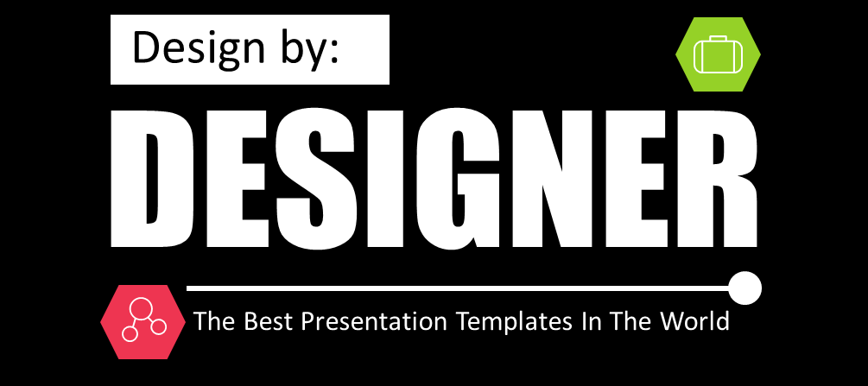
THANK YOU

