Slide 1
桀骜永不退役
COPY OR WRITE YOUR TEXT AND PASTE IT HERE

Slide 2
点击此处添加标题
copy or write your text and paste it here
Kobe Bryant
copy or write your text and paste it here

Slide 3
点击此处添加标题
copy or write your text and paste it here
Since 1996
Kobe Bryant
Kobe Bryant is the best one of the leading scorer in the NBA, breakthrough, shooting, free throws, three ball he is familiar, almost no offense, blind, single game 81 points of personal records is a powerful proved this.

Slide 4
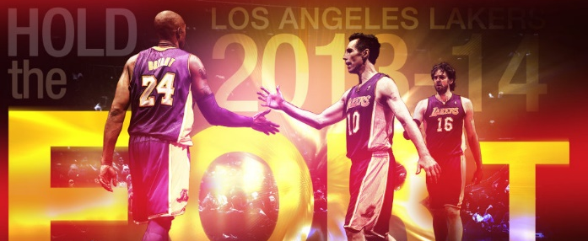
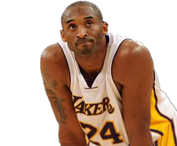
点击此处添加标题
copy or write your text and paste it here
Kobe Bryant
L.A. Lakers
“
1996-2016
Kobe Bryant is the best one of the leading scorer in the NBA, breakthrough, shooting, free throws, three ball he is familiar, almost no offense, blind, single game 81 points of personal records is a powerful proved this.
”

Slide 5
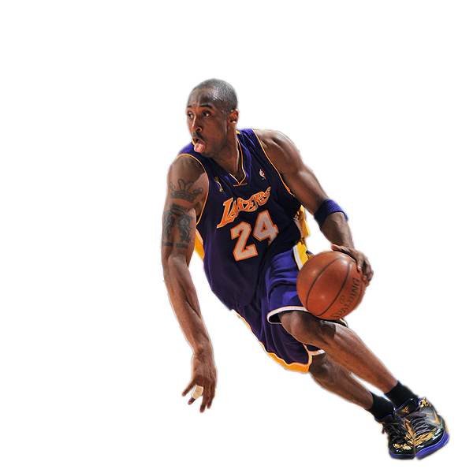
点击此处添加标题
copy or write your text and paste it here
Kobe Bryant is the best one of the leading scorer in the NBA, breakthrough, shooting, free throws, three ball he is familiar, almost no offense, blind, single game 81 points of personal records is a powerful proved this.
In addition to crazy too, Kobe's organizational skills are also very outstanding, often served as the first sponsor of the team's attack. In addition, Kobe is one of the best defenders in the league, personal defense is very oppressive

Slide 6
点击此处添加标题
copy or write your text and paste it here
Kobe Bryant is the best one of the leading scorer in the NBA, breakthrough, shooting, free throws, three ball he is familiar, almost no offense, blind, single game 81 points of personal records is a powerful proved this. In addition to crazy too, Kobe's organizational skills are also very outstanding, often served as the first sponsor of the team's attack. In addition, Kobe is one of the best defenders in the league, personal defense is very oppressive
Kobe Bryant

Slide 7
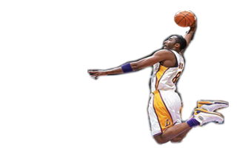
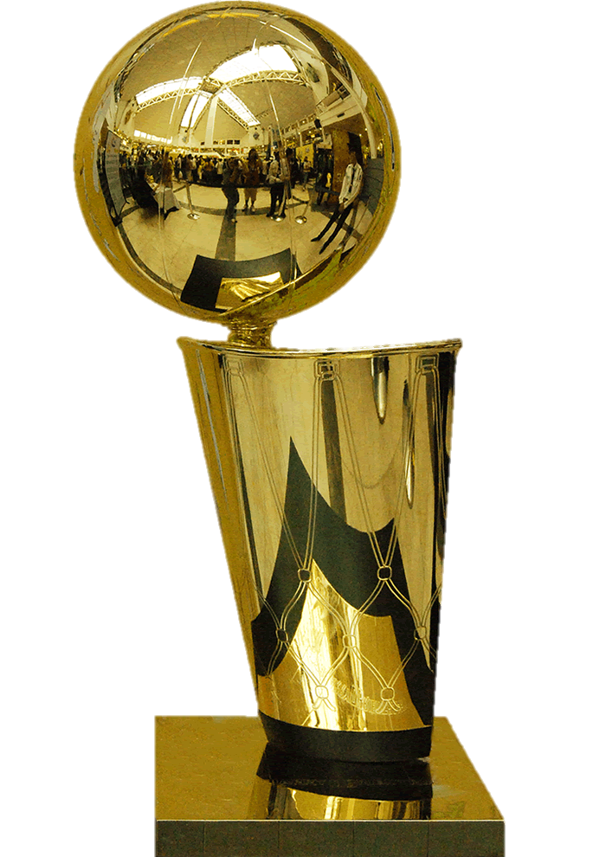
点击此处添加标题
copy or write your text and paste it here
KOBE
NBA CAREER
copy or write your text and paste it here
“
Kobe Bryant is the best one of the leading scorer in the NBA, breakthrough, shooting, free throws, three ball he is familiar, almost no offense, blind, single game 81 points of personal records is a powerful proved this.
”

Slide 8
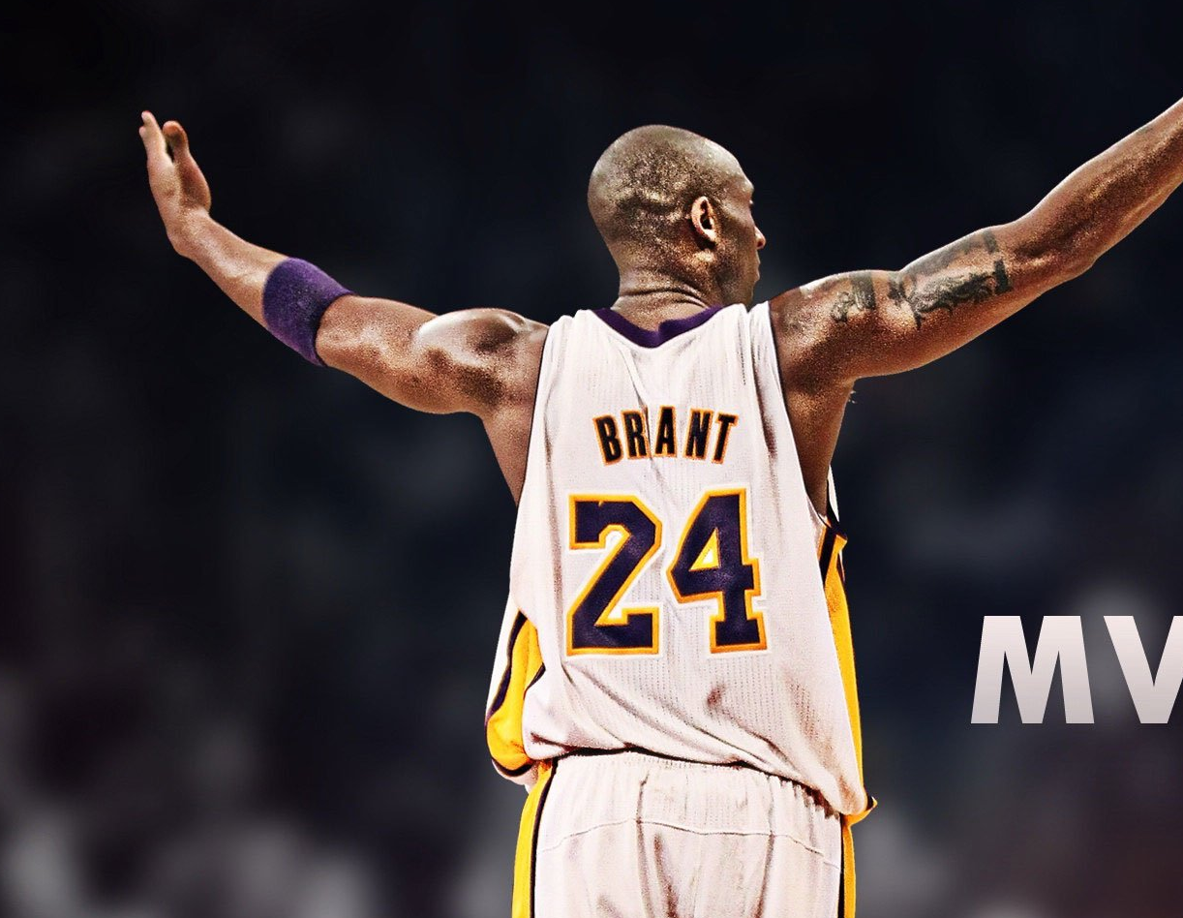
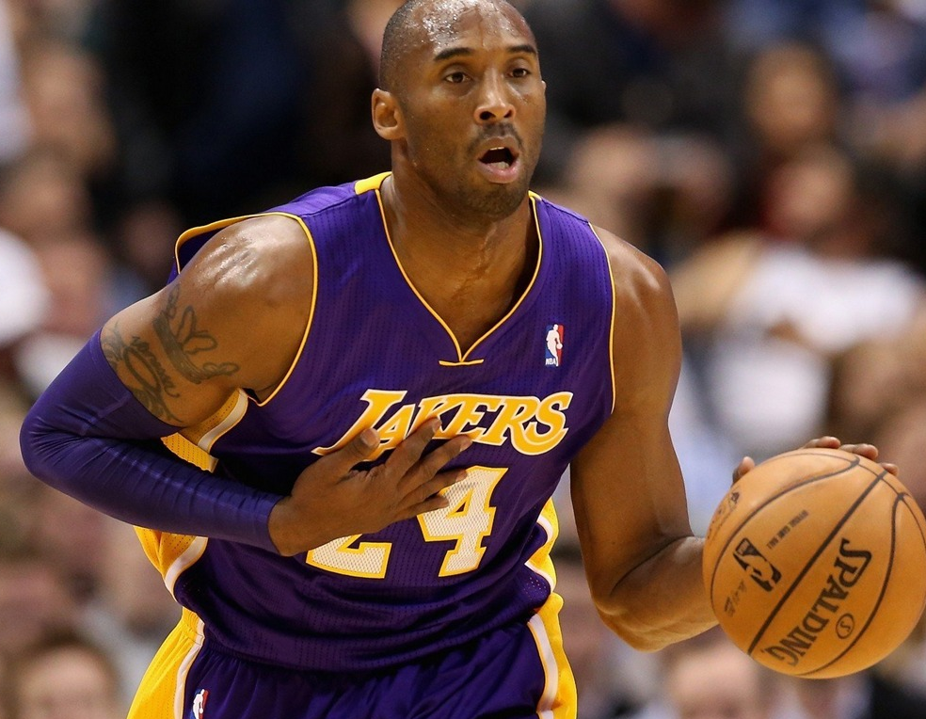
点击此处添加标题
copy or write your text and paste it here
81 SCORE
Kobe Bryant is the best one of the leading scorer in the NBA, breakthrough, shooting, free throws, three ball he is familiar, almost no offense, blind, single game 81 points of personal records is a powerful proved this.
Kobe Bryant

Slide 9
点击此处添加标题
copy or write your text and paste it here
1996
2010
2013
2015
Kobe Bryant is the best one of the leading scorer in the NBA, breakthrough, shooting, free throws, three ball he is familiar, almost no offense, blind, single game 81 points of personal records is a powerful proved this. In addition to crazy too, Kobe's organizational skills are also very outstanding, often served as the first sponsor of the team's attack. In addition, Kobe is one of the best defenders in the league, personal defense is very oppressive

Slide 10
不说再见
COPY OR WRITE YOUR TEXT AND PASTE IT HERE

Slide 11
更多精彩，关注浅语PPT公众号
http://qianyu.yanj.cn/

