Slide 1

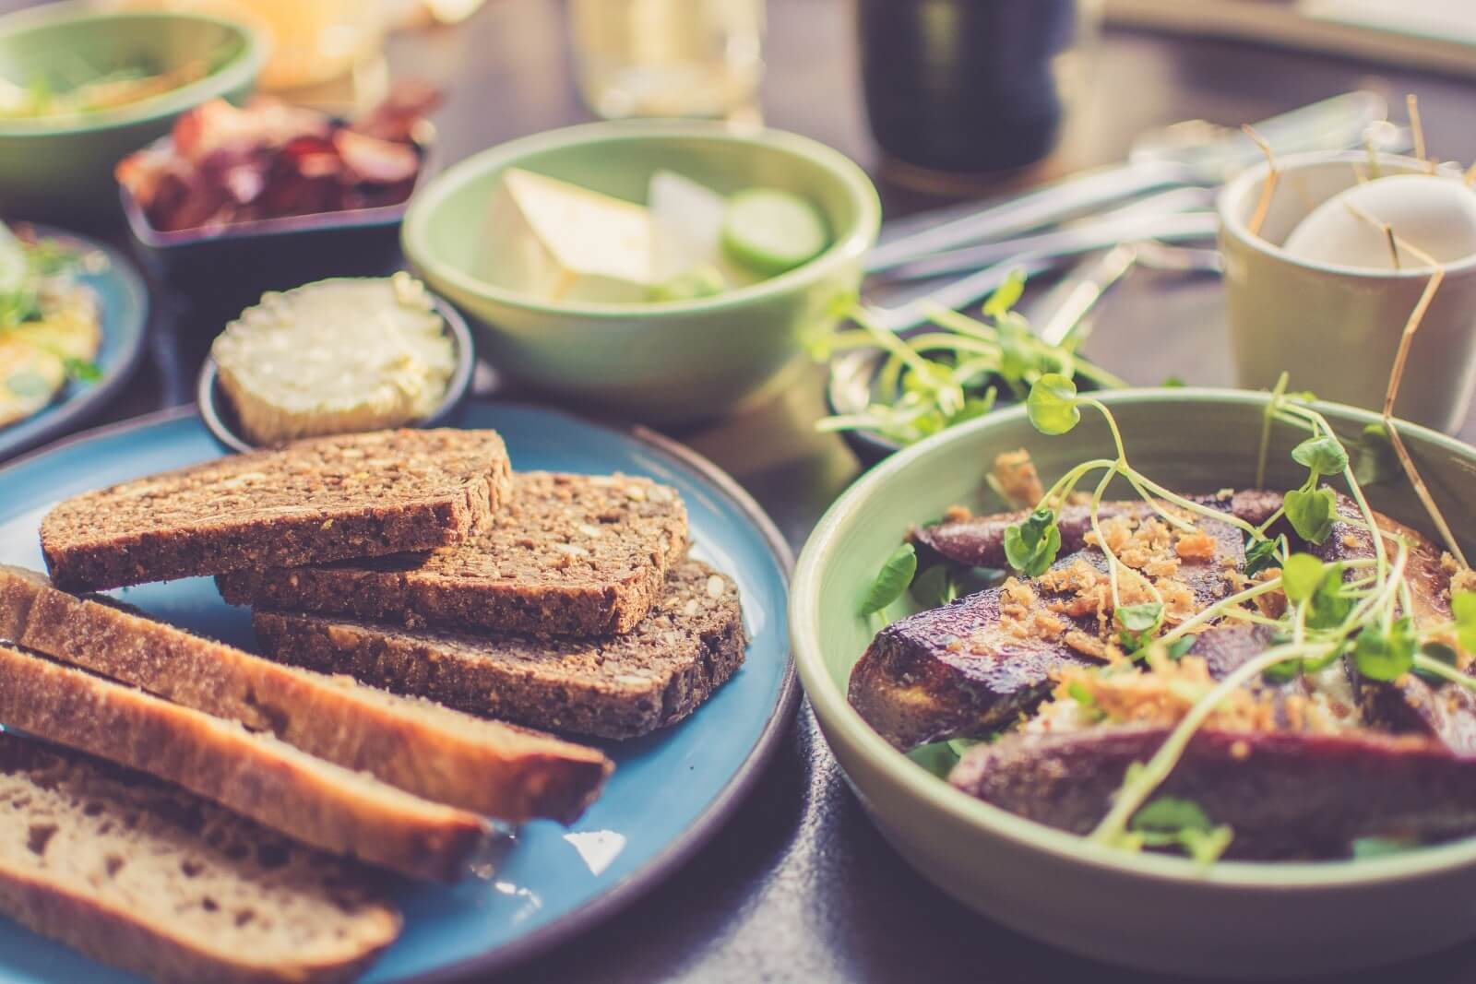
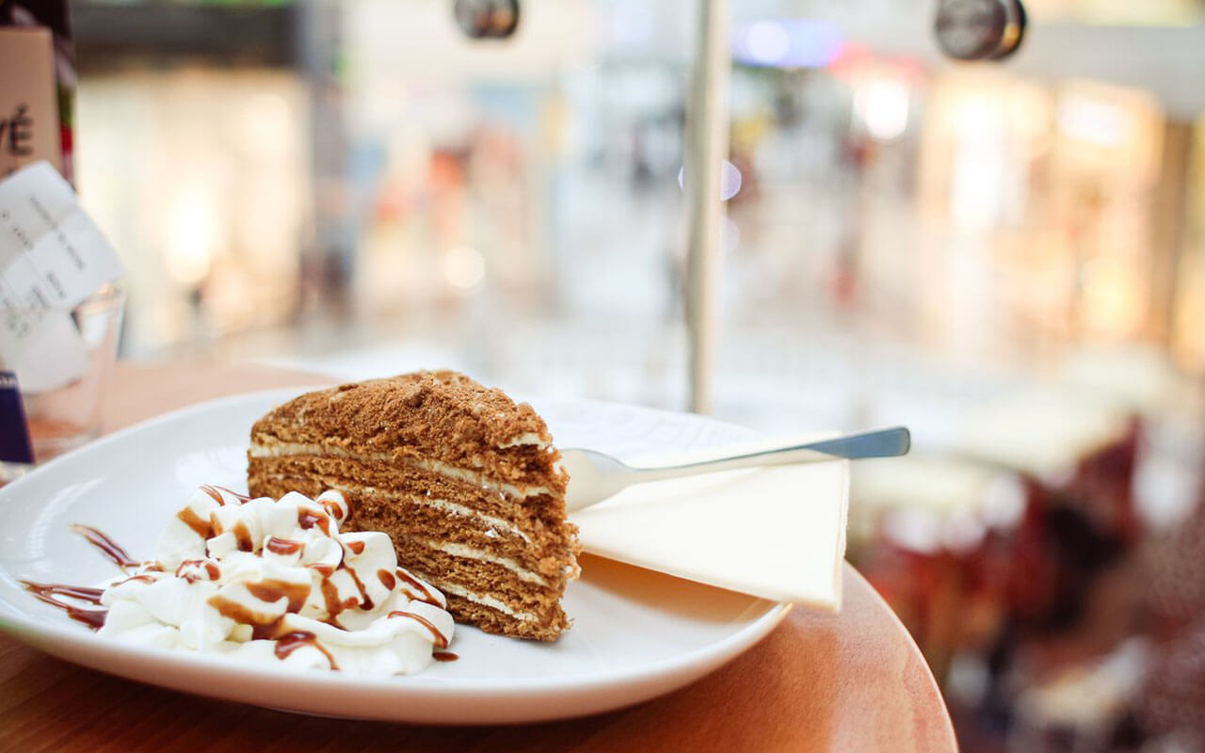
小
清
欢
DESTINY
FREEDOM
人间有味是清欢
一•两•清•欢
DREAM
I love you more than I've ever loved any woman.
I love you more than I've ever loved any woman.

Slide 2
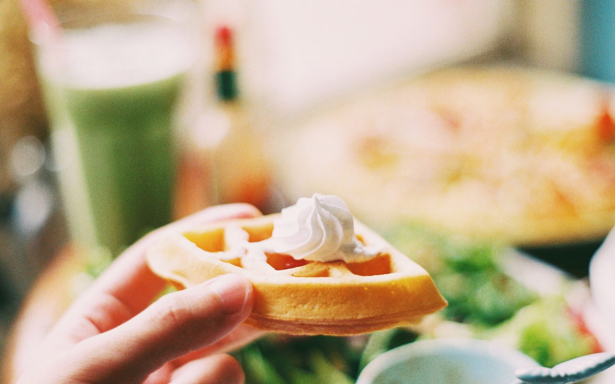
小
Contents
01 Click here to add your title
清
02 Click here to add your title
欢
03 Click here to add your title
04 Click here to add your title

Slide 3
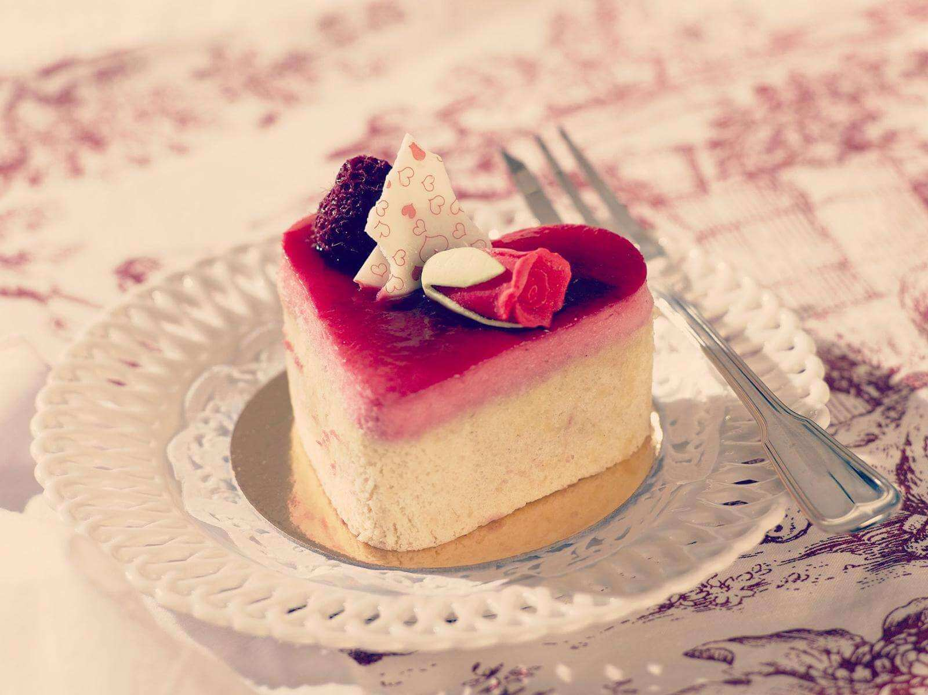
01
Click here to add your title
I love you more than I've ever loved any woman. And I've waited longer for you than I've waited for any woman.
I love you more than I've ever loved any woman. And I've waited longer for you than I've waited for any woman.

Slide 4
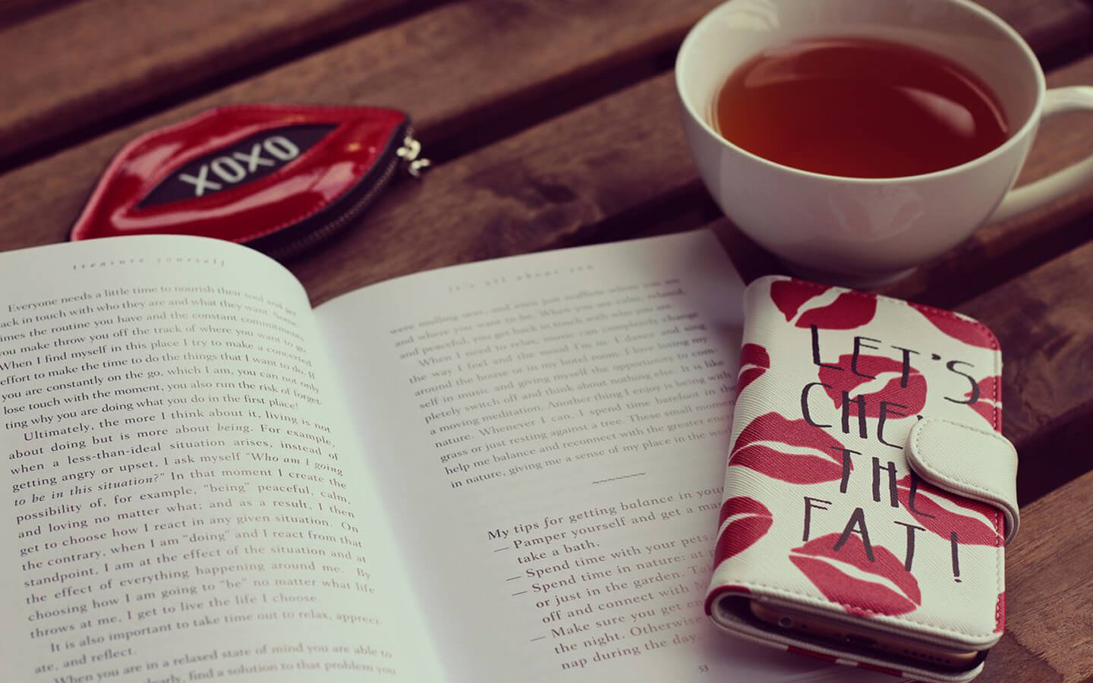
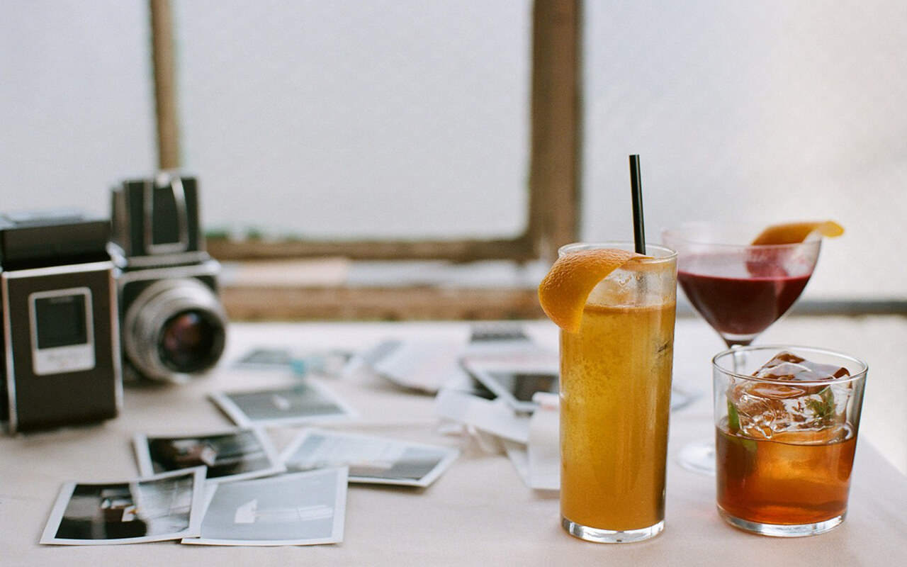


小清欢
一•两•清•欢
DESTINY FREEDOM
I love you more than I've ever loved any woman. And I've waited longer for you than I've waited for any woman.
I love you more than I've ever loved any woman. And I've waited longer for you than I've waited for any woman.

Slide 5
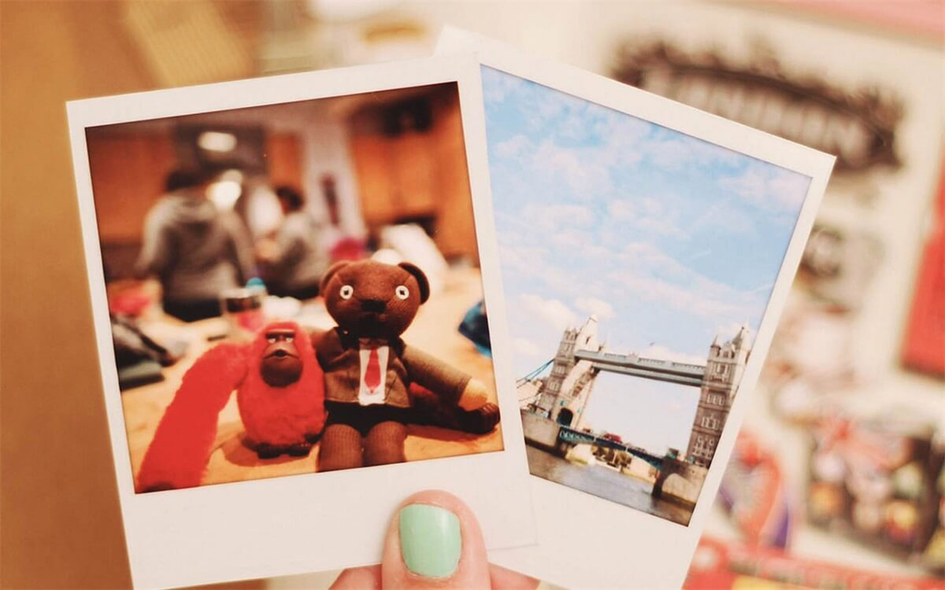
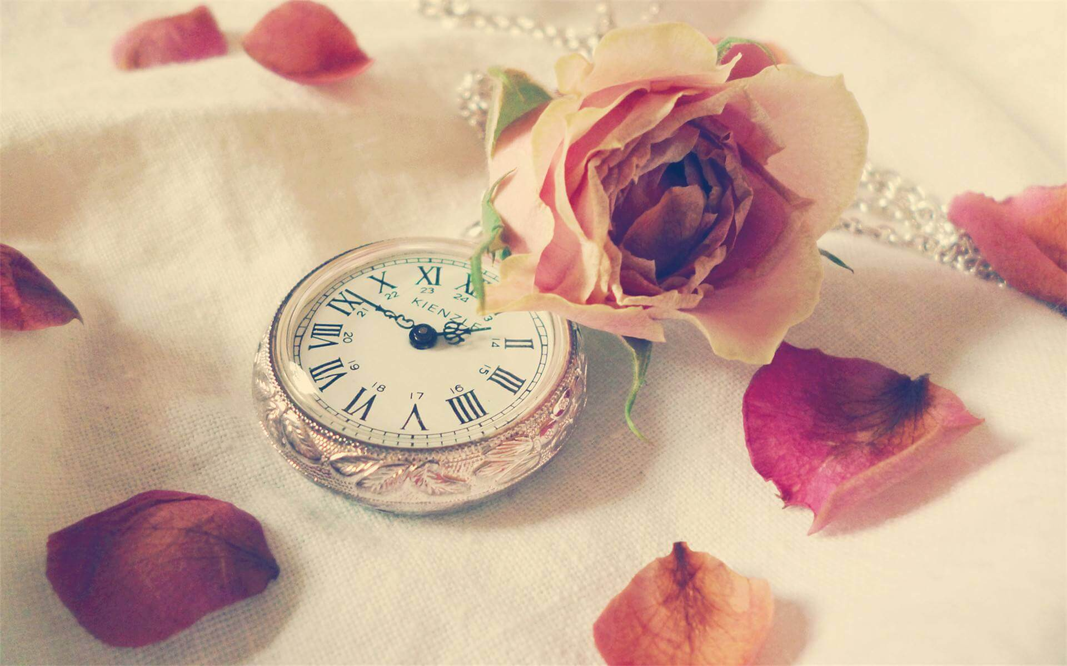
以清净心看世界，以欢喜心过生活，
以平常心生情味，以柔软心除挂碍。
小
清
欢
投三两桃花
掬一两清欢
而今身在梦里荡
不知怎归乡
复朽泪涟涟
无人共语嫣
I love you more than I've ever loved any woman.

Slide 6
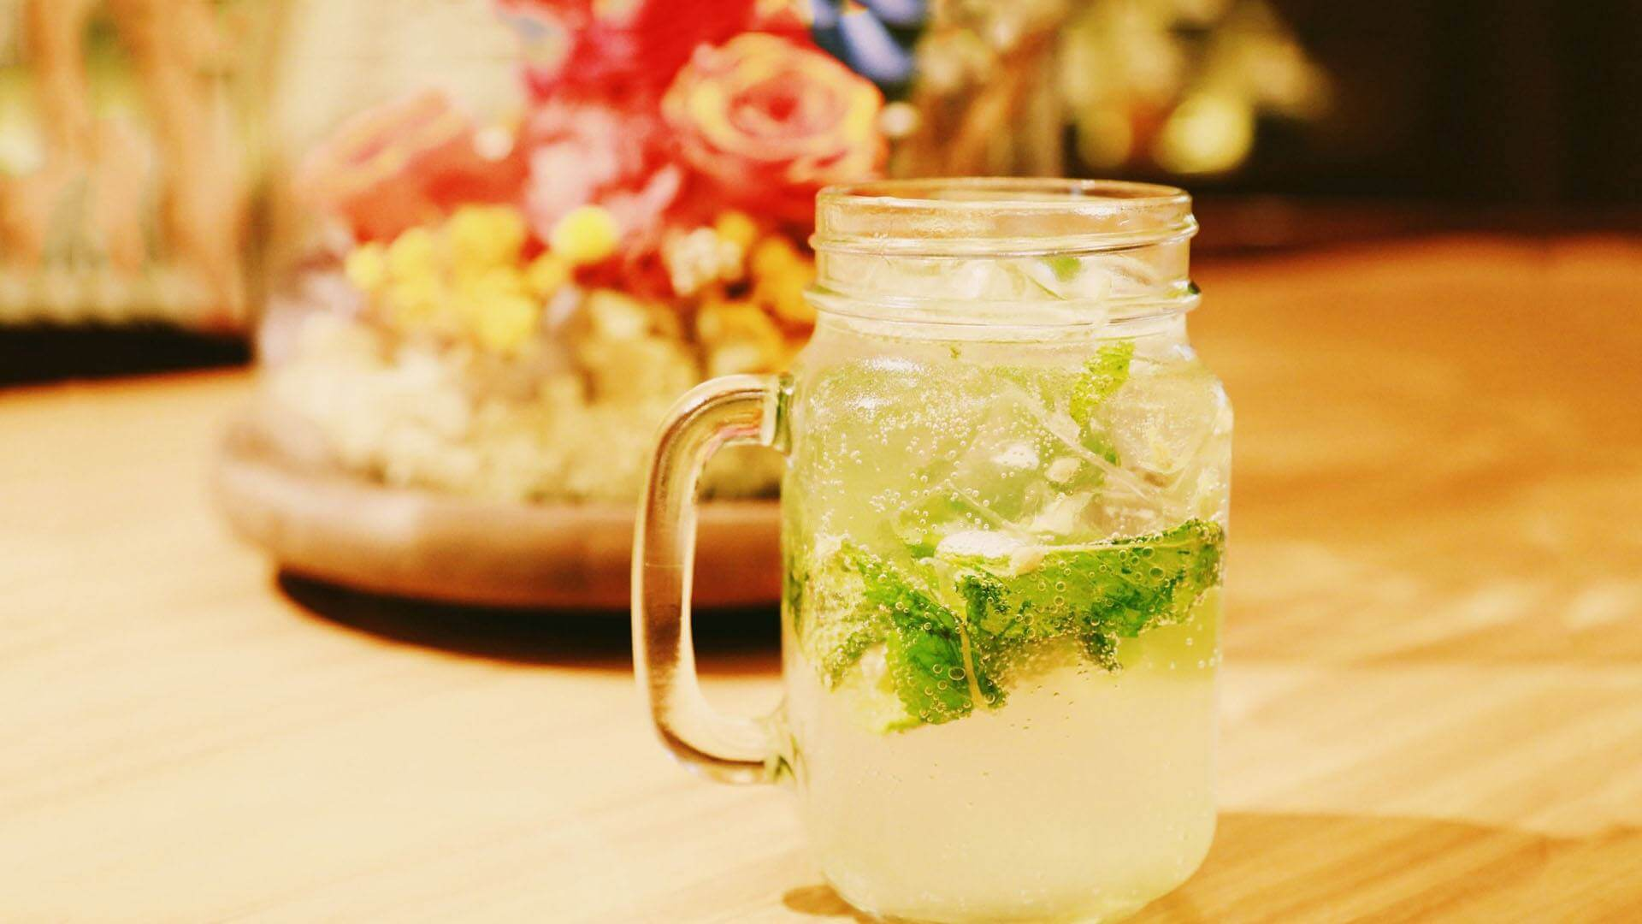

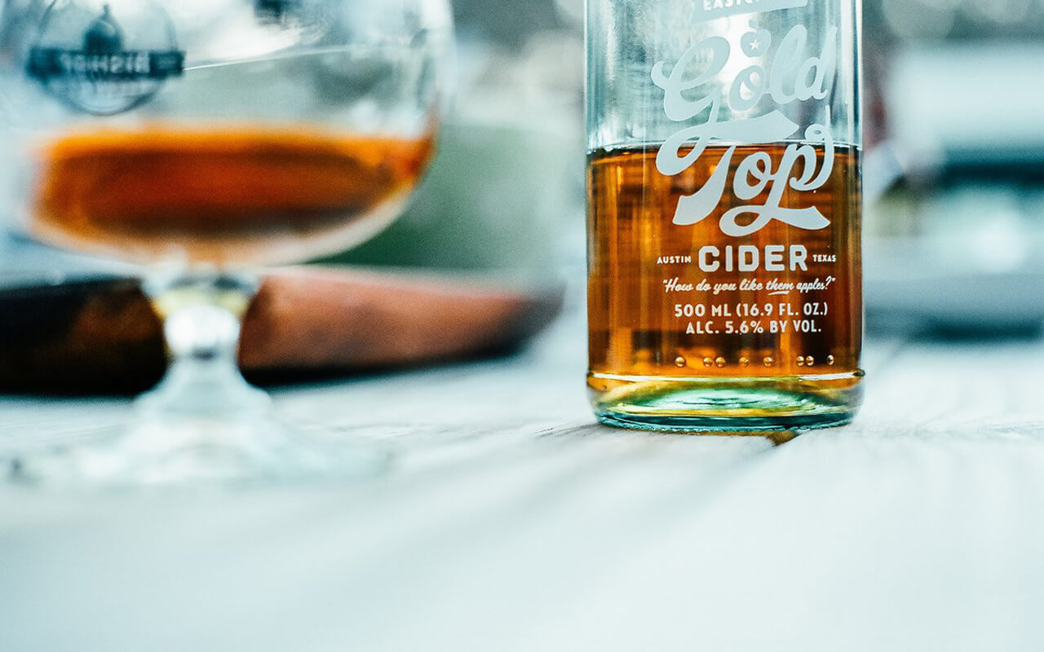

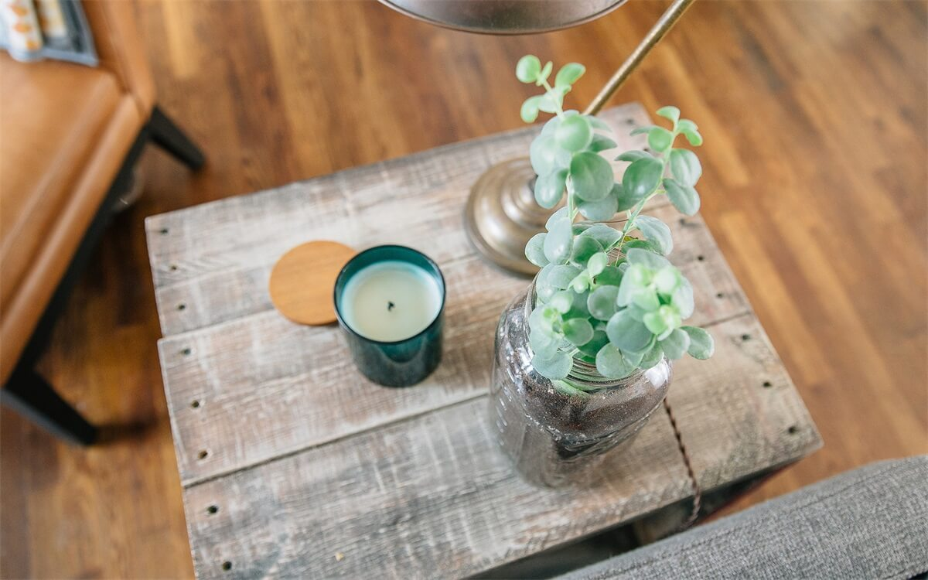
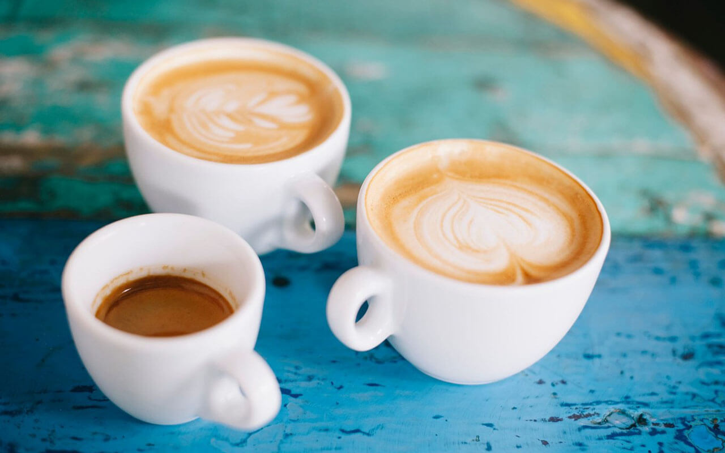
小 | 清 | 欢
小清欢
DESTINY
FREEDOM
一•两•清•欢
I love you more than I've ever loved any woman. And I've waited longer for you than I've waited for any woman.
I love you more than I've ever loved any woman. And I've waited longer for you than I've waited for any woman.

Slide 7
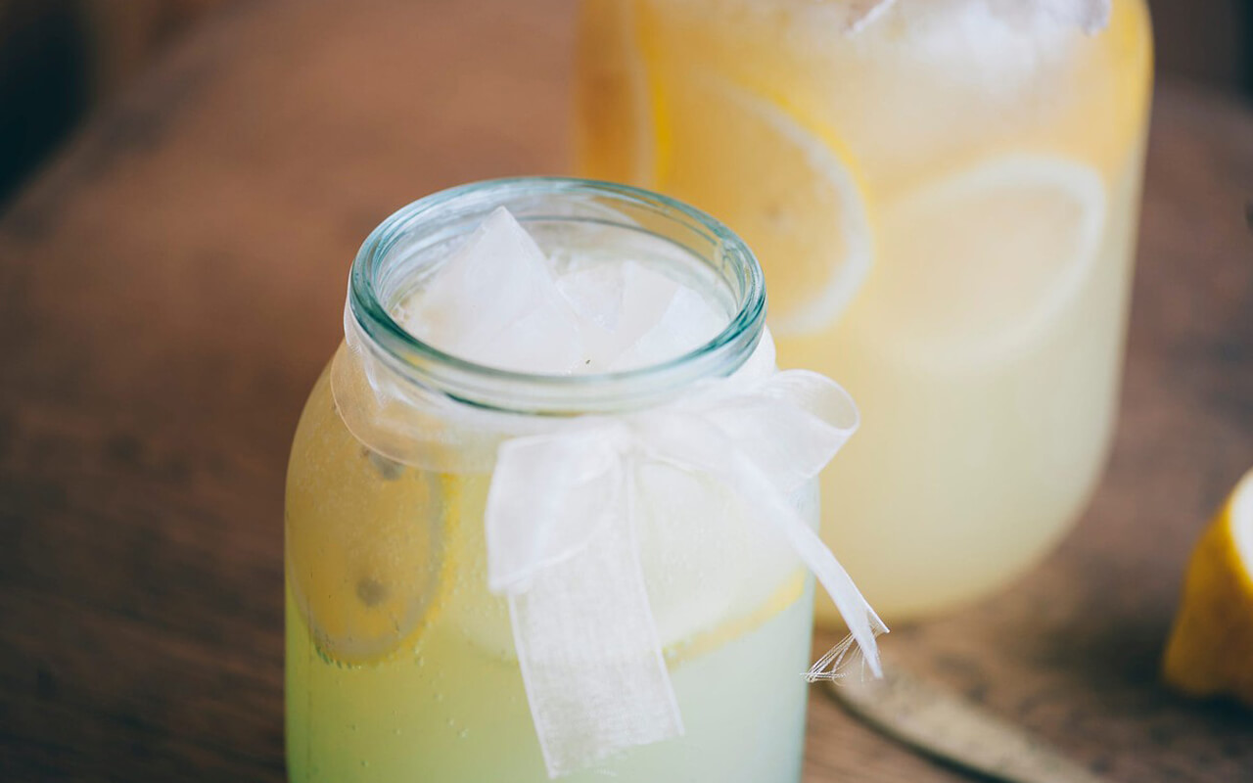
小
清
欢
I love you more than I've ever loved any woman. And I've waited longer for you than I've waited for any woman.I love you more than I've ever loved any woman. And I've waited longer for you than I've waited for any woman.

Slide 8
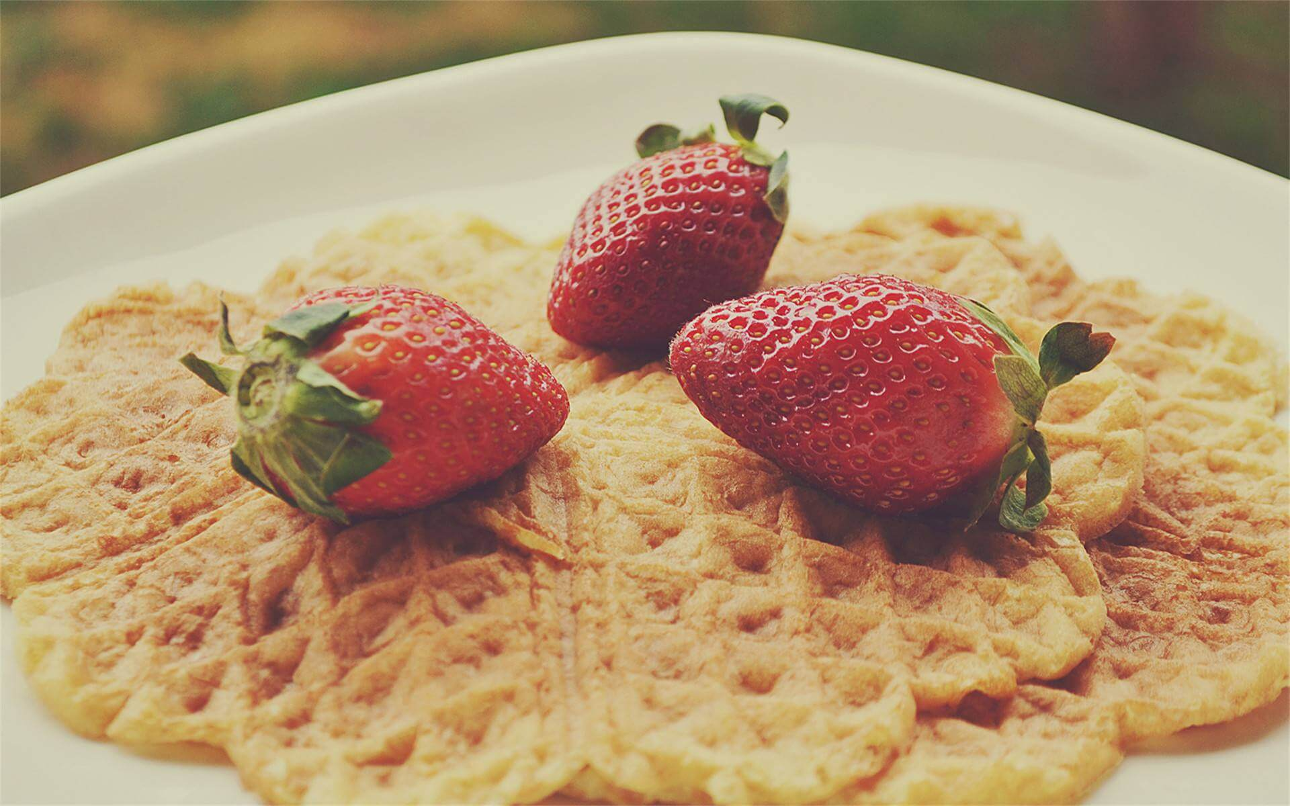
02
Click here to add your title
I love you more than I've ever loved any woman. And I've waited longer for you than I've waited for any woman.
I love you more than I've ever loved any woman. And I've waited longer for you than I've waited for any woman.

Slide 9
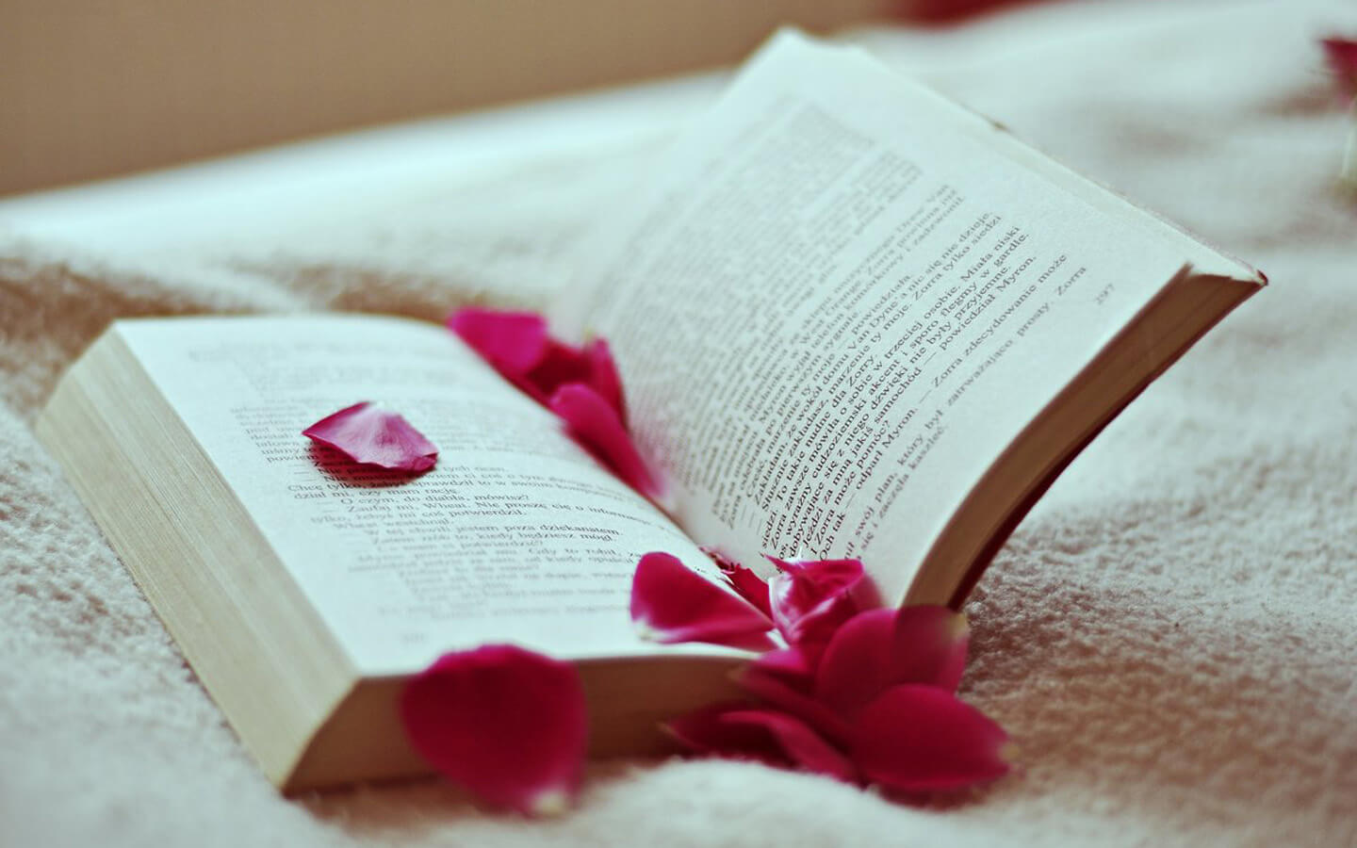
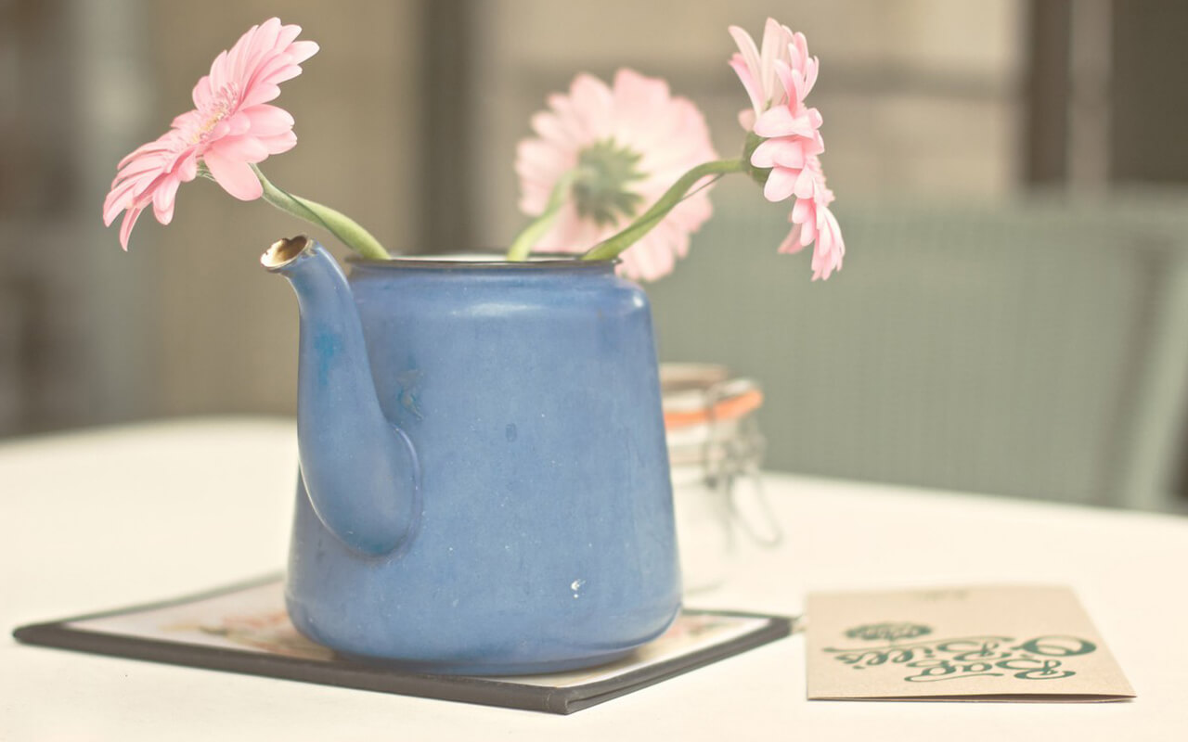
一
两
清
欢
I love you more than I've ever loved any woman. And I've waited longer for you than I've waited for any woman.
I love you more than I've ever loved any woman. And I've waited longer for you than I've waited for any woman.
I love you more than I've ever loved any woman. And I've waited longer for you than I've waited for any woman.
I love you more than I've ever loved any woman. And I've waited longer for you than I've waited for any woman.

Slide 10
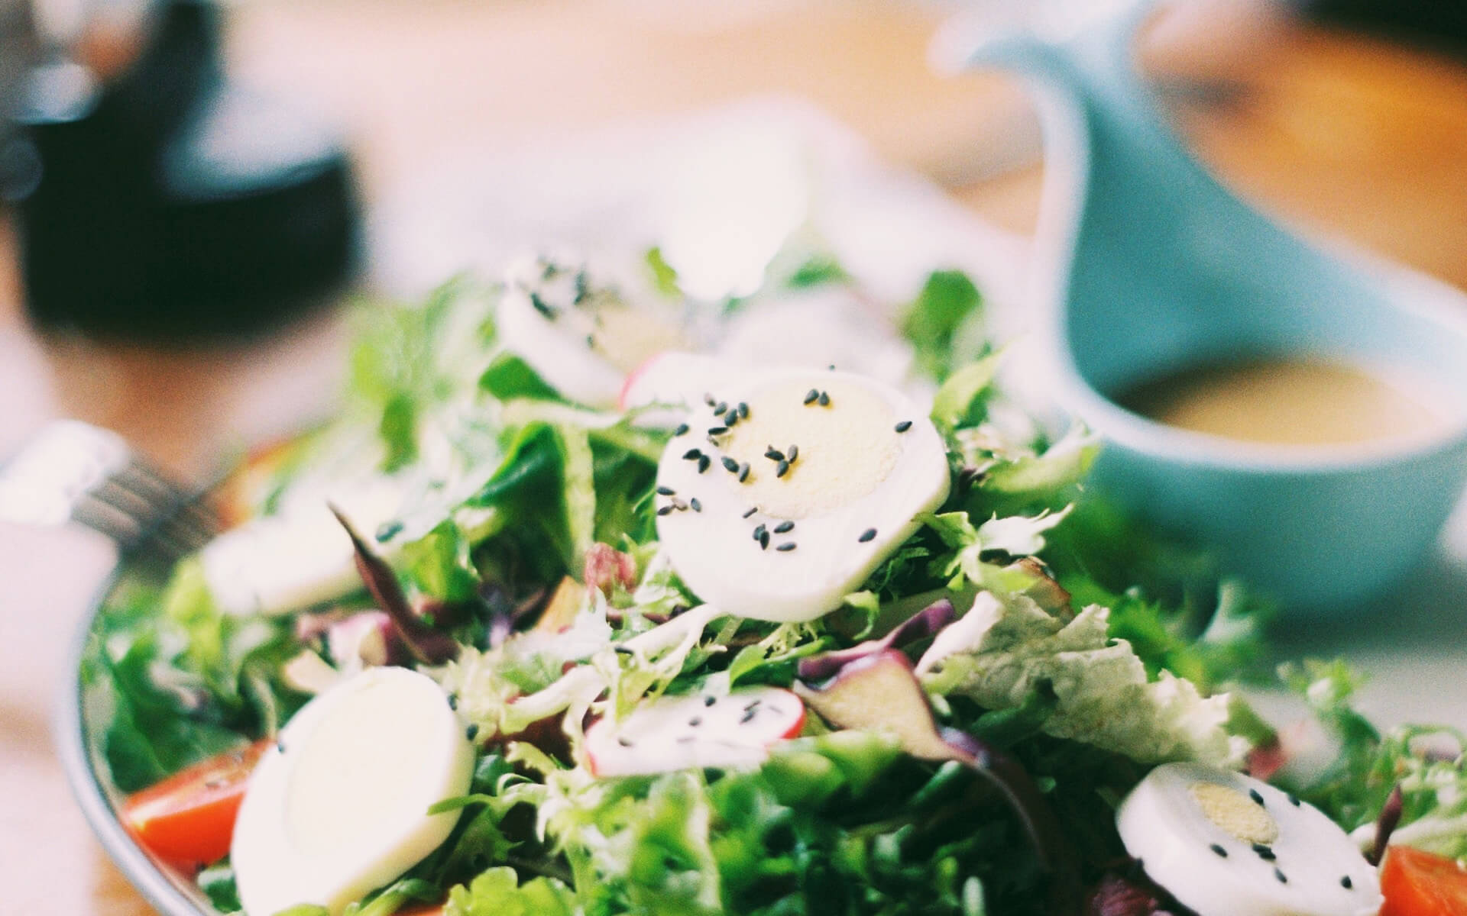
小
清
以清净心看世界，以欢喜心过生活。
欢
以清净心看世界，以欢喜心过生活。
以清净心看世界，以欢喜心过生活。

Slide 11
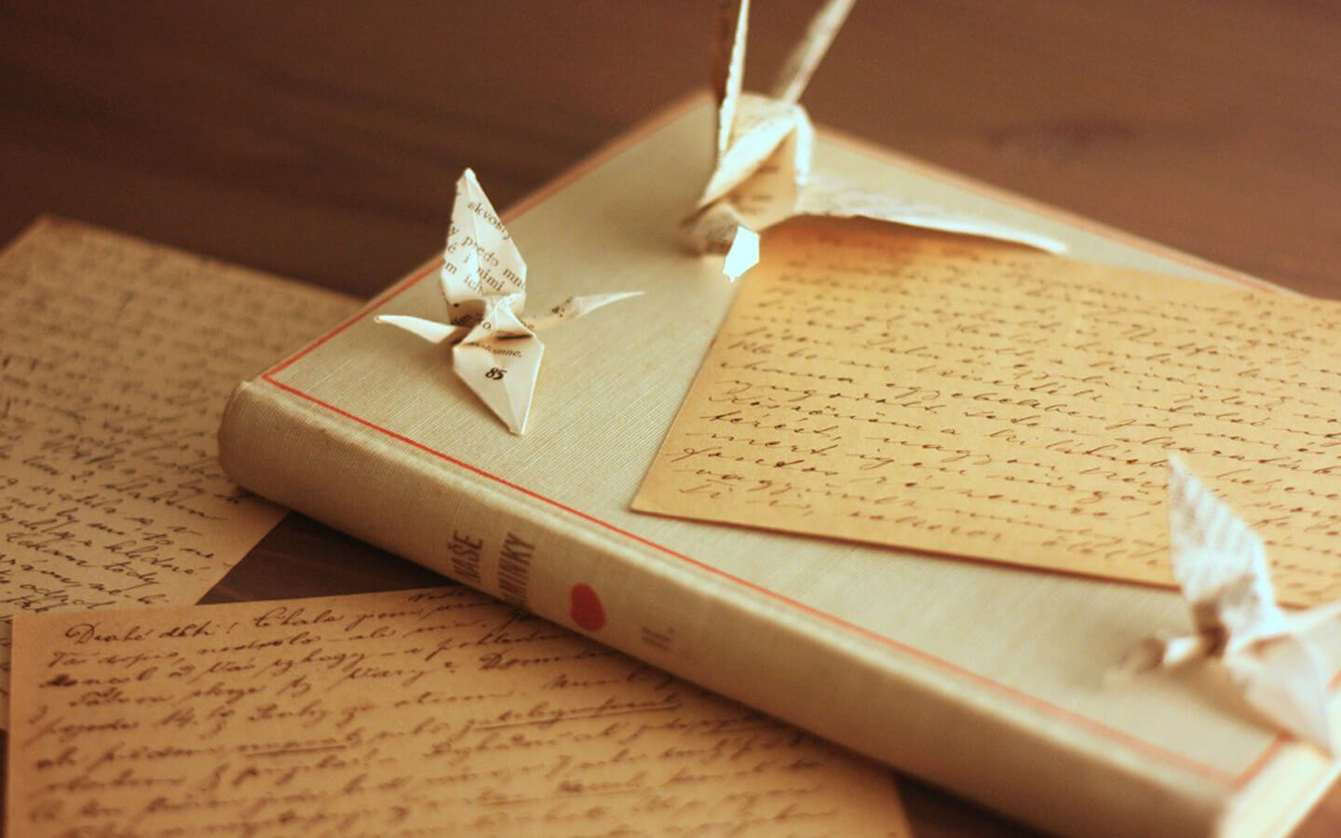
小
清
欢
一•两•清•欢
I love you more than I've ever loved any woman. And I've waited longer for you than I've waited for any woman.
I love you more than I've ever loved any woman. And I've waited longer for you than I've waited for any woman.
投三两桃花，掬一两清欢。

Slide 12
一•两•清•欢
I love you more than I've ever loved any woman. And I've waited longer for you than I've waited for any woman.
I love you more than I've ever loved any woman. And I've waited longer for you than I've waited for any woman.

Slide 13
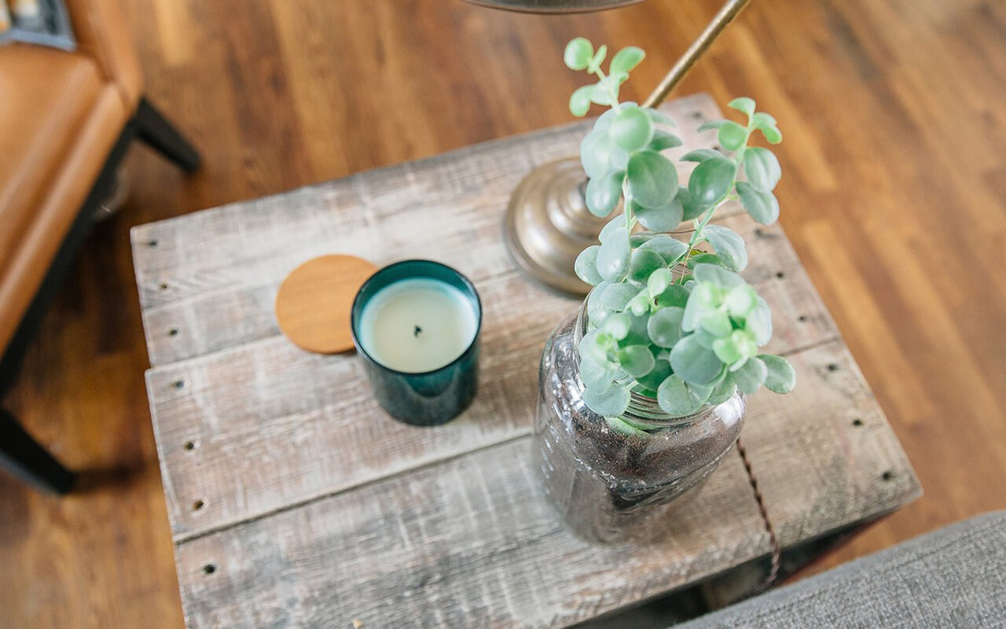
小 | 清 | 欢
小 | 清 | 欢
I love you more than I've ever loved any woman.
投三两桃花，掬一两清欢。
I love you more than I've ever loved any woman. And I've waited longer for you than I've waited for any woman.I love you more than I've ever loved any woman. And I've waited longer for you than I've waited for any woman.

Slide 14
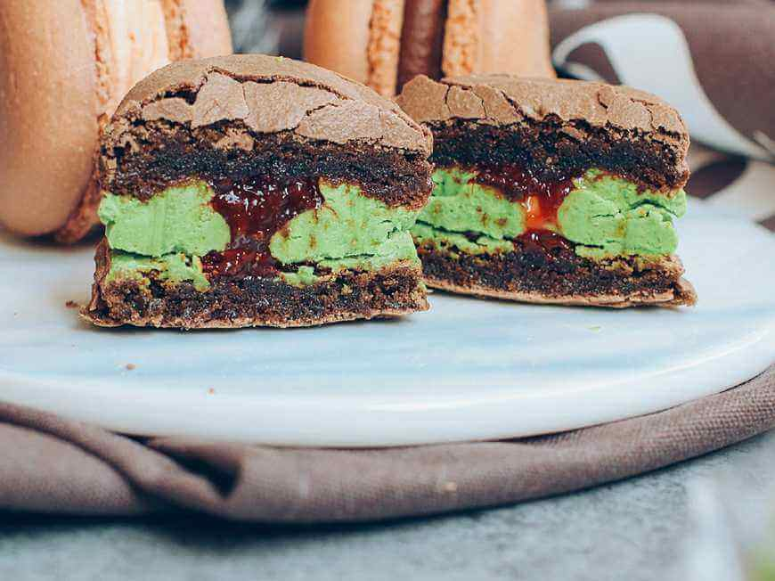
03
Click here to add your title
I love you more than I've ever loved any woman. And I've waited longer for you than I've waited for any woman.
I love you more than I've ever loved any woman. And I've waited longer for you than I've waited for any woman.

Slide 15
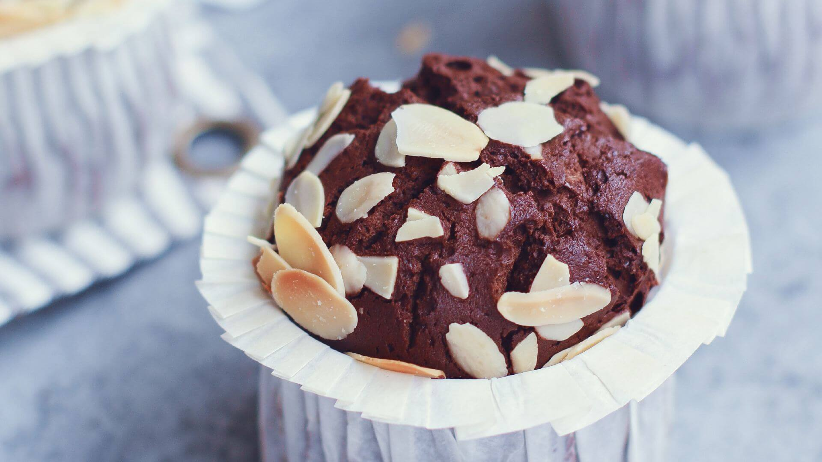
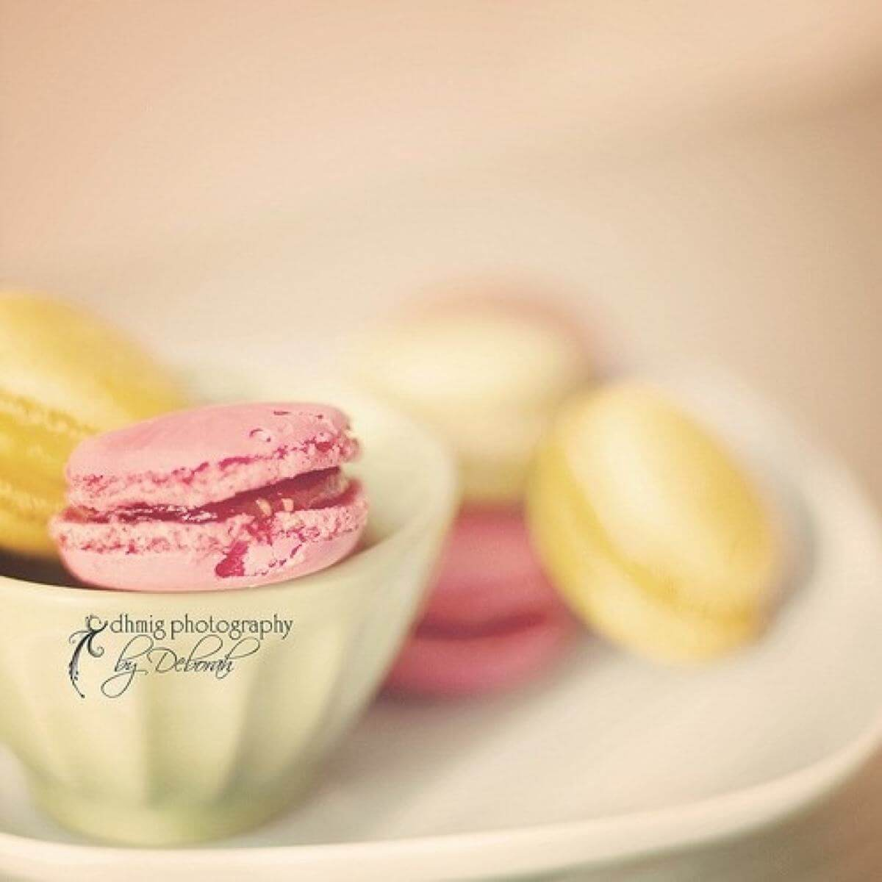
小
一•两•清•欢
清
I love you more than I've ever loved any woman. And I've waited longer for you than I've waited for any woman.
I love you more than I've ever loved any woman. And I've waited longer for you than I've waited for any woman.
小清欢
欢
DESTINY
FREEDOM
I love you more than I've ever loved any woman. And I've waited longer for you than I've waited for any woman.
I love you more than I've ever loved any woman. And I've waited longer for you than I've waited for any woman.

Slide 16
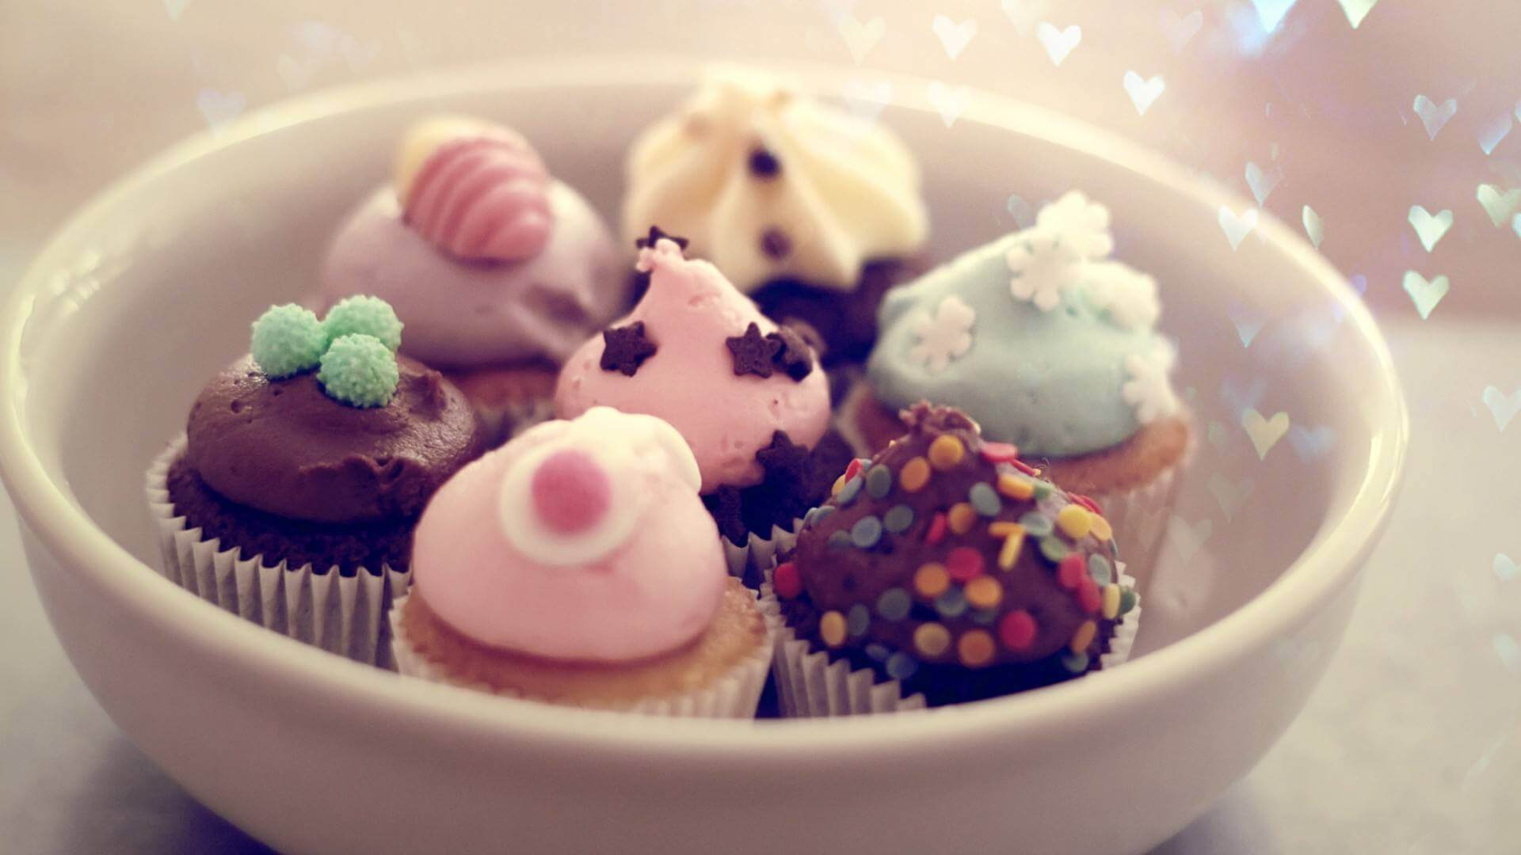
一•两•清•欢
一•两•清•欢
I love you more than I've ever loved any woman. And I've waited longer for you than I've waited for any woman.
I love you more than I've ever loved any woman. And I've waited longer for you than I've waited for any woman.
I love you more than I've ever loved any woman. And I've waited longer for you than I've waited for any woman.
I love you more than I've ever loved any woman. And I've waited longer for you than I've waited for any woman.

Slide 17
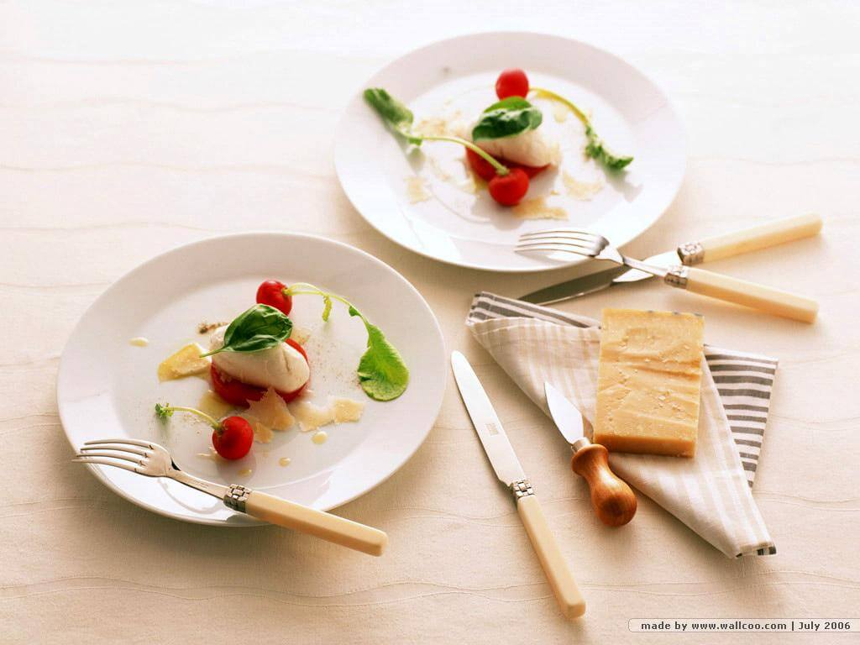
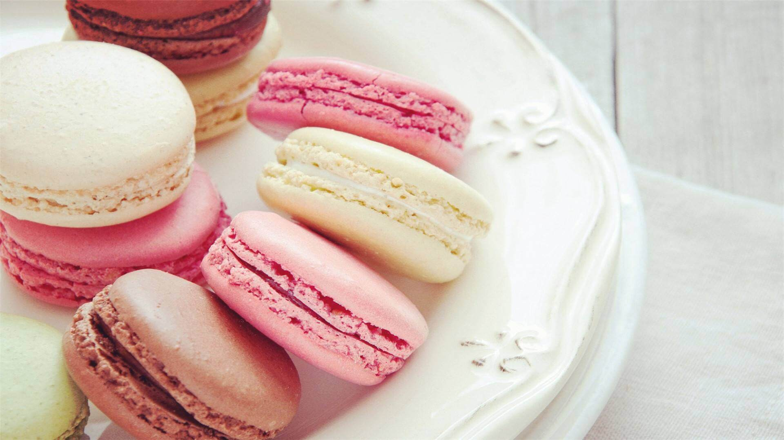
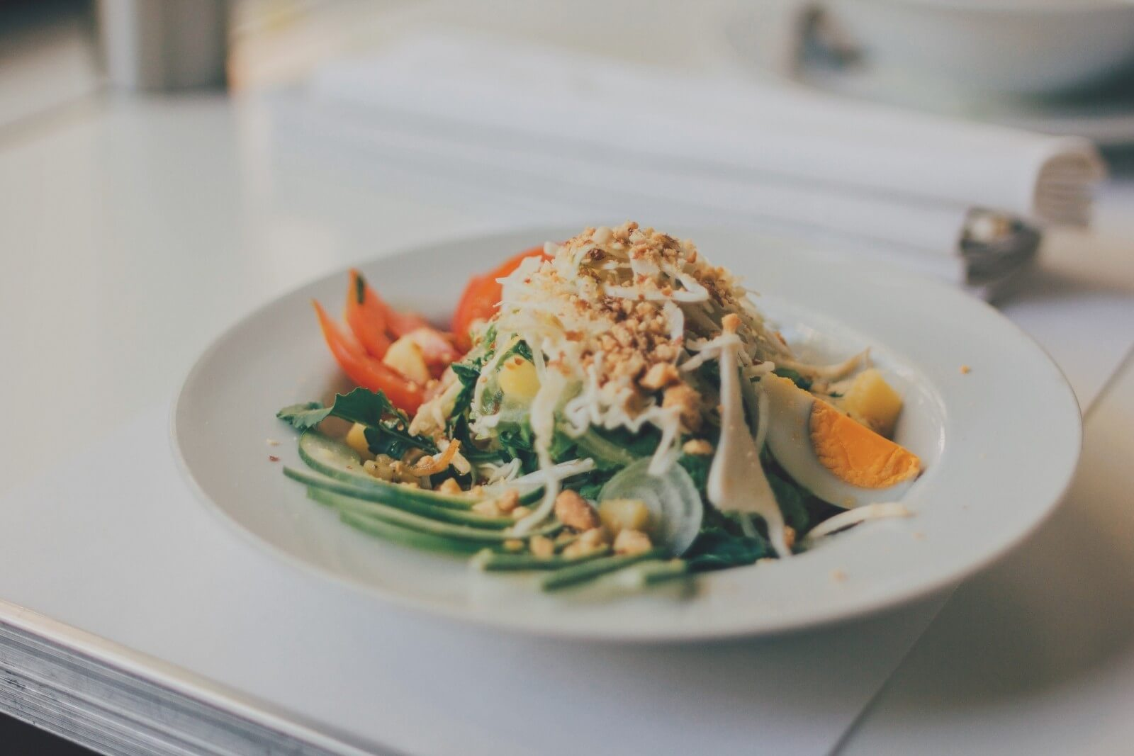
小 | 清 | 欢
I love you more than I've ever loved any woman.
小清欢
DESTINY
FREEDOM
一•两•清•欢
I love you more than I've ever loved any woman. And I've waited longer for you than I've waited for any woman.
I love you more than I've ever loved any woman. And I've waited longer for you than I've waited for any woman.

Slide 18
小
清
欢
一•两•清•欢
I love you more than I've ever loved any woman. And I've waited longer for you than I've waited for any woman.
I love you more than I've ever loved any woman. And I've waited longer for you than I've waited for any woman.
I love you more than I've ever loved any woman. And I've waited longer for you than I've waited for any woman.
I love you more than I've ever loved any woman. And I've waited longer for you than I've waited for any woman.

Slide 19
小
清
欢
一•两•清•欢
投三两桃花，掬一两清欢。
I love you more than I've ever loved any woman. And I've waited longer for you than I've waited for any woman.
I love you more than I've ever loved any woman. And I've waited longer for you than I've waited for any woman.

Slide 20
04
Click here to add your title
I love you more than I've ever loved any woman. And I've waited longer for you than I've waited for any woman.
I love you more than I've ever loved any woman. And I've waited longer for you than I've waited for any woman.

Slide 21
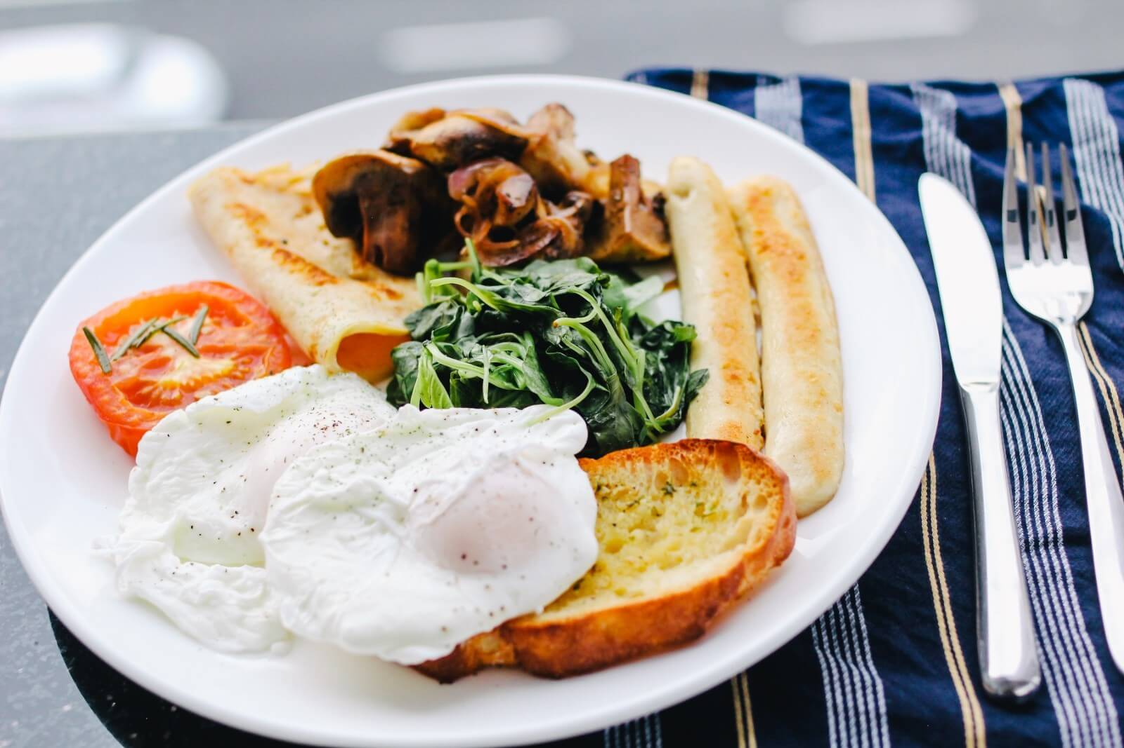
一•两•清•欢
小 | 清 | 欢
I love you more than I've ever loved any woman. And I've waited longer for you than I've waited for any woman.
I love you more than I've ever loved any woman. And I've waited longer for you than I've waited for any woman.
I love you more than I've ever loved any woman. And I've waited longer for you than I've waited for any woman.
I love you more than I've ever loved any woman. And I've waited longer for you than I've waited for any woman.

Slide 22
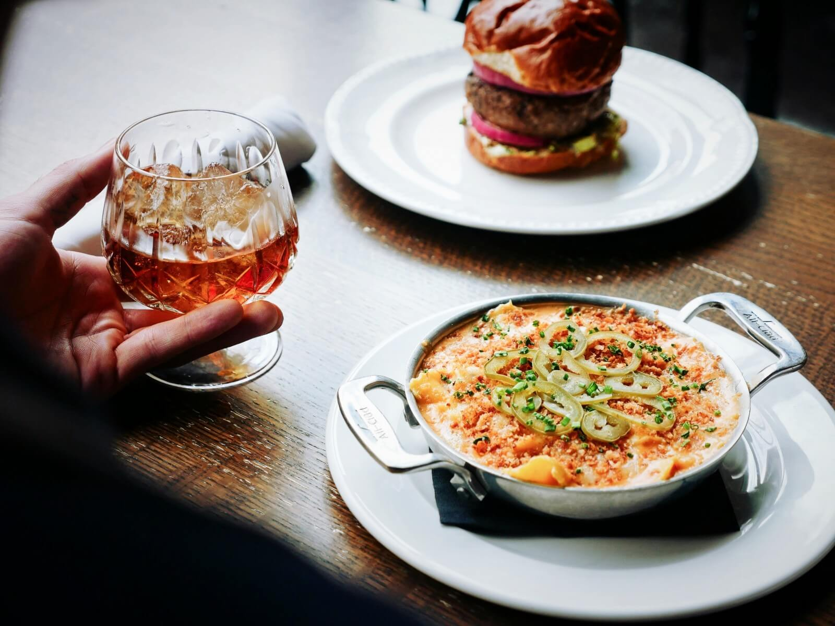
小 | 清 | 欢
I love you more than I've ever loved any woman.
小清欢
DESTINY
FREEDOM
一•两•清•欢
I love you more than I've ever loved any woman. And I've waited longer for you than I've waited for any woman.
I love you more than I've ever loved any woman. And I've waited longer for you than I've waited for any woman.

Slide 23
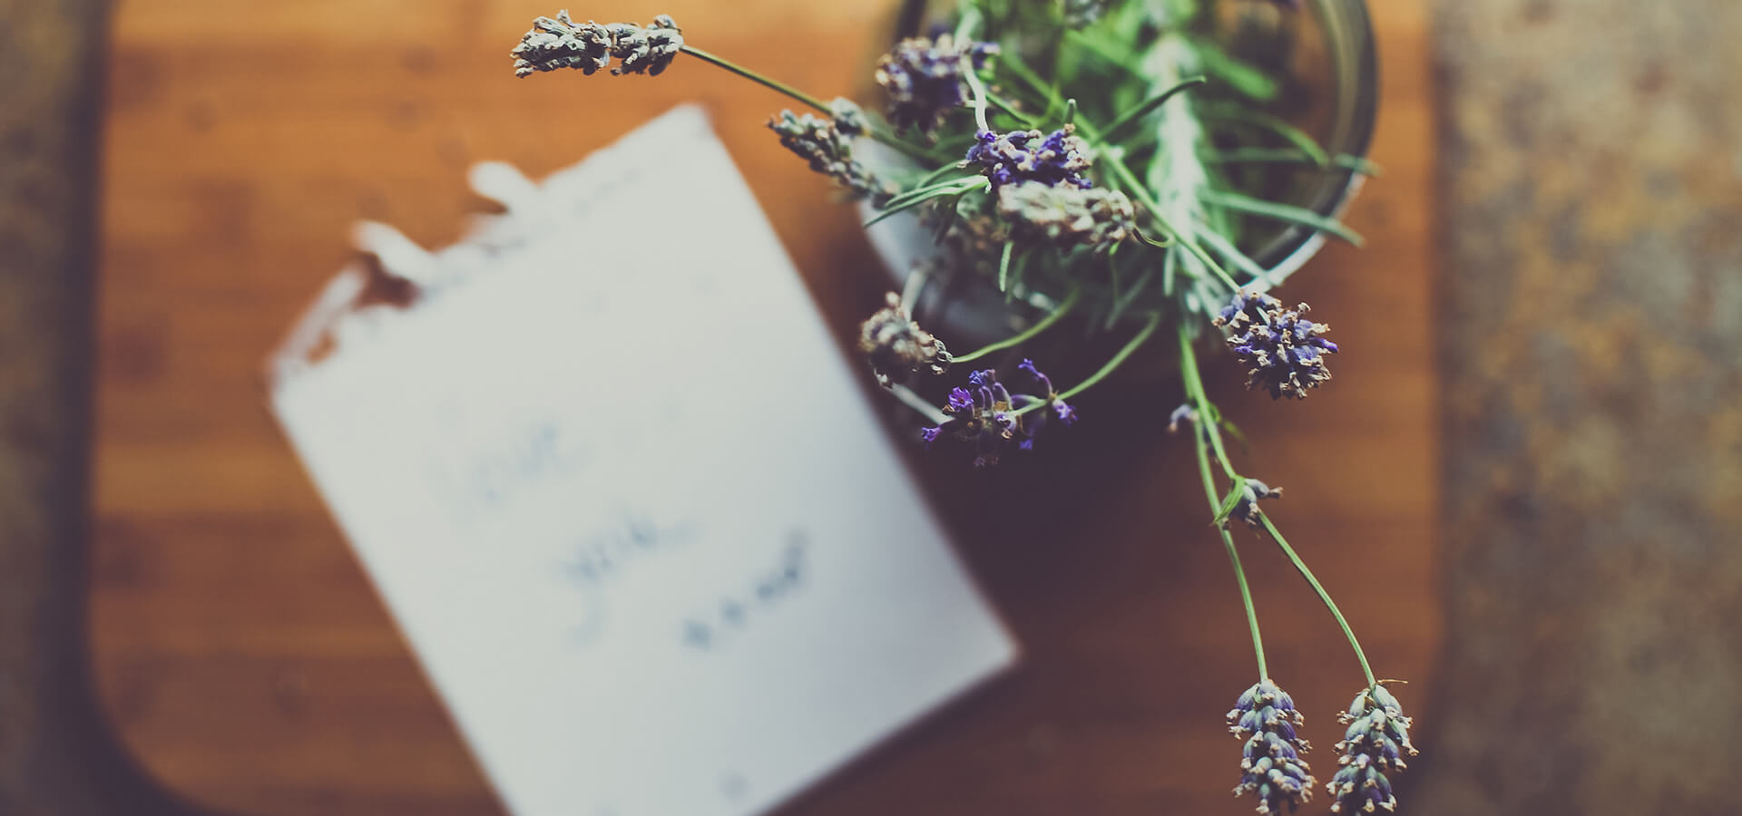
小
清
欢
一•两•清•欢
I love you more than I've ever loved any woman. And I've waited longer for you than I've waited for any woman.
I love you more than I've ever loved any woman. And I've waited longer for you than I've waited for any woman.
I love you more than I've ever loved any woman. And I've waited longer for you than I've waited for any woman.
I love you more than I've ever loved any woman. And I've waited longer for you than I've waited for any woman.

Slide 24
感谢一路有你

