Slide 1
HELLO I AM
BAYMAX
SIMON PPT

Slide 2
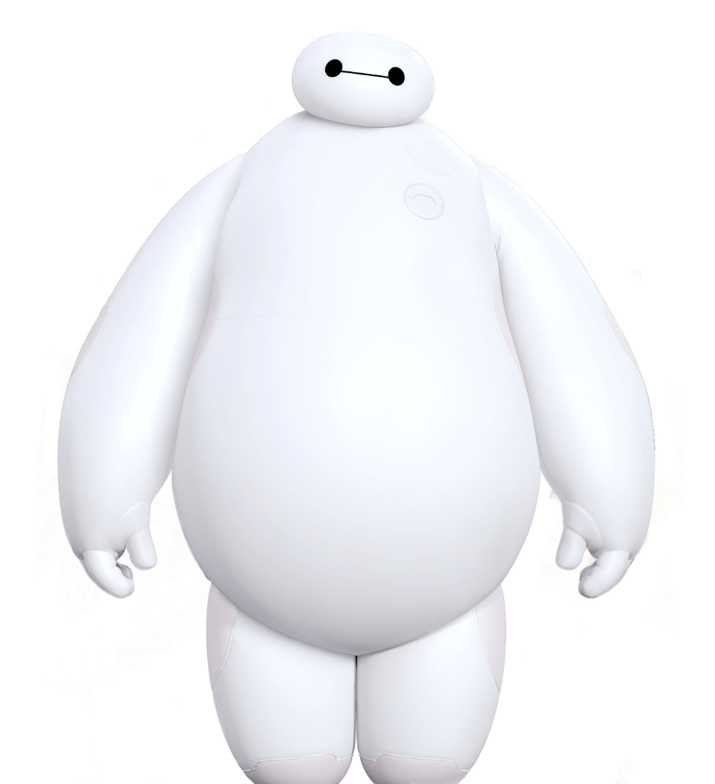
con
tents
Hello. I am Baymax.
3
2
Text here
Tadashi
is here.
4
1
I cannot
deactivate until you say you are satisfied with your care.
I will always be with you.

Slide 3
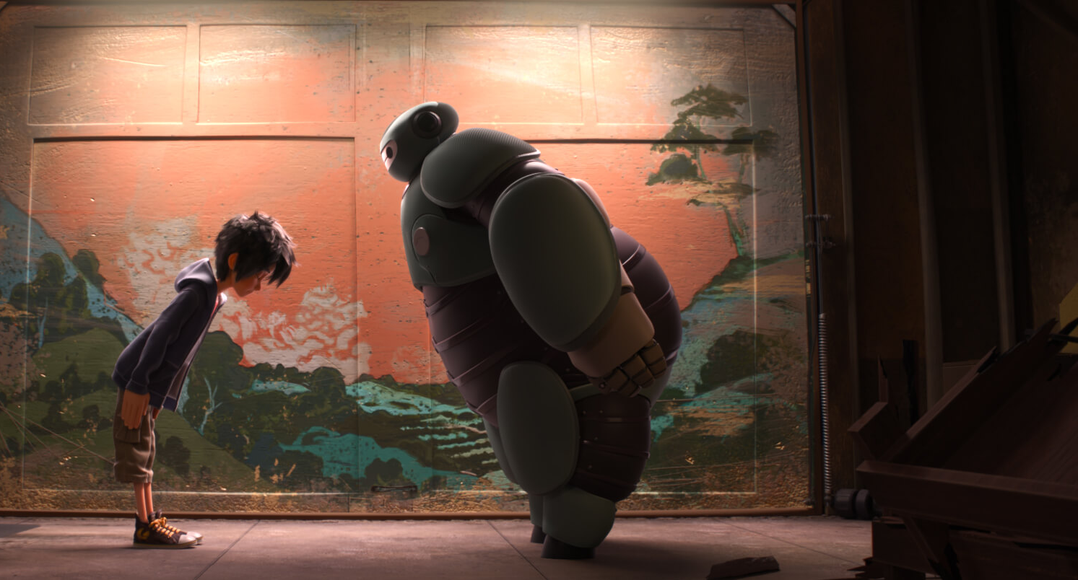
hiro
I will always be with you.
baymax
I can't lose you.
Big Hero 6 is a 2014 film about the story of a young robotics prodigy named Hiro Hamada, who forms a superhero team to combat a masked villain responsible for the death of Hiro's older brother.

Slide 4
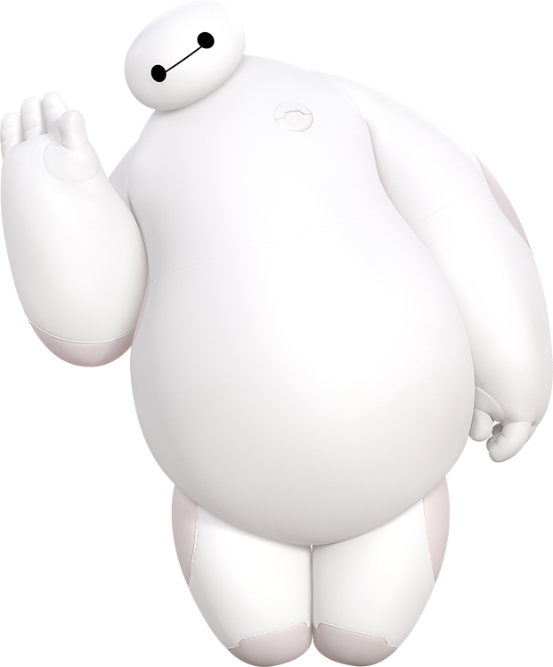
I am Baymax, your personal healthcare companion.
1
Part
ONE

Slide 5
like
dislike
Big Hero 6 is a 2014 film about the story of a young robotics prodigy named Hiro Hamada, who forms a superhero team to combat a masked villain responsible for the death of Hiro's older brother.
Who forms a superhero team to combat a masked villain responsible for the death of Hiro's older brother.

Slide 6
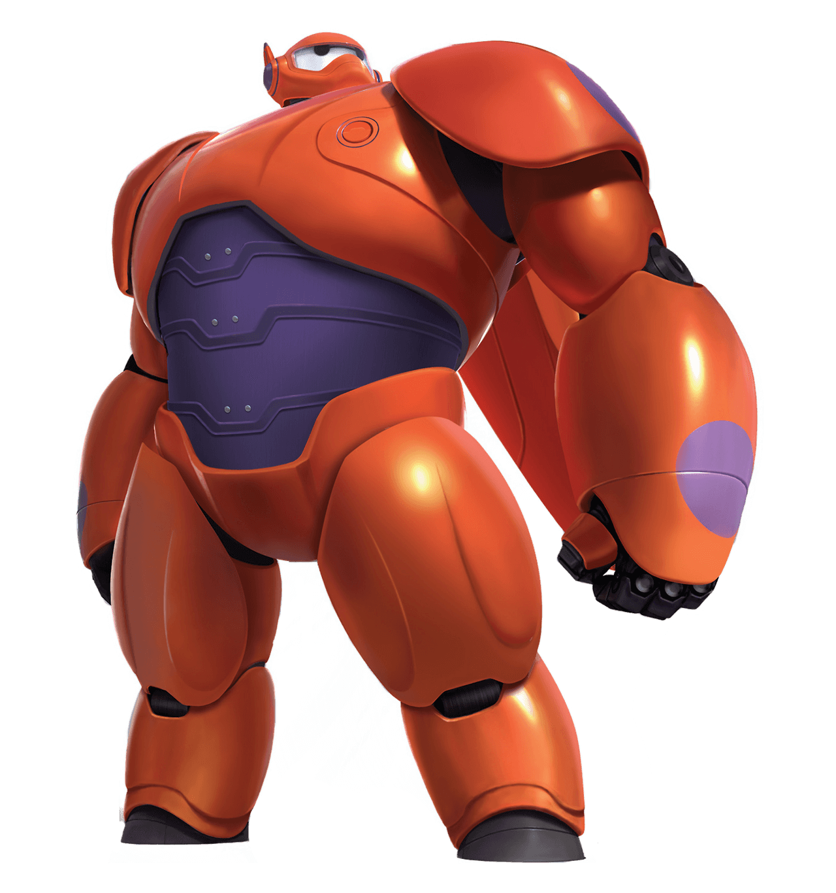
baymax
The special bond that develops between plus-sized inflatable robot Baymax, and prodigy Hiro Hamada, who team up with a group of friends to form a band of high-tech heroes.
Baymax 2.0
The special bond that develops between plus-sized inflatable robot Baymax, and prodigy Hiro Hamada, who team up with a group of friends to form a band of high-tech heroes.

Slide 7
SCALE
On a scale from 1, to 10, How Would You rate your Pain?
1
2
3
4
5
6
7
8
9
10

Slide 8
Part
Oh, no.
TWO
2

Slide 9
BAY
MAX
The special bond that develops between plus-sized inflatable robot Baymax, and prodigy Hiro Hamada.
Always wait one hour after eating before swimming.
I cannot deactivate until you say you are satisfied with your care.
SIMON PPT

Slide 10
9%
On a scale from 1, to 10, How Would You rate your Pain?
10%
On a scale from 1, to 10, How Would You rate your Pain?
58%
23%
On a scale from 1, to 10, How Would You rate your Pain?
On a scale from 1, to 10, How Would You rate your Pain?
PIE CHARTS

Slide 11
I will always be with you.
I will always be with you.
On a scale from 1, to 10,
How Would You rate your Pain?
2011
2012
2013
2014
2015
On a scale from 1, to 10,
How Would You rate your Pain?
On a scale from 1, to 10,
How Would You rate your Pain?

Slide 12
Part
THREE
3
There,
There.

Slide 13
hiro
Tadashi
Baymax
Cass
I will always be with you.
I will always be with you.
I will always be with you.
I will always be with you.
City of
San Fransokyo
Big Hero 6 is a 2014 film about the story of a young robotics prodigy named Hiro Hamada, who forms a superhero team to combat a masked villain responsible for the death of Hiro's older brother.

Slide 14
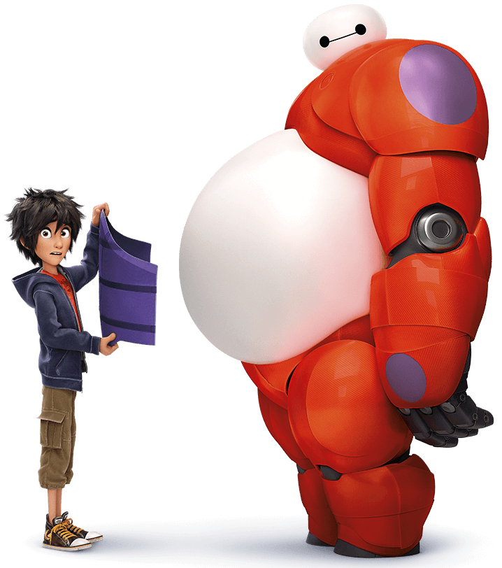
hiro
hi
The special bond that develops between plus-sized inflatable robot Baymax, and prodigy Hiro Hamada, who team up with a group of friends to form a band of high-tech heroes.
BAY
MAX
SIMON PPT
The special bond that develops between plus-sized inflatable robot Baymax, and prodigy Hiro Hamada, who team up with a group of friends to form a band of high-tech heroes.
SIMON PPT

Slide 15
Big Hero 6 is a 2014 film about the story of a young robotics prodigy named Hiro Hamada, who forms a superhero team to combat a masked villain responsible for the death of Hiro's older brother.
TEXT HERE
TEXT HERE
TEXT HERE
baymax
I will always be with you.

Slide 16
baymax
Big Hero 6 is a 2014 film about the story of a young robotics prodigy named Hiro Hamada.
hiro
On a scale from 1, to 10,
How Would You rate your Pain?
Tadashi
I will always be with you.

Slide 17
Part
I am not
Fast.
THREE
4

Slide 18
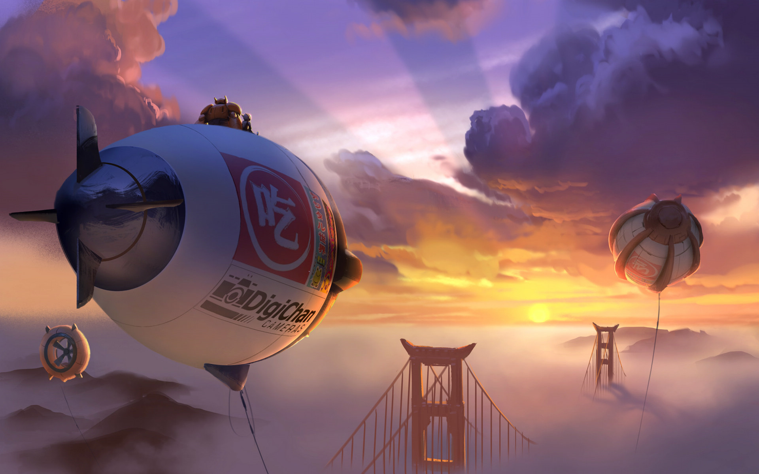
Tadashi
BAY
I will always be with you.
MAX
Big Hero 6 is a 2014 film about the story of a young robotics prodigy named Hiro Hamada.
hiro
I will always be with you.
I will always be with you.

Slide 19
69%
I will always be
with you.
BAY
MAX
I will always be
with you.
Big Hero 6 is a 2014 film about the story of a young robotics prodigy.

Slide 20
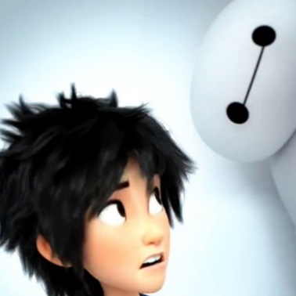
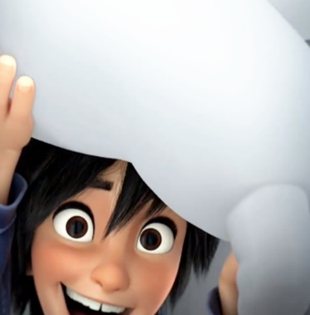
BAY
HIRO
Tadashi
MAX
On a scale from 1, to 10,
How Would You rate your Pain?
On a scale from 1, to 10,
How Would You rate your Pain?
On a scale from 1, to 10,
How Would You rate your Pain?
On a scale from 1, to 10,
How Would You rate your Pain?

Slide 21
Simon
PPT
baymax
simon
Big Hero 6 is a 2014 film about the story of a young robotics prodigy named Hiro Hamada.
Big Hero 6 is a 2014 film about the story of a young robotics prodigy named Hiro Hamada.

Slide 22
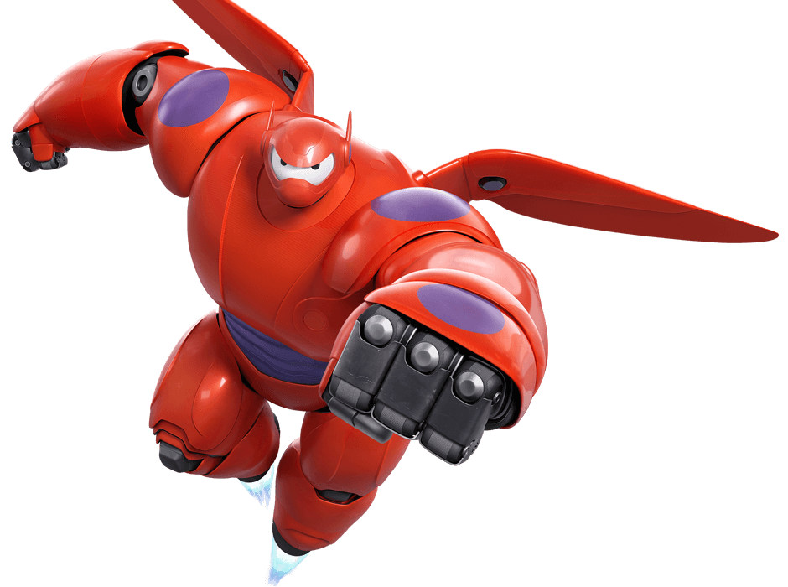
Baymax
2.0
On a scale from 1, to 10,
How Would You rate your Pain?
I will always be with you.

Slide 23
347,231
TEXT HERE
Big Hero 6 is a 2014 film about the story of a young robotics prodigy named Hiro Hamada, who forms a superhero team to combat a masked villain responsible for the death of Hiro's older brother.

Slide 24
THANKS
SIMON PPT, MORE THAN PPT
Supporters say that the ease of use of presentation software can save a lot of time for people who otherwise would have used other types of visual aid—hand-drawn or mechanically typeset slides, blackboards or whiteboards, or overhead projections. Ease of use also encourages those

