Slide 1



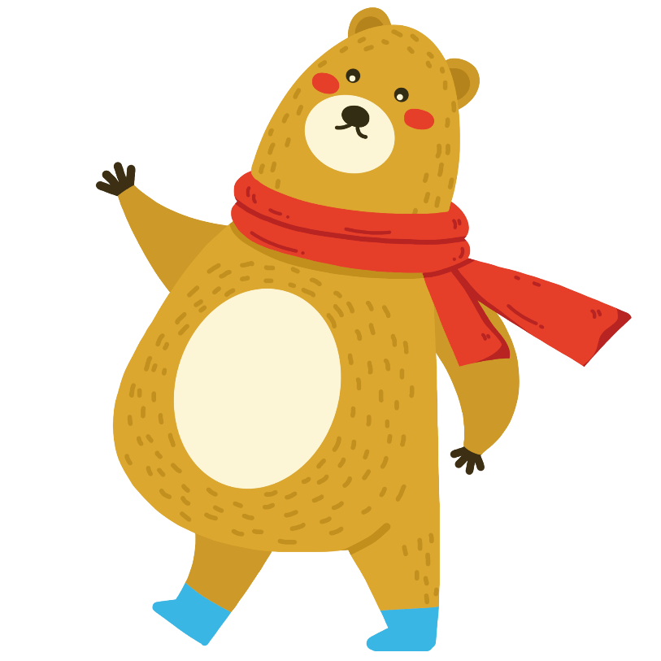



GUESS
英语猜词游戏
英语猜词游戏
XX小学一年级英语课件
演讲人：优页PPT 时间： 20XX年X月X日

Slide 2


What will you break once you say it?
Silence.
(沉默）

Slide 3
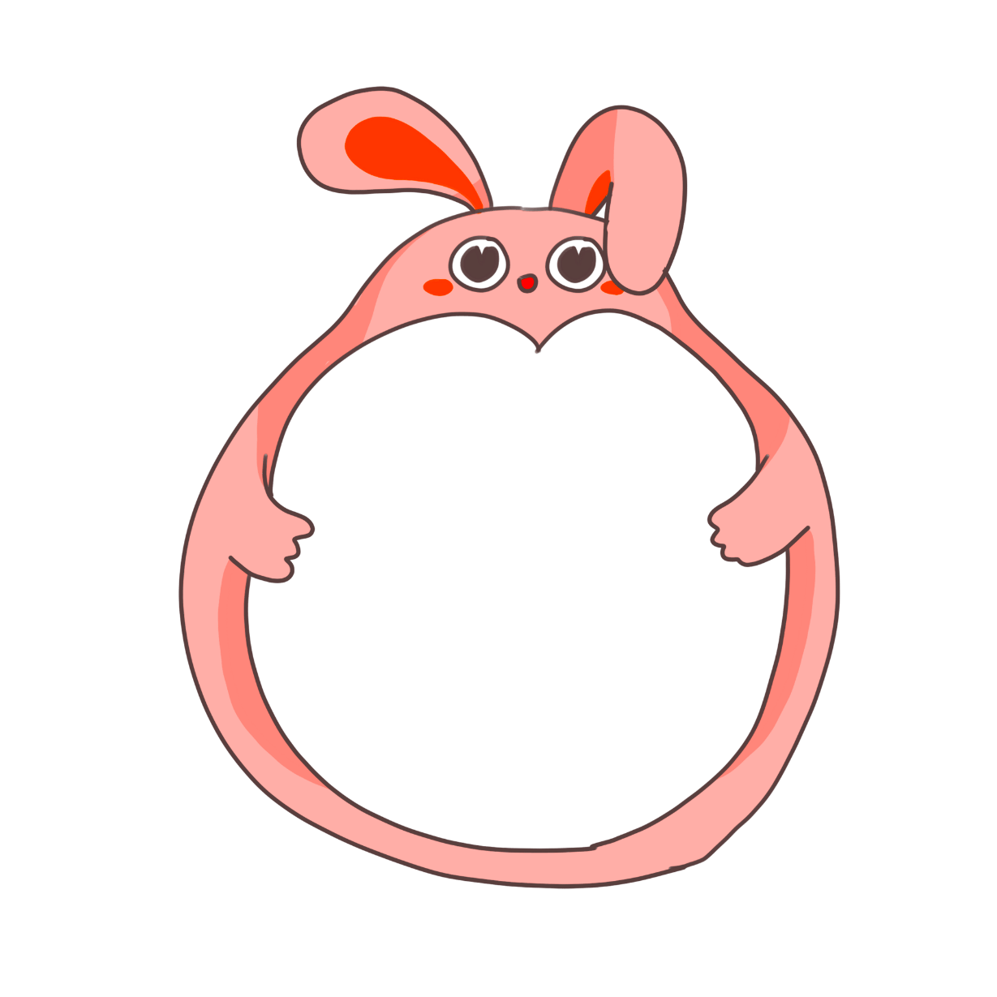

What always goes up and never goes down? (什么东西只升不降？)
Your age.

Slide 4


Why did the boy make his dog sit in the sun?
He wants to have a hot dog.

Slide 5
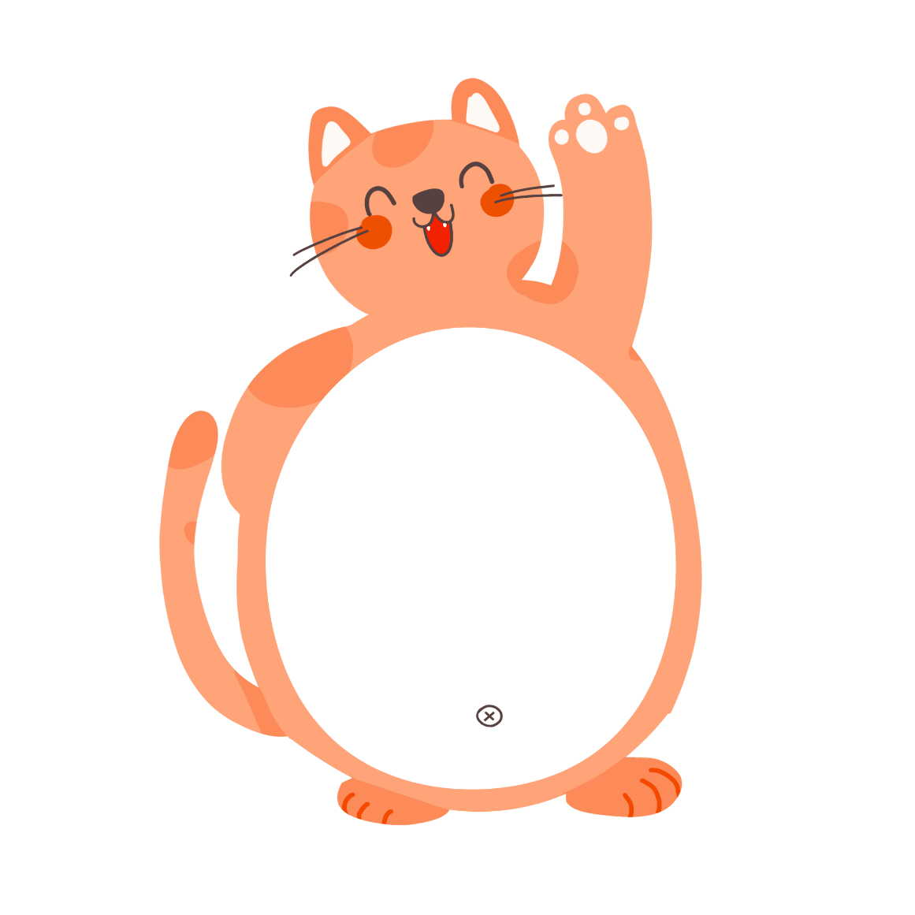

What's the poorest bank in the world?
The river bank

Slide 6


What letter is an animal ?
B（bee)

Slide 7


Why are girls afraid of the letter C ?
Because it makes fat fact!

Slide 8


What is as big as a horse but doesn't weigh anything?
Thehorse'sshadow.马的影子

Slide 9
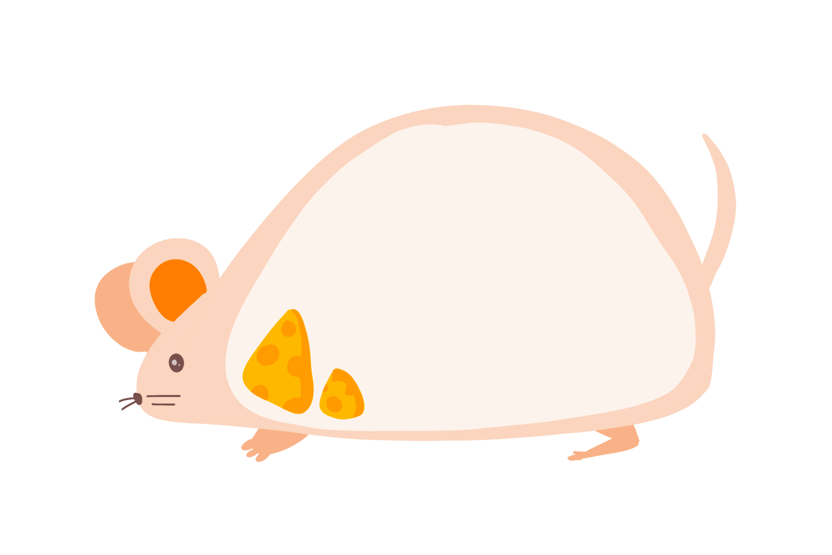

What begins with T, ends with T and has tea in it?
A teapot.
茶壶

Slide 10


Which room has no doors, nowindows.
A mushroom.
蘑菇

Slide 11
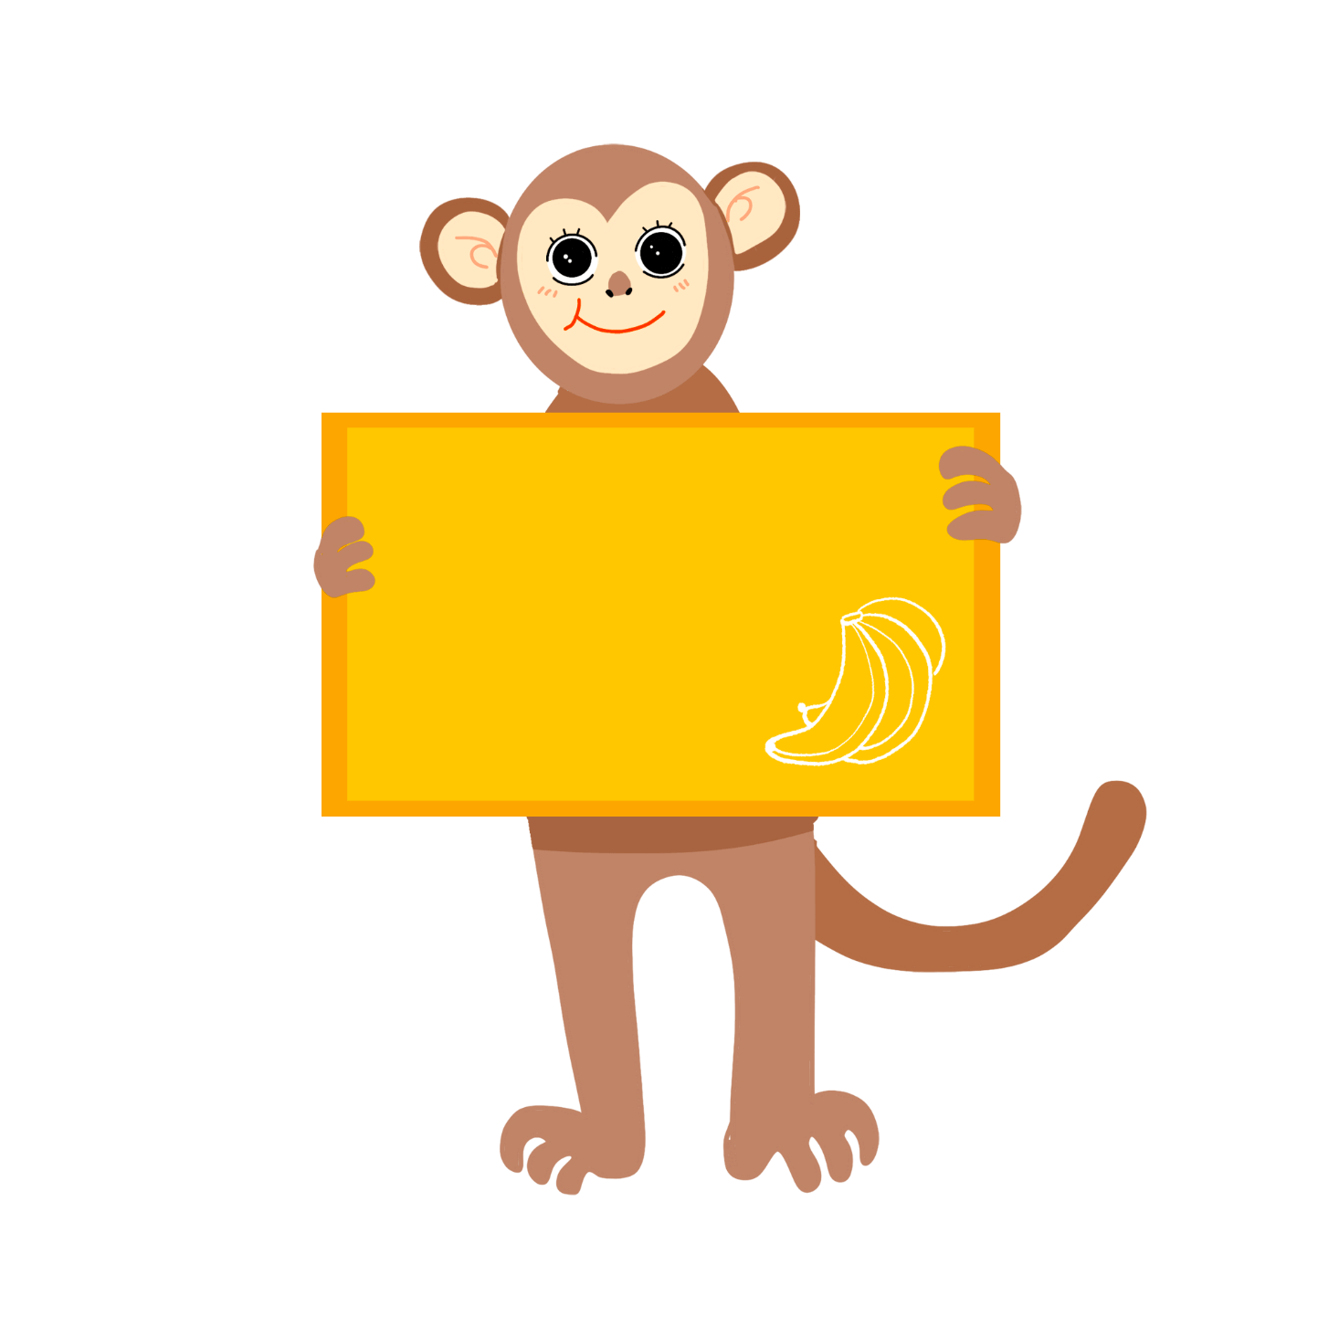

What can't be used until it's broken? W3
An egg.

Slide 12
GUESS
英语猜词游戏
英语猜词游戏
XX小学一年级英语课件
演讲人：优页PPT 时间： 20XX年X月X日

