Slide 1

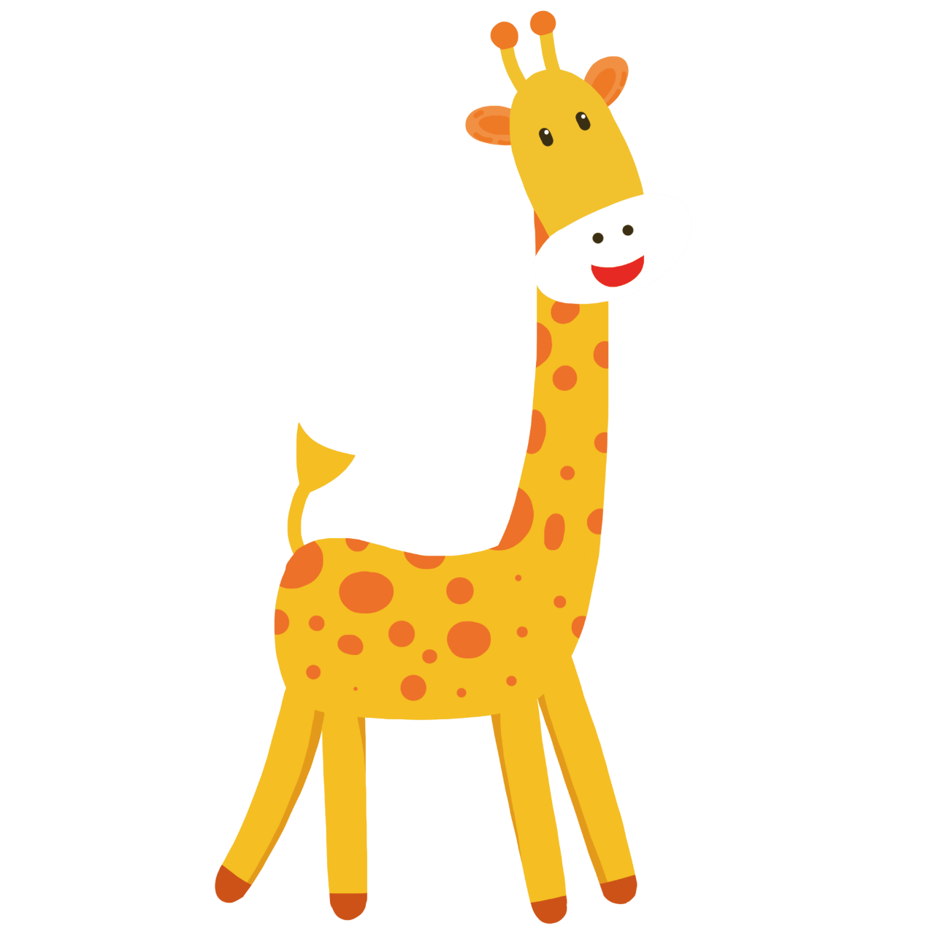


猜
猜
一
GUESS
英语猜词游戏
演讲人：优页PPT 时间： 20XX年X月X日

Slide 2

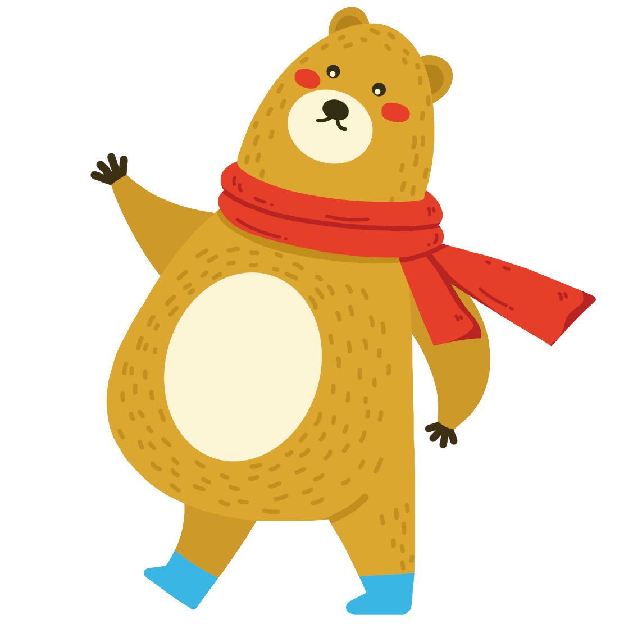

Silence. (沉默）
1. What will you break once you say it?

Slide 3


Your age.
2. What always goes up and never goes down? (什么东西只升不降？)

Slide 4

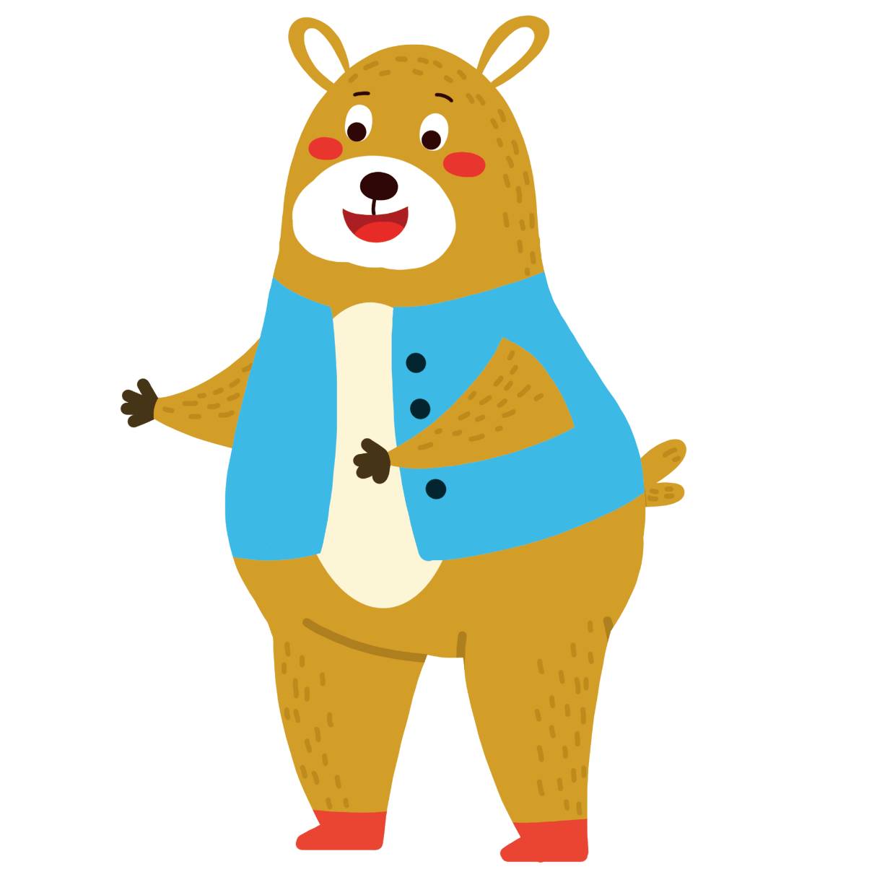
He wants to have a hot dog.
3. Why did the boy make his dog sit in the sun?

Slide 5

The river bank。
4. What's the poorest bank in the world?

Slide 6

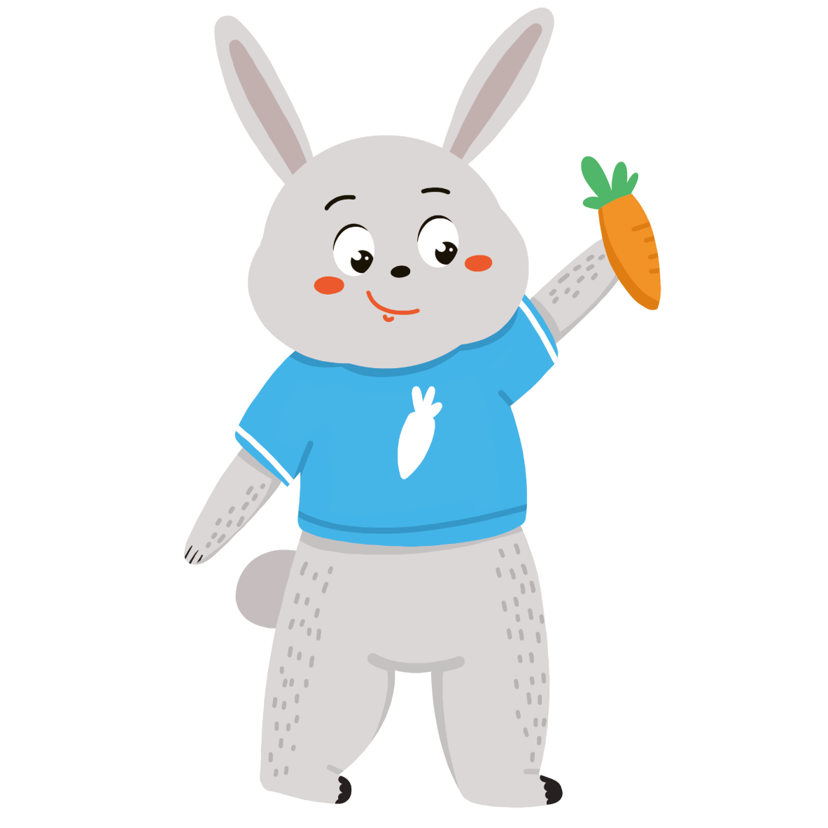

Because it makes fat fact!
5.Why are girls afraid of the letter C ?

Slide 7


B（bee)
6.What letter is ananimal ?

Slide 8
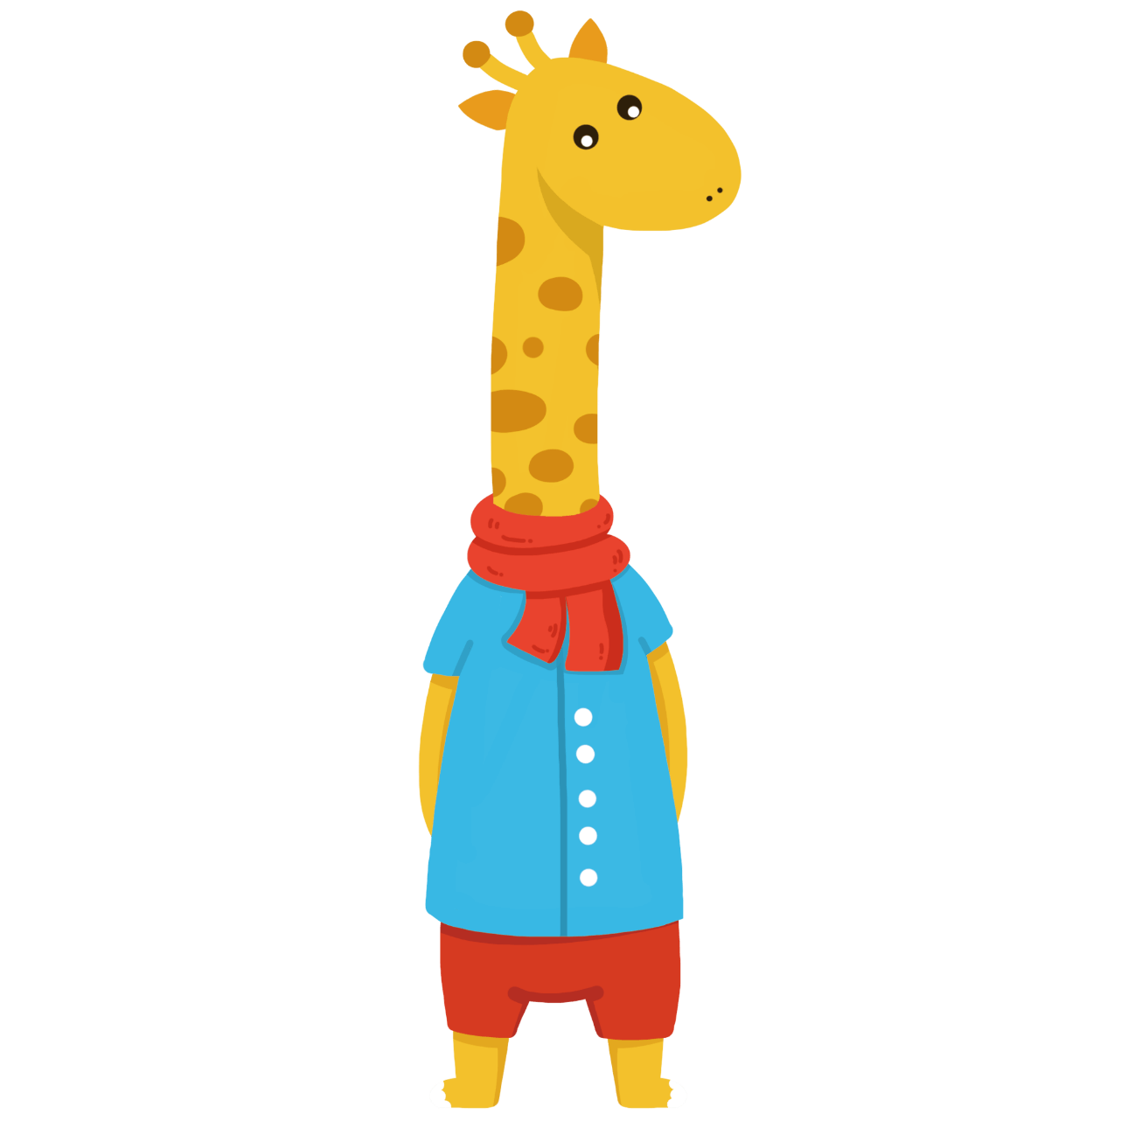
The horse's shadow.
7: What is as big as a horse butdoesn't weigh anything?

Slide 9

A mushroom
8: Which room has no doors, no windows.

Slide 10
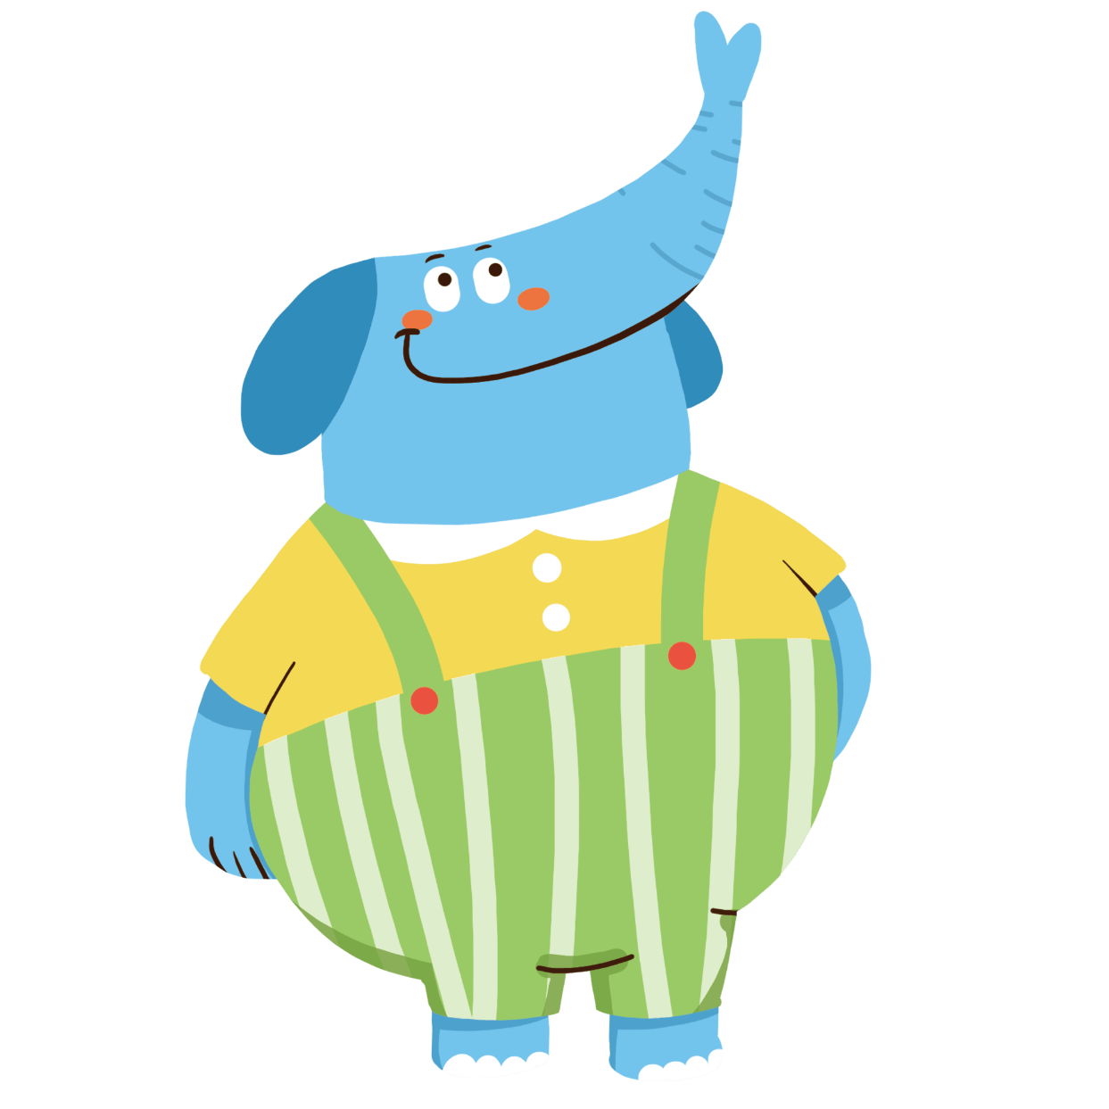

B（bee)
9: Whatbegins with T, ends with T and has tea in it?

Slide 11
An egg.
10: What can't be used until it's broken?

Slide 12
猜
猜
一
GUESS
英语猜词游戏
演讲人：优页PPT 时间： 20XX年X月X日

