Slide 1

点击输入学校名称
enter school name
输入课程名称
主讲人：优页PPT
电话：150 XXXX XXX

Slide 2

点击输入小标题
知识要点
1
理论讲解
2
融会贯通
3
随堂测试
4

Slide 3
案例引导
1
回忆旧知
知识要点
Knowledge points
拓展新知
新知详解

Slide 4
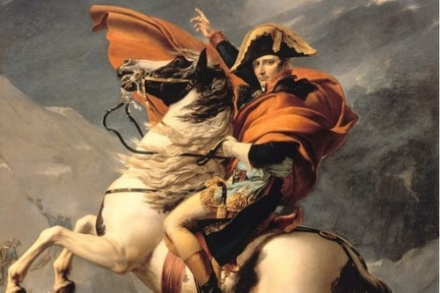
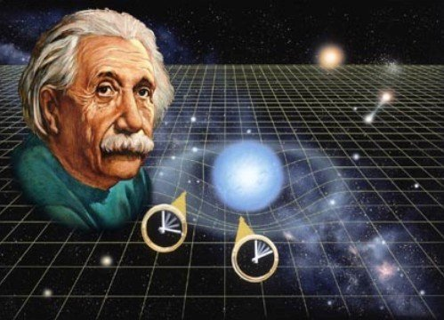
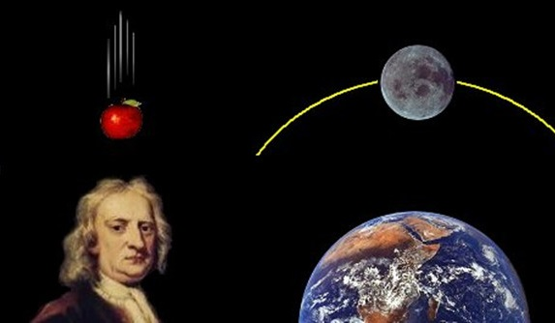
点击输入小标题
小标题
My flower is ephemeral, and she has only four thorns to defend herself against the world. And I have left on my planet, all alone! His flower had told him that she was only one of her kind in all universe. And here were five thousand of them, all alike, in one single garden! I thought that I was rich, with a flower that was unique in all the world; and all I had was a common rose. A common rose…

Slide 5
点击输入小标题
My flower is ephemeral, and she has only four thorns to defend herself against the world. And I have left on my planet, all alone!
已学知识要点
My flower is ephemeral, and she has only four thorns to defend herself against the world. And I have left on my planet, all alone!
My flower is ephemeral, and she has only four thorns to defend herself against the world. And I have left on my planet, all alone!

Slide 6
点击输入小标题
小标题
理论
详解
My flower is ephemeral, and she has only four thorns to defend herself against the world. And I have left on my planet, all alone! His flower had told him that she was only one of her kind in all universe. And here were five thousand of them, all alike, in one single garden!
小标题
应用
说明
My flower is ephemeral, and she has only four thorns to defend herself against the world. And I have left on my planet, all alone! His flower had told him that she was only one of her kind in all universe. And here were five thousand of them, all alike, in one single garden!

Slide 7
点击输入小标题
My flower is ephemeral, and she has only four thorns to defend herself against the
My flower is ephemeral, and she has only four thorns to defend herself against the
XX定理
My flower is ephemeral, and she has only four thorns to defend herself against the
My flower is ephemeral, and she has only four thorns to defend herself against the
My flower is ephemeral, and she has only four thorns to defend herself against the
My flower is ephemeral, and she has only four thorns to defend herself against the

Slide 8
详细定义
2
性质特点
理论讲解
Interpretation of the theory
运用场景
例题解析

Slide 9
点击输入小标题
小标题
My flower is ephemeral, and she has only four thorns to defend herself against the world. And I have left on my planet, all alone! His flower had told him that she was only one of her kind in all universe. And here were five thousand of them, all alike, in one single garden! I thought that I was rich, with a flower that was unique in all the world; and all I had was a common rose. A common rose…
输入
标题

Slide 10
点击输入小标题
小标题
小标题
小标题
小标题
His flower had told him that she was only one of her kind in all universe. And here were five thousand of them, all alike, in one single garden!
His flower had told him that she was only one of her kind in all universe. And here were five thousand of them, all alike, in one single garden!
His flower had told him that she was only one of her kind in all universe. And here were five thousand of them, all alike, in one single garden!
His flower had told him that she was only one of her kind in all universe. And here were five thousand of them, all alike, in one single garden!

Slide 11
点击输入小标题
小标题
小标题
His flower had told him that she was only one of her kind in all universe. And here were five thousand of them, all alike, in one single garden!
His flower had told him that she was only one of her kind in all universe. And here were five thousand of them, all alike, in one single garden!
重要
定理
小标题
小标题
His flower had told him that she was only one of her kind in all universe. And here were five thousand of them, all alike, in one single garden!
His flower had told him that she was only one of her kind in all universe. And here were five thousand of them, all alike, in one single garden!
小标题
小标题
His flower had told him that she was only one of her kind in all universe. And here were five thousand of them, all alike, in one single garden!
His flower had told him that she was only one of her kind in all universe. And here were five thousand of them, all alike, in one single garden!

Slide 12
点击输入小标题
life is about enjoying yourself to the fullest while reaching the goals.
life is about enjoying yourself to the fullest while reaching the goals.
life is about enjoying yourself to the fullest while reaching the goals.
1
2
3
4
5
6
life is about enjoying yourself to the fullest while reaching the goals.
life is about enjoying yourself to the fullest while reaching the goals.
life is about enjoying yourself to the fullest while reaching the goals.

Slide 13
浅显应用
3
知识拓展
融会贯通
digest
灵活应用
举一反三

Slide 14
点击输入小标题
此处输入标题
小标题
My flower is ephemeral, and she has only four thorns to defend herself against the world. And I have left on my planet, all alone! His flower had told him that she was only one of her kind in all universe. And here were five thousand of them, all alike, in one single garden! I thought that I was rich, with a flower that was unique in all the world; and all I had was a common rose. A common rose…
此处输入标题
此处输入标题

Slide 15
点击输入小标题
My flower is ephemeral, and she has only four thorns to defend herself against the world.
My flower is ephemeral, and she has only four thorns to defend herself against the world.
My flower is ephemeral, and she has only four thorns to defend herself against the world.
My flower is ephemeral, and she has only four thorns to defend herself against the world.
拓展
My flower is ephemeral, and she has only four thorns to defend herself against the world.
My flower is ephemeral, and she has only four thorns to defend herself against the world.

Slide 16
点击输入小标题
小标题
And I have left on my planet, all alone! His flower had told him that she was only one of her kind in all universe.
标题
小标题
And I have left on my planet, all alone! His flower had told him that she was only one of her kind in all universe.
小标题
And I have left on my planet, all alone! His flower had told him that she was only one of her kind in all universe.

Slide 17
点击输入小标题
My flower is ephemeral, and she has only four thorns to defend herself against the world.
My flower is ephemeral, and she has only four thorns to defend herself against the world.
My flower is ephemeral, and she has only four thorns to defend herself against the world.
My flower is ephemeral, and she has only four thorns to defend herself against the world.
My flower is ephemeral, and she has only four thorns to defend herself against the world.
My flower is ephemeral, and she has only four thorns to defend herself against the world.

Slide 18
经典应用
4
旧题新解
随堂测试
In-class test
随堂小练
答案解析

Slide 19
点击输入小标题
小标题
My flower is ephemeral, and she has only four thorns to defend herself against the world. And I have left on my planet, all alone! His flower had told him that she was only one of her kind in all universe. And here were five thousand of them, all alike, in one single garden! I thought that I was rich, with a flower that was unique in all the world; and all I had was a common rose. A common rose…
小标题
小标题
小标题
小标题
And I have left on my planet, all alone! His flower had told him that she was only one of her kind in all universe.
And I have left on my planet, all alone! His flower had told him that she was only one of her kind in all universe.
And I have left on my planet, all alone! His flower had told him that she was only one of her kind in all universe.
And I have left on my planet, all alone! His flower had told him that she was only one of her kind in all universe.

Slide 20

点击输入小标题
解1
解2
My flower is ephemeral, and she has only four thorns to defend herself against the world. And I have left on my planet, all alone! His flower had told him that she was only one of her kind in all universe. And here were five thousand of them, all alike, in one single garden! I thought that I was rich, with a flower that was unique in all the world; and all I had was a common rose. A common rose…
My flower is ephemeral, and she has only four thorns to defend herself against the world. And I have left on my planet, all alone! His flower had told him that she was only one of her kind in all universe. And here were five thousand of them, all alike, in one single garden! I thought that I was rich, with a flower that was unique in all the world; and all I had was a common rose. A common rose…

Slide 21
点击输入小标题
随堂测试
My flower is ephemeral, and she has only four thorns to defend herself against the world. And I have left on my planet, all alone! His flower had told him that she was only one of her kind in all universe. And here were five thousand of them, all alike, in one single garden! I thought that I was rich, with a flower that was unique in all the world; and all I had was a common rose. A common rose…
My flower is ephemeral, and she has only four thorns to defend herself against the world. And I have left on my planet, all alone! His flower had told him that she was only one of her kind in all universe. And here were five thousand of them, all alike, in one single garden! I thought that I was rich, with a flower that was unique in all the world; and all I had was a common rose. A common rose…

Slide 22
点击输入小标题
小标题
My flower is ephemeral, and she has only four thorns to defend herself against the world. And I have left on my planet, all alone! His flower had told him that she was only one of her kind in all universe.
小标题
My flower is ephemeral, and she has only four thorns to defend herself against the world. And I have left on my planet, all alone! His flower had told him that she was only one of her kind in all universe.
小标题
My flower is ephemeral, and she has only four thorns to defend herself against the world. And I have left on my planet, all alone! His flower had told him that she was only one of her kind in all universe.

Slide 23
点击输入学校名称
enter school name
谢谢观看
电话：150 XXXX XXX

