Slide 1

孟菲斯时尚
Entrepreneurial activities differ substantially depending on the type of organization and activities differ
FANSION

Slide 2

01
PART ONE
Click here to add words
02
PART TWO
CONTENTS
Click here to add words
03
PART THREE
Click here to add words
04
PART FOUR
Click here to add words

Slide 3


PART ONE

Slide 4

https://www.youyedoc.com/
Entrepreneurial activities differ substantially depending on the type of organization and creativity. Entrepreneurial activities differ
01
FANSION
Entrepreneurial activities differ substantially depending on the type of organization and creativity. Entrepreneurial activities differ
01

Slide 5


Entrepreneurial activities differ substantially depending on the type of organization and creativity. Entrepreneurial activities differ

Slide 6

01
NICE DAY
Entrepreneurial activities differ substantially depending differ
02
NICE DAY
NICE DAY
Entrepreneurial activities differ substantially depending differ
03
NICE DAY
Entrepreneurial activities differ substantially depending differ

Slide 7


NICE DAY
Entrepreneurial activities differ substantially depending on the type of organization and creativity. Entrepreneurial activities differ

Slide 8
PART TWO

Slide 9

32%
Entrepreneurial activities differ substantially depending on the type of organization and creativity. Entrepreneurial activities differ
NICE DAY

Slide 10



Slide 11

NICE DAY
Entrepreneurial activities differ substantially depending on the type of organization and creativity. Entrepreneurial activities differ

Slide 12

NICE DAY
NICE DAY
NICE DAY
Entrepreneurial activities differ substantially depending differ
Entrepreneurial activities differ substantially depending differ
Entrepreneurial activities differ substantially depending differ

Slide 13
PART THREE

Slide 14

NICE DAY
Entrepreneurial activities differ substantially depending on the type of organization and creativity. Entrepreneurial activities differ substantially depending on the type of organization and creativity

Slide 15
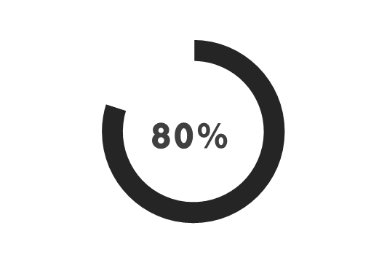
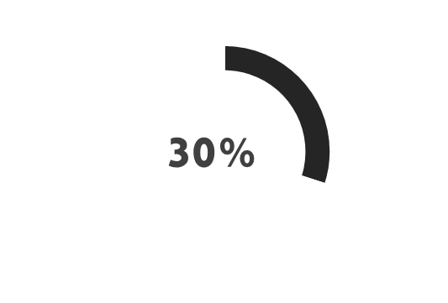
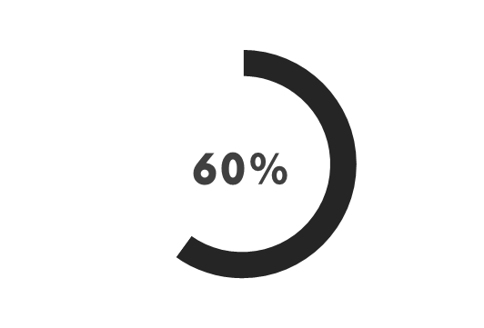
YOUR TITLE HERE
YOUR TITLE HERE
YOUR TITLE HERE
Entrepreneurial activities differ substantially depending on the type of organization and creativity. Entrepreneurial

Slide 16

Entrepreneurial activities differ substantially depending on the type of organization and creativity. Entrepreneurial

Slide 17
PART FOUR

Slide 18

01
NICE DAY
Entrepreneurial activities differ substantially depending differ
02
NICE DAY
Entrepreneurial activities differ substantially depending differ

Slide 19
NICE DAY
Entrepreneurial activities differ substantially depending on the type of organization and creativity. Entrepreneurial activities differ

Slide 20

Entrepreneurial activities differ substantially depending on the type of organization and creativity. Entrepreneurial

Slide 21
THANKS
Entrepreneurial activities differ substantially depending on the type of organization and activities differ
FANSION

