Slide 1
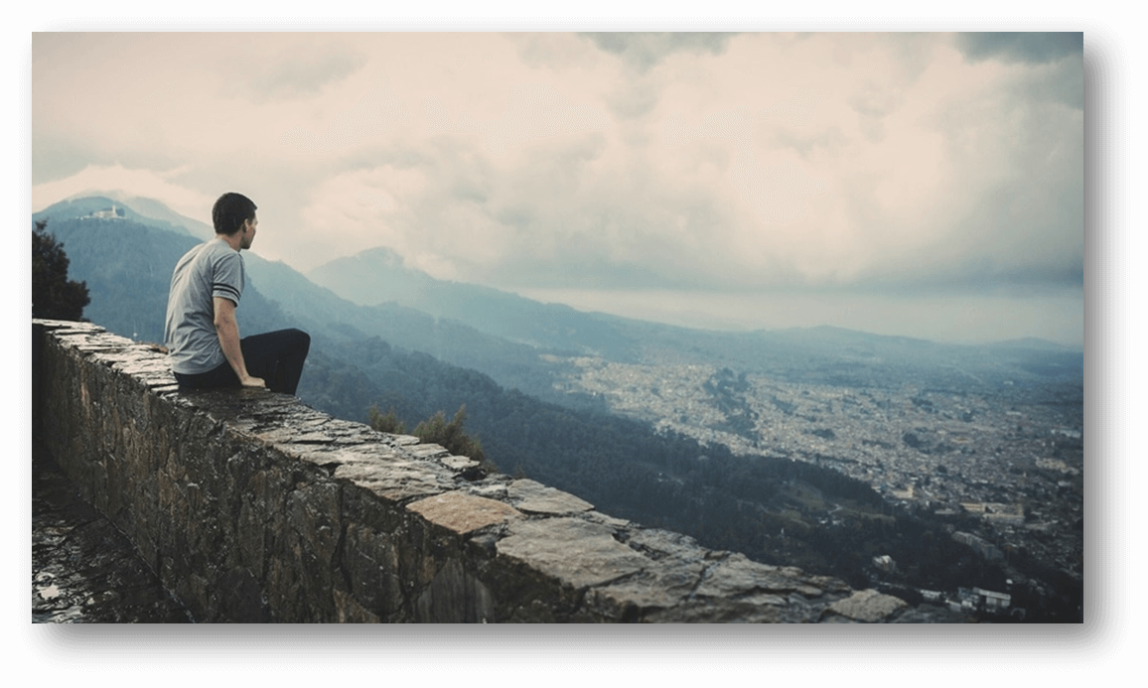
Small Potato
If small potatoes can also make history

Slide 2
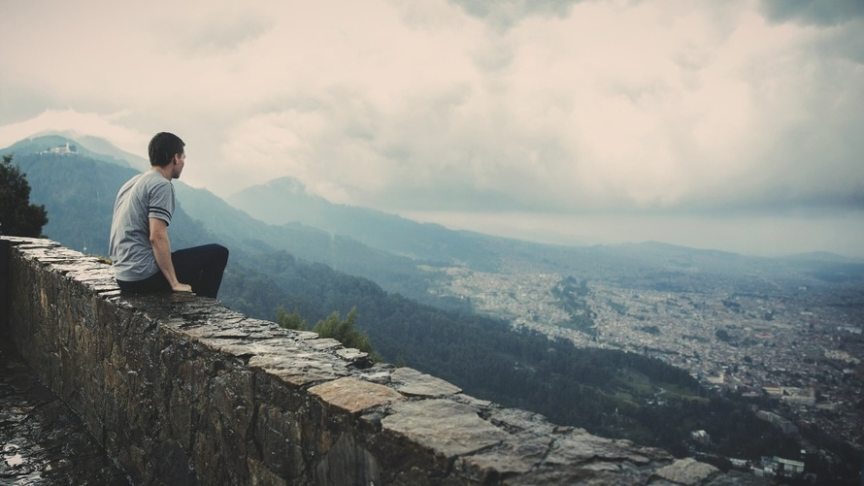
小人物 small potatoes
1
If small potatoes can also make history 。
2
3

Slide 3
PART ONE
If small potatoes can also make history

Slide 4
Tittle one
If small potatoes can also make history 。
Tittle two
If small potatoes can also make history 。

Slide 5
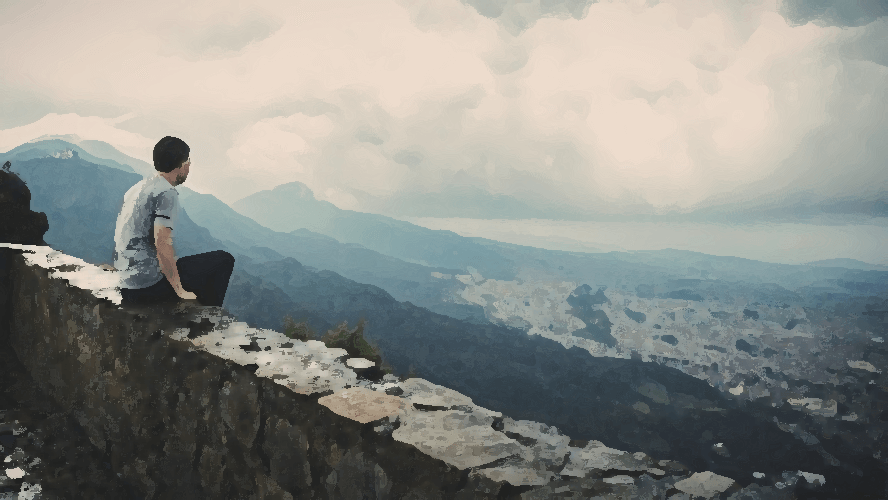
Tittle two
If small potatoes can also make history 。

Slide 6
Tittle two
If small potatoes can also make history 。

Slide 7
PART Two
If small potatoes can also make history

Slide 8
STAP TWO
If small potatoes can also make history
STAP THREE
If small potatoes can also make history
STAP TWO
If small potatoes can also make history

Slide 9
STAP TWO
If small potatoes can also make history
STAP THREE
If small potatoes can also make history

Slide 10
PART Three
If small potatoes can also make history

Slide 11
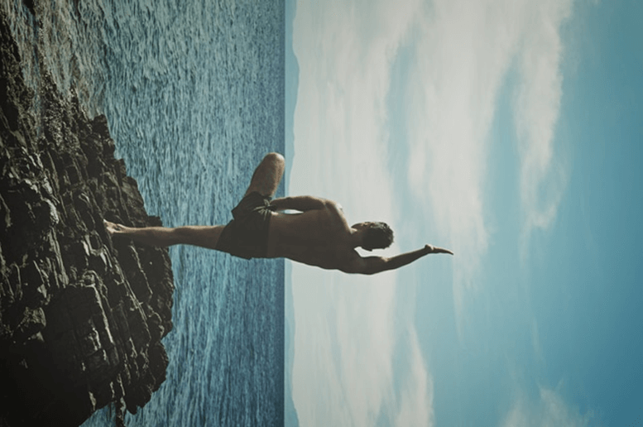
THE END
If small potatoes can also make history
如果小人物也能改变历史 、如果我也可以拼命地生长。
有一天我会站在海的面前、安静地迎风祷告。

Slide 13


