Slide 11
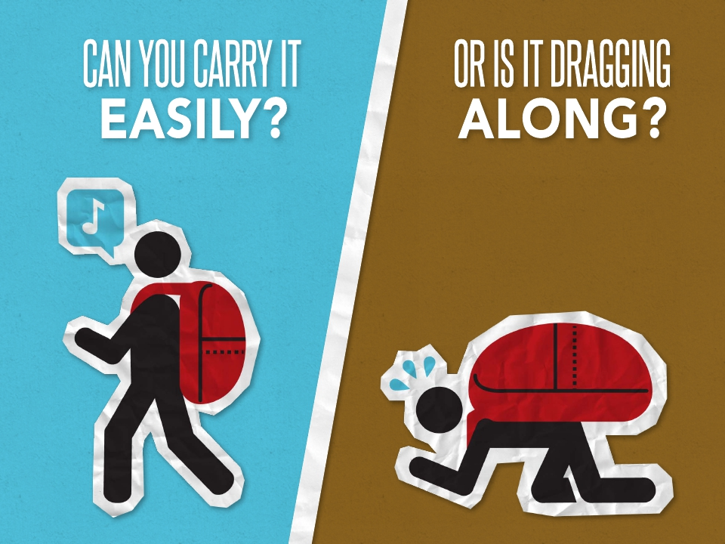

Slide 21
更多精品PPT资源尽在—优页PPT！
www.youyedoc.com
PPT模板下载：www.youyedoc.com/moban/ 节日PPT模板：www.youyedoc.com/jieri/
PPT背景图片：www.youyedoc.com/beijing/ PPT图表下载：www.youyedoc.com/tubiao/
PPT素材下载： www.youyedoc.com/sucai/ PPT教程下载：www.youyedoc.com/jiaocheng/

