Slide 1
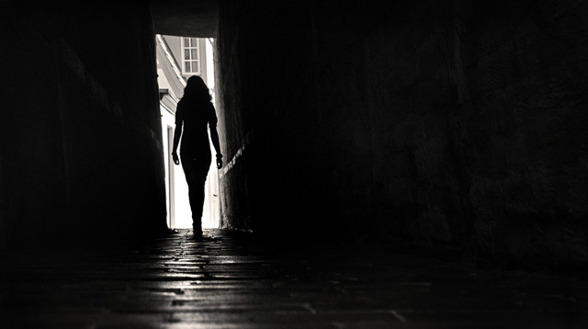
WHO
I WAS ?

Slide 2
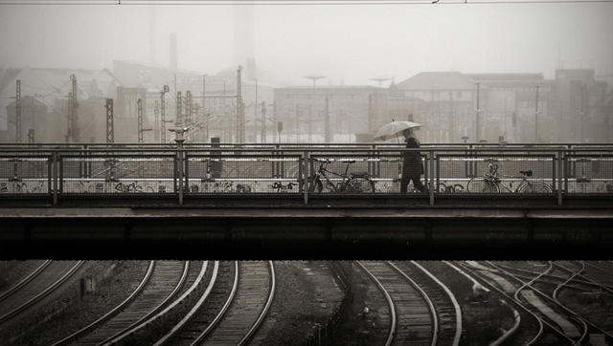
Became a searcher wanting to find out who I was and what made me unique
My view of myself was changing I wanted a solid base to start from

Slide 3
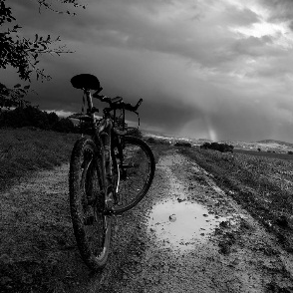
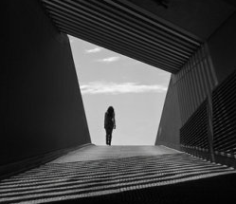
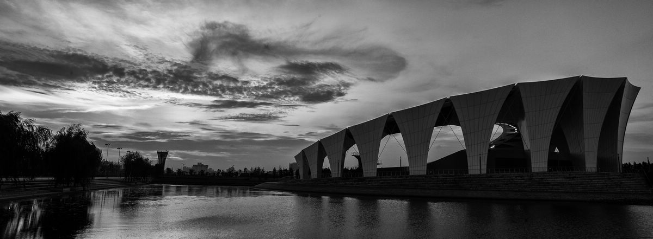
I started to resist pressure to act in ways that I didn’t like any more
And I was delighted by who I really was
CONTENTS
I came to feel much more sure that no one can ever take my place

Slide 4

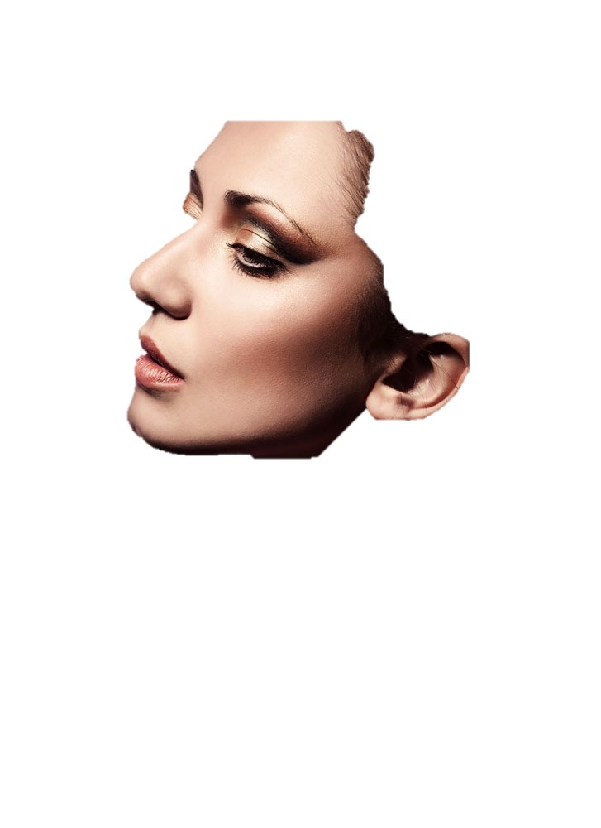

Slide 5
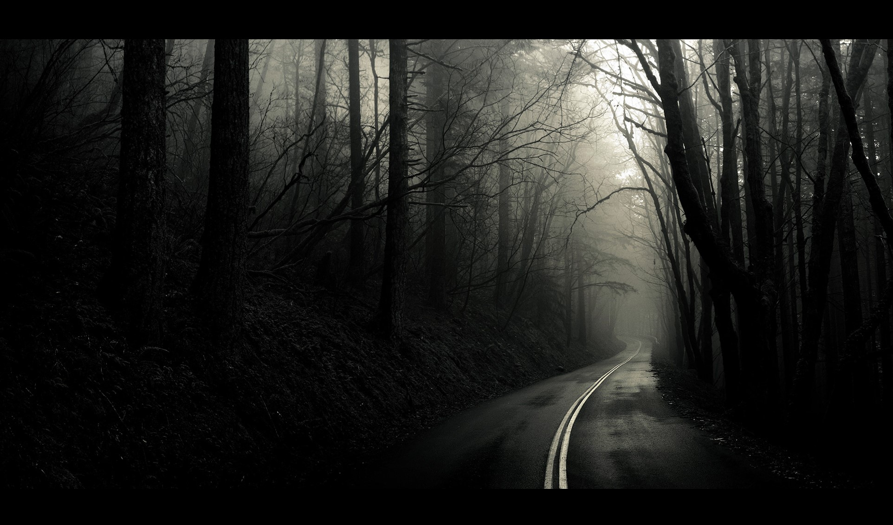
It takes more than just breathing in the fresh air of opportunity
opportunity
01

Slide 6

Title 01
Title 02
Title 03
It doesn't matter what "floor" the opportunity is on What matters is what you do with it
It doesn't matter what "floor" the opportunity is on What matters is what you do with it
It doesn't matter what "floor" the opportunity is on What matters is what you do with it

Slide 7
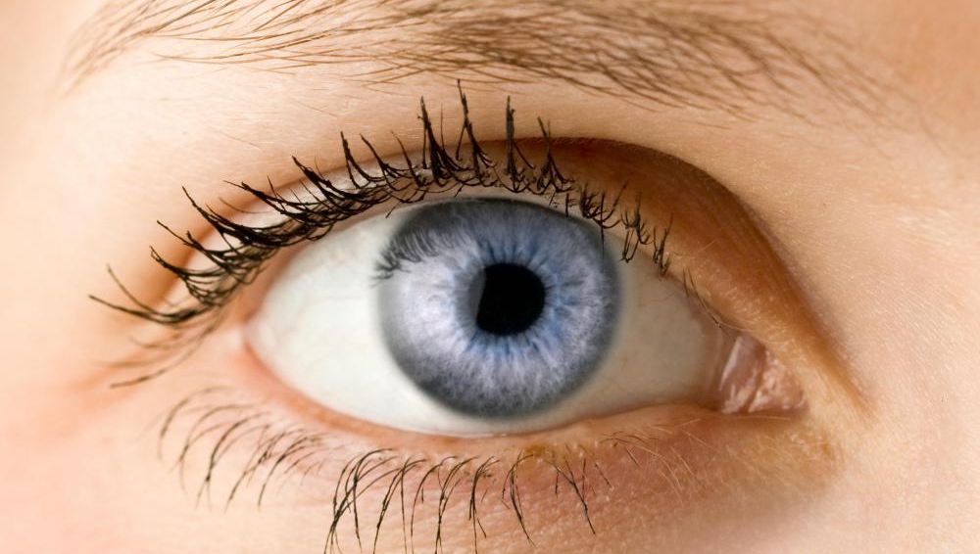

46%
42%
39%
Just as you need air to breathe you need opportunity to succeed
37%

Slide 8
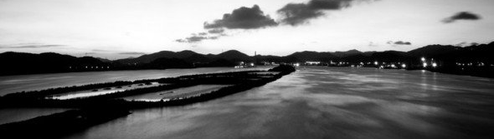
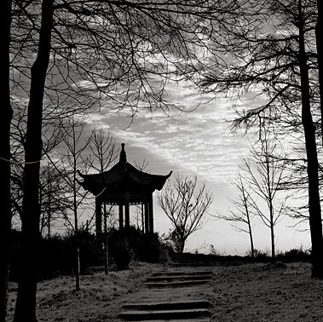
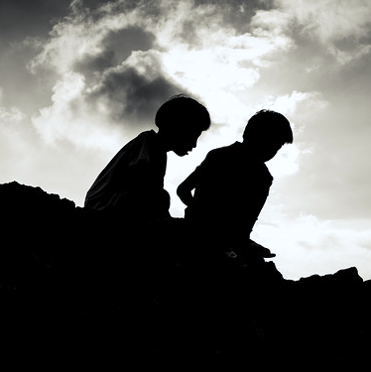
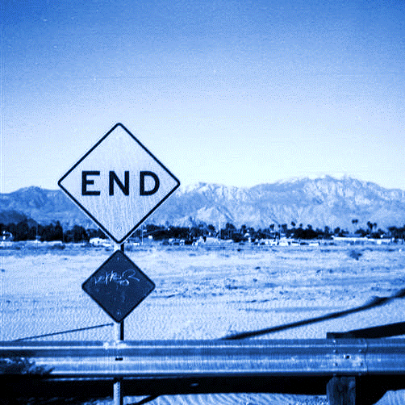
Opportunity
It takes more than just breathing in the fresh air of opportunity however You must make use of that opportunity That's not up to the opportunity
That's up to you It doesn't matter what "floor" the opportunity is on What matters is what you do with it

Slide 9

Just me
I'm special
In the entire world there's nobody like me
Since the beginning of time
there has never been another person like me
Nobody has my smile
Nobody has my eyes
my nose my hair my hands or my voice

Slide 10
Just as you need air to breathe you need opportunity to succeed
Just as you need air to breathe you need opportunity to succeed
Just as you need air to breathe you need opportunity to succeed
2013
2015
Time to
Succeed
2012
2014
2016
Just as you need air to breathe you need opportunity to succeed
Just as you need air to breathe you need opportunity to succeed

Slide 11

Opportunity
It takes more than just breathing in the fresh air of opportunity however You must make use of that opportunity That's not up to the opportunity
That's up to you It doesn't matter what "floor" the opportunity is on What matters is what you do with it
FIRST OPINION
45%
SECOND OPINION
75%

Slide 12

Each of us holds a unique place in the world You are special no matter what others say or what you may think So forget about being replaced You can not be

