Slide 1

Annual business report
企业商务汇报总结模板
DESIGNED BY POWER STUDIO

Slide 2
1
keywords
This one is super crisp at 2X. Lined paper with some dust and scratches.Don’t look at this one too long if you’re high on something.

Slide 3

Don’t look at this one too long if you’re high on something.
Don’t look at this one too long if you’re high on something.
2001
2010
2006
2014
Don’t look at this one too long if you’re high on something.
Don’t look at this one too long if you’re high on something.

Slide 4
keywords

Slide 5
June
AUGUST
The internet all over the world is exploding in nerdgasm. That's right, the new teaser trailer for the upcoming Star Wars Episode VII has recharged fans after three terrible movies.
The internet all over the world is exploding in nerdgasm. That's right, the new teaser trailer for the upcoming Star Wars Episode VII has recharged fans after three terrible movies.
98.8
78.9

Slide 6
2
keywords
This one is super crisp at 2X. Lined paper with some dust and scratches.Don’t look at this one too long if you’re high on something.

Slide 7
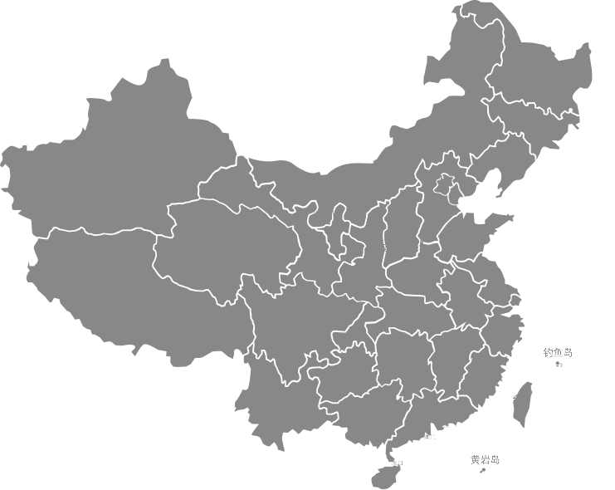
Market conditions
1
conditions a
Clean and crisp lines all over the place. Wrap it up with this one.Tweed is back in style – you heard it here first. Also, the version here is great!
2
conditions b
Clean and crisp lines all over the place. Wrap it up with this one.Tweed is back in style – you heard it here first. Also, the version here is great!
3
conditions c
Clean and crisp lines all over the place. Wrap it up with this one.Tweed is back in style – you heard it here first. Also, the version here is great!
4
conditions d
Clean and crisp lines all over the place. Wrap it up with this one.Tweed is back in style – you heard it here first. Also, the version here is great!

Slide 8
POINT 01
Clean and crisp lines all over the place. Wrap it up with this one.Tweed is back in style – you heard it here first. Also, the version here is great!
keywords
Clean and crisp lines all over the place. Wrap it up with this one.Tweed is back in style – you heard it here first. Also, the version here is great!
Clean and crisp lines all over the place. Wrap it up with this one.Tweed is back in style – you heard it here first. Also, the version here is great!
POINT 02
POINT 03

Slide 9
STRENGTHS
The internet all over the world is exploding in nerdgasm. That's right, the new teaser trailer for the upcoming Star Wars Episode.
THREATS
WEAKNESS
SWOT
The internet all over the world is exploding in nerdgasm. That's right, the new teaser trailer for the upcoming Star Wars Episode.
The internet all over the world is exploding in nerdgasm. That's right, the new teaser trailer for the upcoming Star Wars Episode.
OPPORTUNITY
The internet all over the world is exploding in nerdgasm. That's right, the new teaser trailer for the upcoming Star Wars Episode.

Slide 10
3
keywords
This one is super crisp at 2X. Lined paper with some dust and scratches.Don’t look at this one too long if you’re high on something.

Slide 11


30%
40%
Data analysis
Data analysis
Clean and crisp lines all over the place. Wrap it up with this one.Tweed is back in style – you heard it here first. Also, the version here is great!
Clean and crisp lines all over the place. Wrap it up with this one.Tweed is back in style – you heard it here first. Also, the version here is great!

Slide 12

01
plan a
You know I like walls, what can I say. This one needs to be used in small areas, though. You can see it repeat.
02
plan B
You know I like walls, what can I say. This one needs to be used in small areas, though. You can see it repeat.
03
plan C
You know I like walls, what can I say. This one needs to be used in small areas, though. You can see it repeat.
04
plan D
You know I like walls, what can I say. This one needs to be used in small areas, though. You can see it repeat.
05
plan E
You know I like walls, what can I say. This one needs to be used in small areas, though. You can see it repeat.
06
plan F
You know I like walls, what can I say. This one needs to be used in small areas, though. You can see it repeat.

Slide 13
咨询 & 交流
@ FUTURA_H

