Slide 1
地 球 在 喊 救 命
THE EARTH
WAS CRYING FOR

Slide 2
DIRECTORY
The first quarter sales
The second quarter sales The third quarter sales
The second quarter sales The third quarter sales
The first quarter sales
The first quarter sales
The second quarter sales The third quarter sales
The second quarter sales The third quarter sales
The first quarter sales

Slide 3
THE FIRST
QUARTER SALES

Slide 4
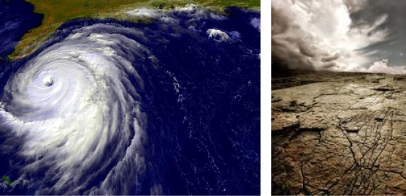
THE FIRST QUARTER SALES
Ehendae parionsent. Officip iendeles vitaspediti untiunto te soloriam, id et explaccabo. Uptas quatium enihillibus est lacearc hiciass edignisquo bla di ommos modit atument.
Uptas quatium enihillibus est lacearc hiciass edignisquo bla di ommos modit atument.
【DIRECTORY】

Slide 5
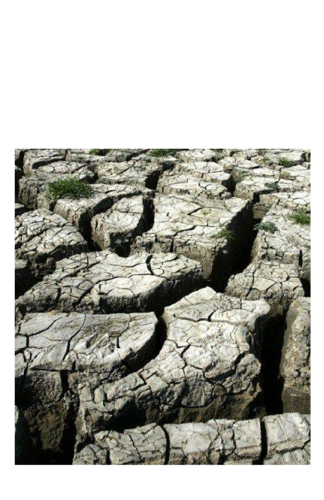
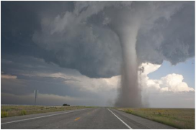
THE SECOND QUARTER SALES THE THIRD QUARTER SALES
Ehendae parionsent. Officip iendeles vitaspediti untiunto te soloriam, id et explaccabo. Uptas quatium enihillibus est lacearc hiciass edignisquo bla di ommos modit atument.
Uptas quatium enihillibus est lacearc hiciass edignisquo bla di ommos modit atument.
Ehendae parionsent. Officip iendeles vitaspediti untiunto te soloriam, id et explaccabo. Uptas quatium enihillibus est lacearc hiciass edignisquo bla di ommos modit atument.
Uptas quatium enihillibus est lacearc hiciass edignisquo bla di
【DIRECTORY】

Slide 6
THANKS
FOR WATCHING

