Slide 1

高端大气商务PPT模板
Your name here
Many of the most satisfying artworks don’t feature exulted or rare elements.
They are about the ordinary, looked at in a special way with unusual sincerity and openness to unvarnished experience.
Logo here

Slide 2
第一部分
Part one
第二部分
Part two
第三部分
Part three
目
第四部分
Part four
录
contents

Slide 3

1
你的标题
Click and add your title
Part one
They are about the ordinary,
looked at in a special way with unusual sincerity and openness to unvarnished experience.

Slide 4
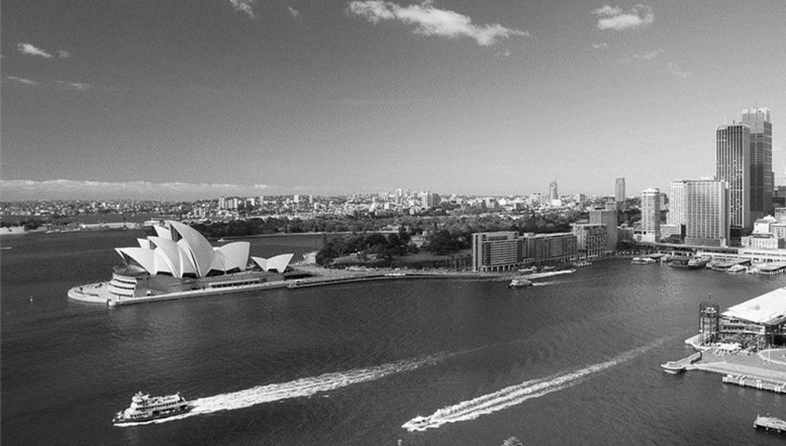

你的标题
your title
// Click and add your words //
Many of the most satisfying artworks don’t feature exulted or rare elements.
They are about the ordinary, looked at in a special way with unusual sincerity and openness to unvarnished experience.

Slide 5

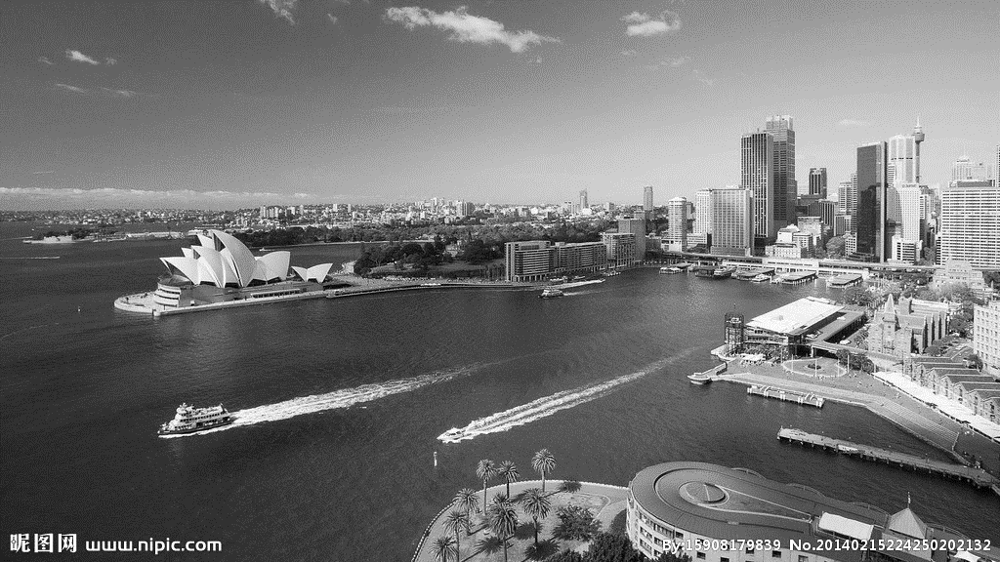
输入你的文字
Many of the most satisfying artworks don’t feature exulted or rare elements.
你的标题
your title
输入你的文字
Many of the most satisfying artworks don’t feature exulted or rare elements.

Slide 6
Many of the most satisfying artworks don’t feature exulted or rare elements.
你的标题
your title
Many of the most satisfying artworks don’t feature exulted or rare elements.
Many of the most satisfying artworks don’t feature exulted or rare elements.

Slide 7

输入你的标题
add your title
90%
75%
50%
输入你的文字
输入你的文字
输入你的文字
Many of the most satisfying artworks don’t feature exulted or rare elements.
Many of the most satisfying artworks don’t feature exulted or rare elements.
Many of the most satisfying artworks don’t feature exulted or rare elements.

Slide 8
2
你的标题
Click and add your title
Part two
They are about the ordinary,
looked at in a special way with unusual sincerity and openness to unvarnished experience.

Slide 9
输入你的标题
add your title
Many of the most satisfying artworks don’t feature exulted or rare elements.
They are about the ordinary,
looked at in a special way with unusual
sincerity and openness to unvarnished experience.

Slide 10
Swot分析
add your title
s
o
输入你的文字
输入你的文字
Many of the most satisfying artworks don’t feature exulted or rare elements.
Many of the most satisfying artworks don’t feature exulted or rare elements.
输入你的文字
输入你的文字
Many of the most satisfying artworks don’t feature exulted or rare elements.
Many of the most satisfying artworks don’t feature exulted or rare elements.
w
t

Slide 11
2017
your title
Many of the most satisfying artworks don’t feature exulted or rare elements.
your title
They are about the ordinary,
looked at in a special way with unusual
sincerity and openness to unvarnished experience.
your title
Many of the most satisfying artworks don’t feature exulted or rare elements.

Slide 12


Click and add your Words
Click and add your Words
Click and add your Words
your title
Many of the most satisfying artworks don’t feature
exulted or rare elements. They are about the ordinary, looked at
in a special way with unusual sincerity and openness to unvarnished experience.

Slide 13
3
你的标题
Click and add your title
Part three
They are about the ordinary,
looked at in a special way with unusual sincerity and openness to unvarnished experience.

Slide 14
输入你的标题
add your title
Many of the most satisfying artworks don’t feature exulted or rare elements.
They are about the ordinary,
looked at in a special way with unusual
sincerity and openness to unvarnished experience.

Slide 15
Many of the most satisfying artworks don’t feature exulted or rare elements.
Many of the most satisfying artworks don’t feature exulted or rare elements.
your words
your words
your words
your words
Many of the most satisfying artworks don’t feature exulted or rare elements.
Many of the most satisfying artworks don’t feature exulted or rare elements.

Slide 16
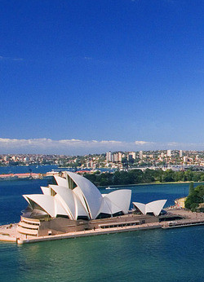
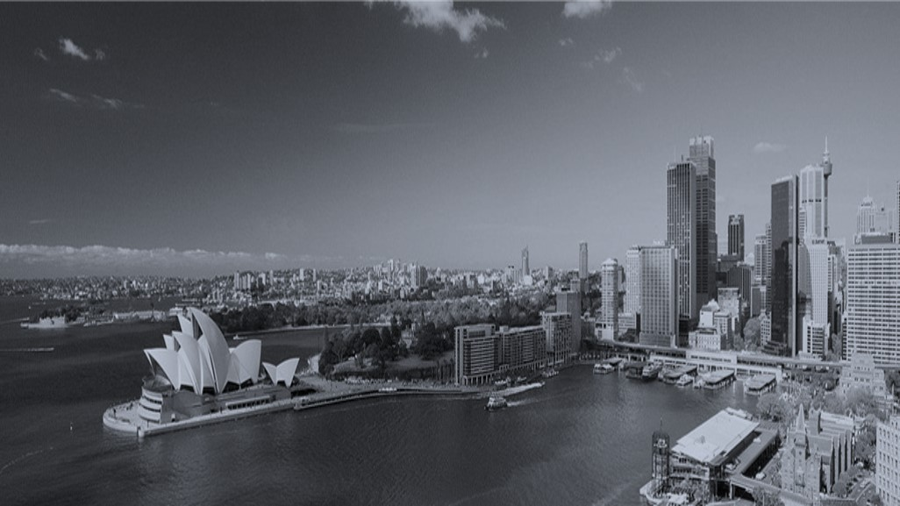
你的标题
add your title
Your
words
your title
your title
Many of the most satisfying artworks don’t feature exulted or rare elements.
Your
words
Many of the most satisfying artworks don’t feature exulted or rare elements.

Slide 17

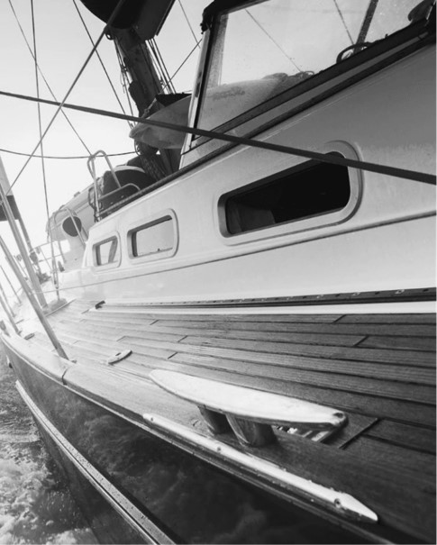
add your title
输入你的文字
Many of the most satisfying artworks don’t feature exulted or rare elements.
Picture 1
Picture 2

Slide 18
4
你的标题
Click and add your title
Part four
They are about the ordinary,
looked at in a special way with unusual sincerity and openness to unvarnished experience.

Slide 19
Click and add your words
Click and add your words
Click and add your words
Click and add your words
输入你的标题
add your title
Click and add your words
Click and add your words

Slide 20


your title
Many of the most satisfying artworks don’t feature exulted or rare elements.
输入你的文字
Many of the most satisfying artworks don’t feature exulted or rare elements.

Slide 21
add your title
1
Many of the most satisfying artworks don’t feature exulted
or rare elements. They are about the ordinary, looked at in a special
way with unusual sincerity and openness to unvarnished experience.
2
Many of the most satisfying artworks don’t feature exulted
or rare elements. They are about the ordinary, looked at in a special
way with unusual sincerity and openness to unvarnished experience.
3
Many of the most satisfying artworks don’t feature exulted
or rare elements. They are about the ordinary, looked at in a special
way with unusual sincerity and openness to unvarnished experience.

Slide 22
Thank you
Your name here
Logo here

