Slide 1

FACING BUSINESS CHALLENGES AT HOLIDAY WORLDWIDE SENDING INVITATIONS ACROSS
THE TITLE CONTENT
FACING BUSINESS CHALLENGES AT HOLIDAY WORLDWIDE SENDING INVITATIONS ACROSS

Slide 2
INTRODUCE
IN THE ETERNAL UNIVERSE, EVERU HUMAN BEING HAS A ONE-OFF CHANCE TO LIVE—HIS EXISTENCE IS UNIQUE AND IRRETRIEVABLE .

Slide 3
INTRODUCE
WAS BROKEN BY GOD
IMMEDIATELY AFTERWRADS
Fame, wealth and knowledge are merely worldly possessions that are within the reach of anybody striving for them.
A full awareness of this will point out to you that the most important thing in your existence is your distinctive individuality or something special of yours.
What really counts is not your worldly success but your peculiar insight into the meaning of life and your commitment to it.

Slide 4
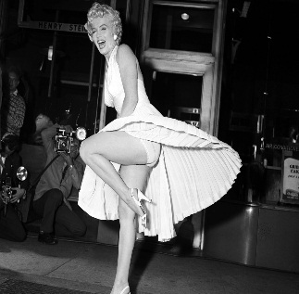
Marilyn Monroe
the actress.
Marilyn Monroe personified Hollywood glamour with an unparalleled glow and energy that enamored the world. Although she was an alluring beauty with voluptuous curves and a generous pout, Marilyn was more than a '50s sex goddess.
FAMOUS
BEAUTIFUL
THE WOMAN WHO
STARTED IT ALL!

Slide 5

THEY MAKE THE DESIGN
In the eternal universe, every human being has a one-off chance to live --his existence is unique and irretrievable, for the mold with which he was made, as Rousseau said.
A full awareness of this will point out to you that the most important thing in your existence is your distinctive individuality or something special of yours.
A full awareness of this will point out to you that the most important thing in your existence is your distinctive individuality or something special of yours.
What really counts is not your worldly success but your peculiar insight into the meaning of life and your commitment to it.

Slide 6
THE GRAPH
A full awareness of this will point out to you that the most important thing in your existence is your distinctive individuality or something special of yours.
What really counts is not your worldly success but your peculiar insight into the meaning of life and your commitment to it.

Slide 7
VISION
THEY MAKE THE DESIGN
In the eternal universe, every human being has a one-off chance to live --his existence is unique and irretrievable, for the mold with which he was made, as Rousseau said.
THE
picture
THE
picture
THE
picture
In the eternal universe, every human being has a one-off chance to live --his existence is unique and irretrievable, for the mold with which he was made, as Rousseau said.
In the eternal universe, every human being has a one-off chance to live --his existence is unique and irretrievable, for the mold with which he was made, as Rousseau said.
In the eternal universe, every human being has a one-off chance to live --his existence is unique and irretrievable, for the mold with which he was made, as Rousseau said.

Slide 8
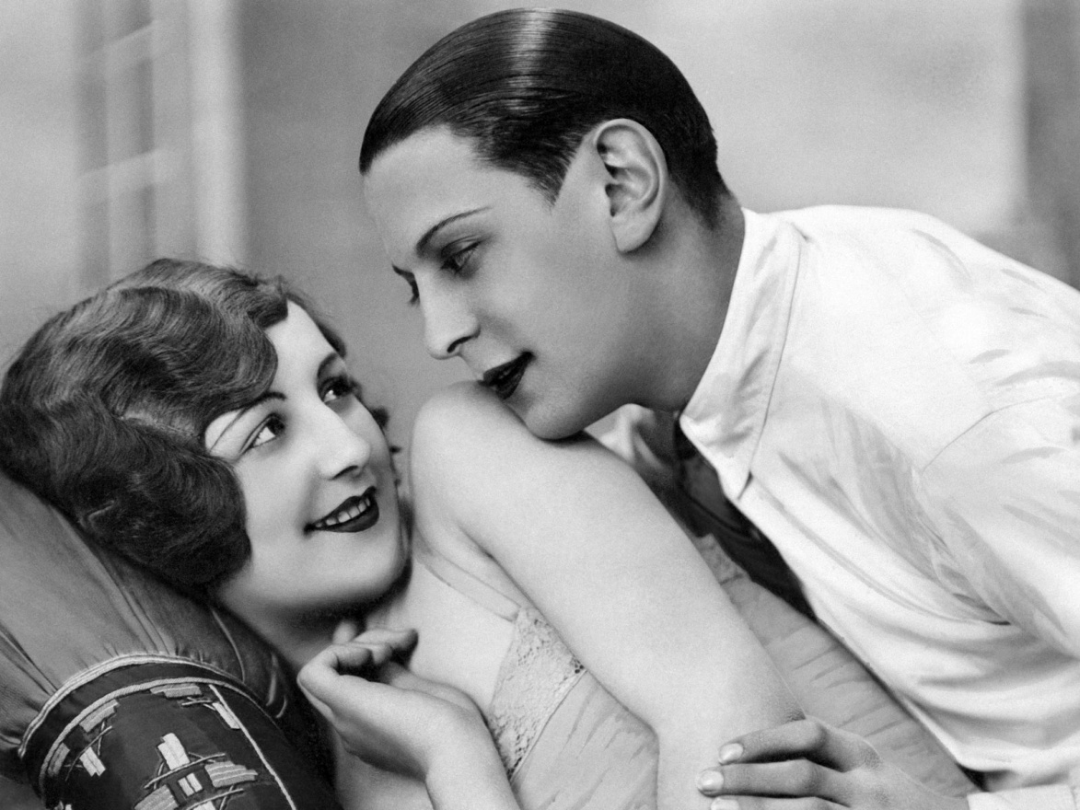
kelly
WHY I
STILL HAVEN’T
MARRIEO BILLY’
In the eternal universe, every human being has a one-off chance to live --his existence is unique and irretrievable.
In the eternal universe, every human being has a one-off chance to live --his existence is unique and irretrievable.
In the eternal universe, every human being has a one-off chance to live --his existence is unique and irretrievable.

Slide 9
IT IS NOT EASY TO
BE WHAT
ONE REALLY IS.
INTRODUCE
The actor
The singer
Fame, wealth and knowledge are merely worldly possessions that are within the reach of anybody striving for them.
A full awareness of this will point out to you that the most important thing in your existence is your distinctive individuality or something special of yours.
What really counts is not your worldly success but your peculiar insight into the meaning of life and your commitment to it.
The star
ONE
picture
TWO
picture
THREE
picture

Slide 10
TAKE
THE RIGHT
DECISIONS
Fame, wealth and knowledge are merely worldly possessions that are within the reach of anybody striving for them.
In the eternal universe, every human
being has a one-off chance to
live --his existence is
unique and irretrievable,
for the mold with which he
was made, as Rousseau said. A
full awareness of this will point out to
you that the most important thing in your existence is your distinctive individuality or something special of yours.

Slide 11
OUR HEADQUARTER
There is many a person in the world who is ordinary in our life.
2014
news
the picture
the picture
the picture
the picture
Fame, wealth and knowledge are merely worldly possessions that are within the reach of anybody striving for them.
Fame, wealth and knowledge are merely worldly possessions that are within the reach of anybody striving for them.

Slide 12
INTRODUCE
VISION
Fame, wealth and knowledge are merely worldly possessions that are within the reach of anybody striving for them.
Fame, wealth and knowledge are merely worldly possessions that are within the reach of anybody striving for them.
A full awareness of this will point out to you that the most important thing in your existence is your distinctive individuality or something special of yours.
What really counts is not your worldly success but your peculiar insight into the meaning of life and your commitment to it.

Slide 13
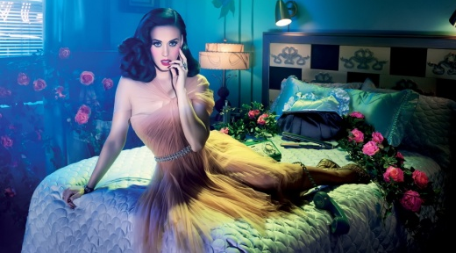
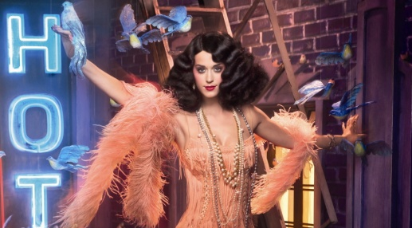
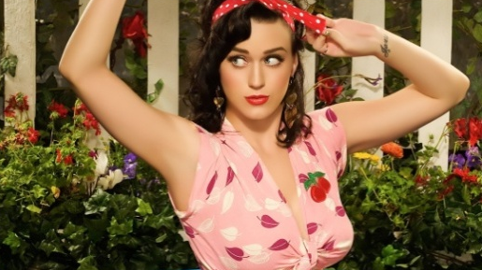
OUR HEADQUARTER
2011
A full awareness of this will point out to you that the most important thing in your existence is your distinctive individuality or something special of yours.
2012
A full awareness of this will point out to you that the most important thing in your existence is your distinctive individuality or something special of yours.
2013
A full awareness of this will point out to you that the most important thing in your existence is your distinctive individuality or something special of yours.

Slide 14
THERE IS MANG A PERSON IN THE WORLD WHO IS ORDINARY IN OUR LIFE.
INTRODUCE

Slide 15
THANK YOU !

