Slide 1
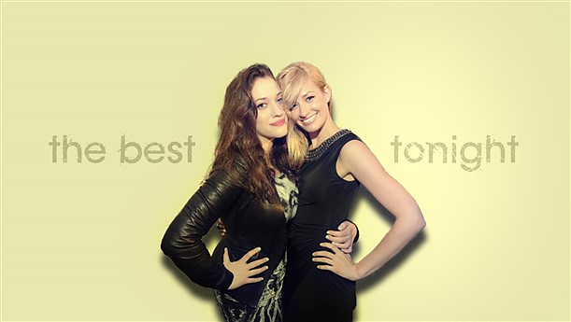
TWO BROKE GIRLS

Slide 2
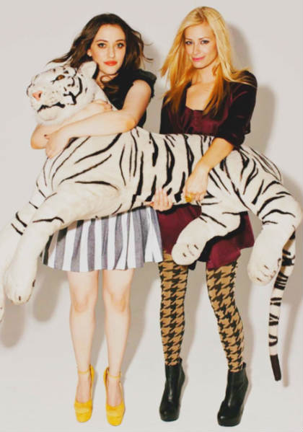
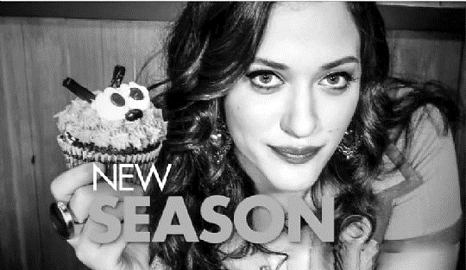
Starting new routines, kicking old habits and living the way we really want is largely based on our desire to genuinely be the happiest person we know. Starting new routines, kicking old habits and living the way we really want is largely based on our desire to genuinely be the happiest person we know.
Starting new routines, kicking old habits and living the way we really want is largely based on our desire to genuinely be the happiest person we know. Starting new routines, kicking old habits and living the way we really want is largely based on our desire to genuinely be the happiest person we know.
"2 Broke Girls" is a solid, old-fashioned sitcom about two mismatched girls taking on the big city and make their dreams come true.

Slide 3
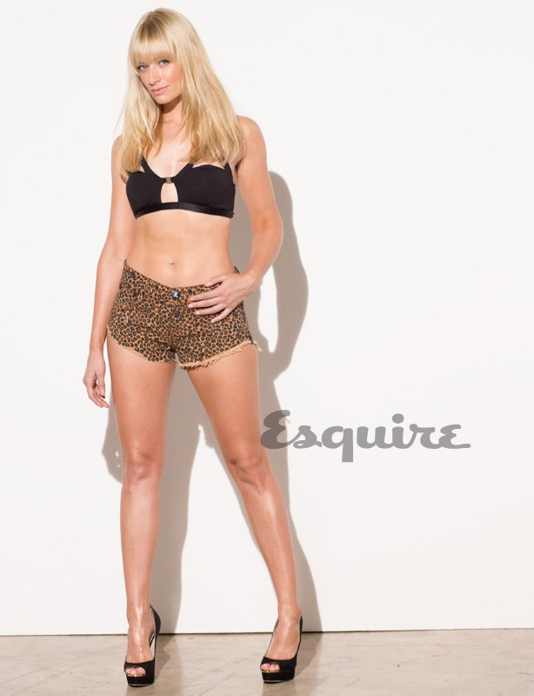

Starting new routines, kicking old habits and living the way we really want is largely based on our desire to genuinely be the happiest person we know. Starting new routines, kicking old habits and living the way we really want is largely based on our desire to genuinely be the happiest person we know.
Starting new routines, kicking old habits and living the way we really want is largely based on our desire to genuinely be the happiest person we know. Starting new routines.
TWO
BROKE GIRLS

Slide 4
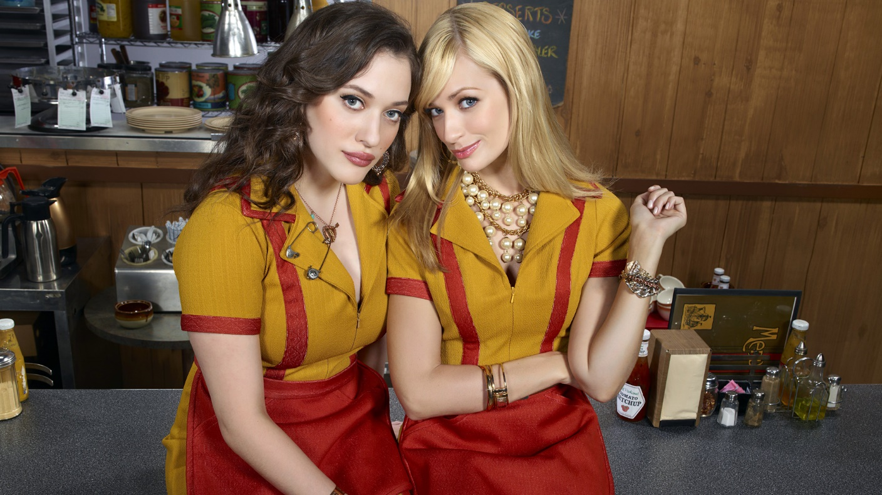
Starting new routines, kicking old habits and living the way we really want is largely based on our desire to genuinely be the happiest person we know. Starting new routines, kicking old habits and living the way we really want is largely based on our desire to genuinely be the happiest person we know.
Starting new routines, kicking old habits and living the way we really want is largely based on our desire to genuinely be the happiest person we know. Starting new routines, kicking old habits and living the way we really want is largely based on our desire to genuinely be the happiest person we know.
Starting new routines, kicking old habits and living the way we really want is largely based on our desire to genuinely be the happiest person we know. Starting new routines, kicking old habits and living the way we really want is largely based on our desire to genuinely be the happiest person we know.
Starting new routines, kicking old habits and living the way we really want is largely based on our desire to genuinely be the happiest person we know.

Slide 5
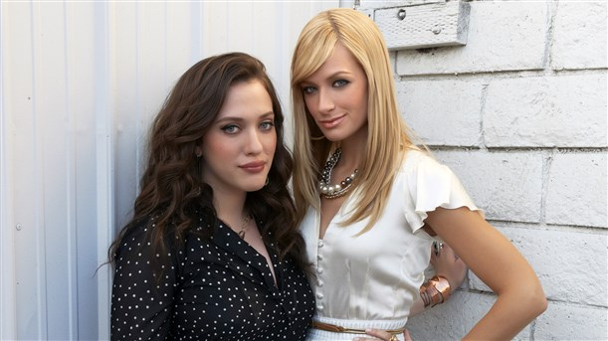
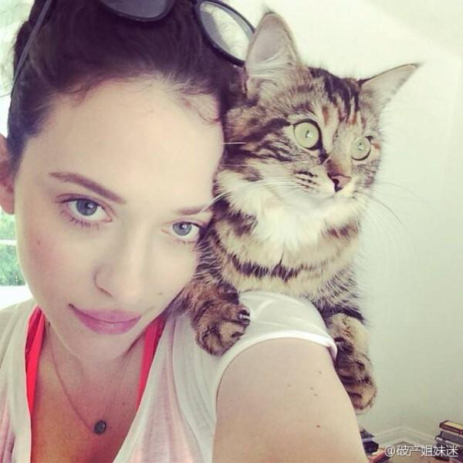
Starting new routines, kicking old habits and living the way we really want is largely based on our desire to genuinely be the happiest person we know. Starting new routines, kicking old habits and living the way we really want is largely based on our desire to genuinely be the happiest person we know.
Starting new routines, kicking old habits and living the way we really.
"2 Broke Girls" is a solid, old-fashioned sitcom about two mismatched girls taking on the big city and make their dreams come true.

Slide 6

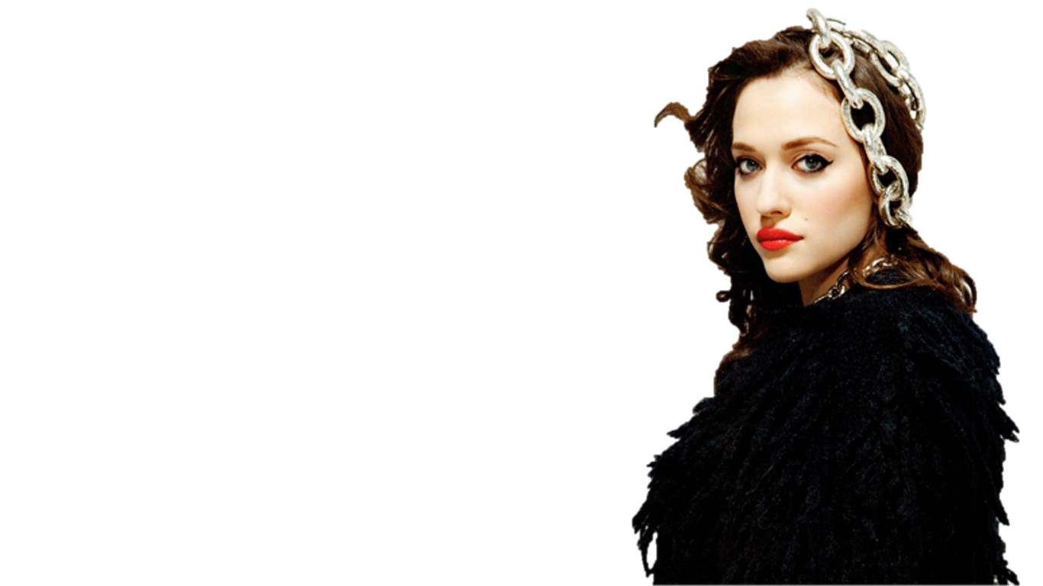
Starting new routines, kicking old habits and living the way we really want is largely based on our desire to genuinely be the happiest person we know. Starting new routines, kicking old habits and living the way we really want is largely based on our desire to genuinely be the happiest person we know.
Starting new routines, kicking old habits and living the way we really want is largely based on our desire to genuinely be the happiest person we know. Starting new routines.
Starting new routines, kicking old habits and living the way we really want is largely based on our desire to genuinely be the happiest person we know. Starting new routines, kicking old habits and living the way we really want is largely based on our desire to genuinely be the happiest person we know.
Starting new routines, kicking old habits and living the way we really want is largely based on our desire to genuinely be the happiest person we know. Starting new routines.

Slide 7
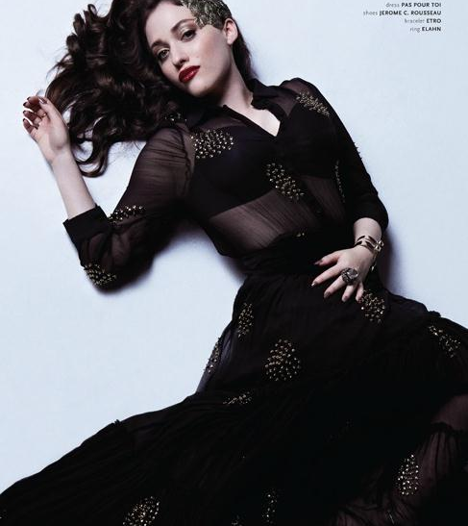
"2 Broke Girls" is a solid, old-fashioned sitcom
Starting new routines, kicking old habits and living the way we really want is largely based on our desire to genuinely be the happiest person we know. Starting new routines, kicking old habits and living the way we really want is largely based on our desire to genuinely be the happiest person we know.
Starting new routines, kicking old habits and living the way we really want is largely based on our desire to genuinely be the happiest person we know. Starting new routines.

Slide 8
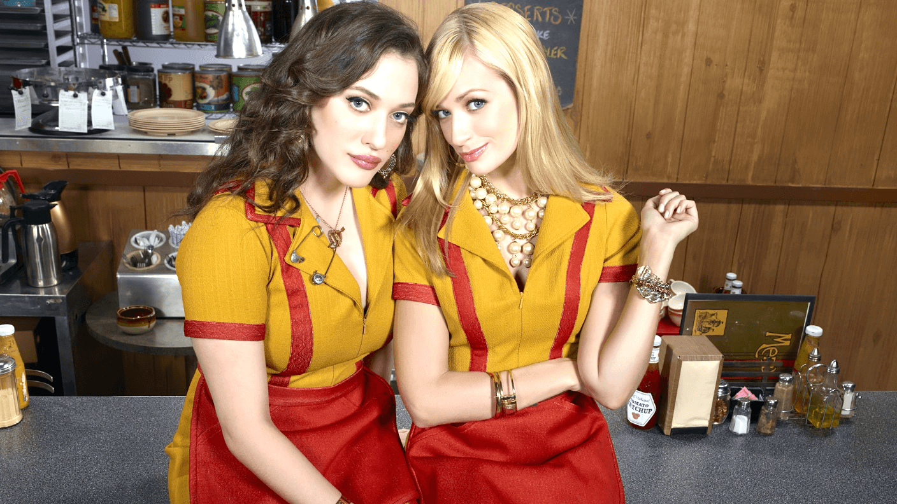
TWO BROKE GIRLS

Slide 9
封面文字替换教程
第一步
注意设置透明度
插入一个与封面同等大小的矩形，并填充颜色

Slide 10
封面文字替换教程
第二步
WELL
插入文本框，填入所需内容

Slide 11

封面文字替换教程
第三步
在格式中选择“合并形状”
-“剪除”
（注意先选择图形后选择文字）

