Slide 1

一起去旅行
TRAVEL ALBUM
旅行相册 赏春/出游/踏青
点击开始吧

Slide 2

点击添加标题
In this part you should describe your business to the investor. You have to make sure he can make it clearIn this part you should describe your business to the investor. You have to make sure he can make it clear
In this part you should describe your business to the investor. You have to make sure he can make it clear

Slide 3

添加标题
In this part you should describe your business to the investor. You have to make sure he can make it clear

Slide 4

添加标题
In this part you should describe your business to the investor. You have to make sure he can make it clearIn this part you should describe your business to the investor. You have to make sure he can make it clear
In this part you should describe your business to the investor. You have to make sure he can make it clear

Slide 5


添加标题
In this part you should describe your business to the investor. You have to make sure he can make it clearIn this part you should describe your business to the investor. You have to make sure he can make it clear
In this part you should describe your business to the investor. You have to make sure he can make it clear

Slide 6


添加标题
In this part you should describe your business to the investor. You have to make sure he can make it clearIn this part you should describe your business

Slide 7

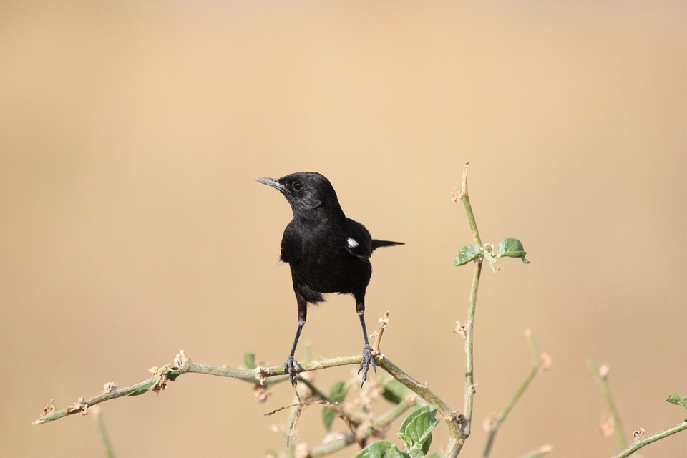
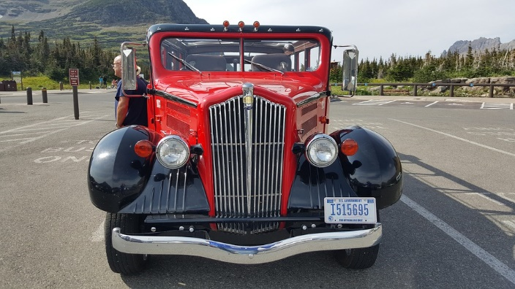
点击添加标题
In this part you should describe your business to the investor. You have to make sure he can make it clearIn this part you should describe your business to the investor.

Slide 8

添加标题
In this part you should describe your business to the investor. You have to make sure he can make it clearIn this part you should describe your business to the investor. You have to make sure he can make it clear
In this part you should describe your business to the investor. You have to make sure he can make it clear

Slide 9


In this part you should describe your business to the investor. You have to make sure he can make it clearIn this part you should describe your business to the investor. In this part you should describe your business to the investor. You have to make sure he can make it clearIn this part you should describe your business to the investor. In this part you should describe your business to the investor.
点击添加标题
点击输入一句动人的话

Slide 10

In this part you should describe your business to the investor. You have to make sure he can make it clearIn this part you should describe your business to the investor. In this part you should describe your business to the investor. You have to make sure he can make it clearIn this part you should describe your business to the investor. In this part you should describe your business to the investor.
点击添加标题

Slide 11
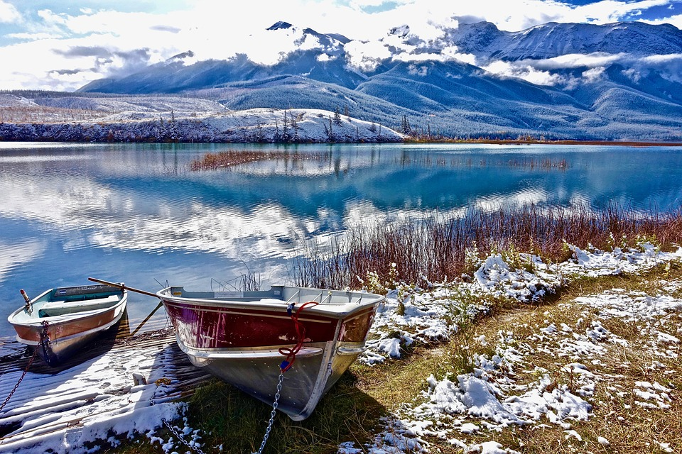
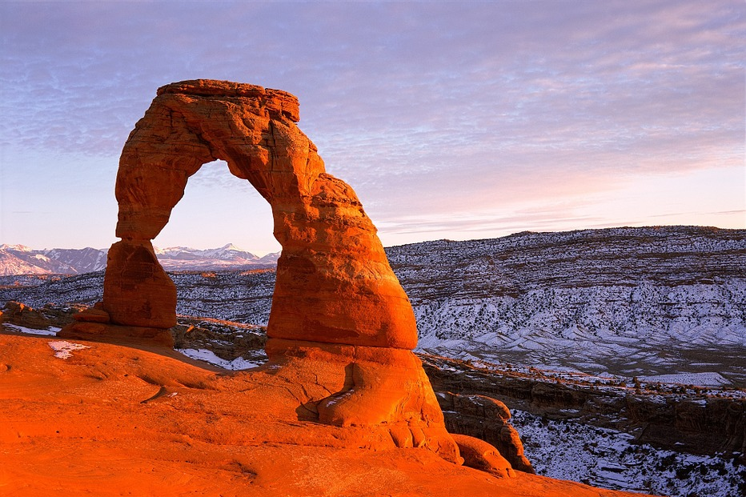

添加标题
In this part you should describe your business to the investor. You have to make sure he can make it clearIn this part you should describe your business

Slide 12


In this part you should describe your business to the investor. You have to make sure he can make it clearIn this part you should describe your business to the investor. In this part you should describe your business to the investor. You have to make sure he can make it clearIn this part you should describe your business to the
点击添加标题
In this part you should describe your business to the investor. You have to make sure he can make it clearIn this part you should describe your business to the investor. In this part you should describe your business to the investor. You have to make sure he can

Slide 13


In this part you should describe your business to the investor. You have to make sure he can make it clearIn this part you should describe your business to the investor.
点击添加标题

Slide 14
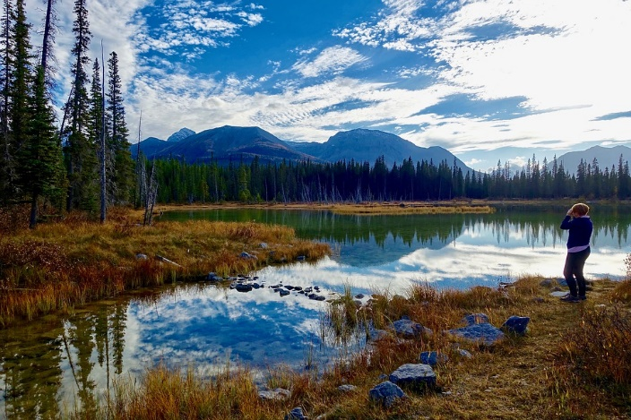




In this part you should describe your business to the investor. You have to make sure he can make it clearIn this part you should describe your business to the investor. In this part you should describe your business to the investor. You have to make sure he can make it clearIn this part you should describe your business to the
In this part you should describe your business to the investor. You have to make sure he can make it clearIn this part you should describe your business to the investor. In this part you should describe your business to the investor.
添加标题
In this part you should describe your business to the investor. You have to

Slide 15
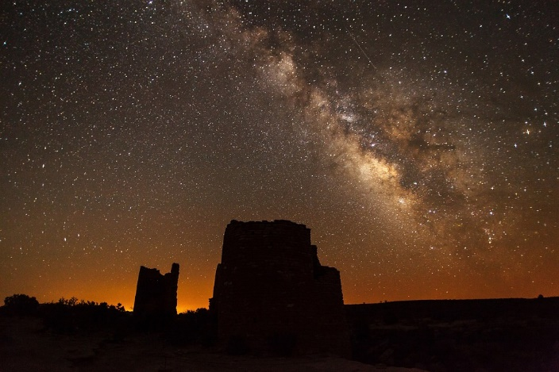

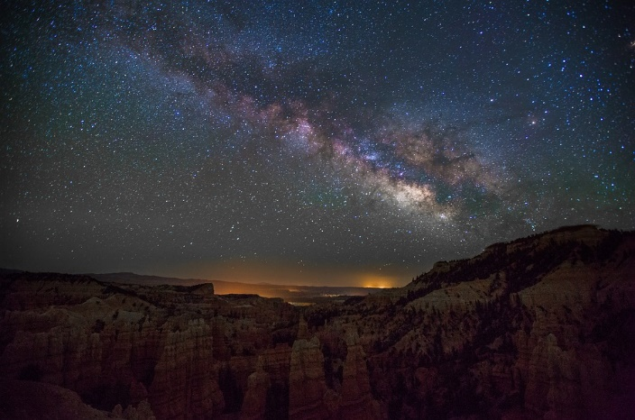
点击添加标题
In this part you should describe your business to the investor. You have to make sure he can make it clearIn this part you should describe your business to the investor. In this part you should describe your business to the investor. You have to make sure he canIn this part you should describe your business to the investor. You have to make sure he can make it clearIn this part you should describe your business to the investor. In this part you should describe your business to the investor.

Slide 16


In this part you should describe your business to the investor. You have to make sure he can make it clearIn this part you should describe your business to the investor. In this part you should describe your business to the investor.
点击添加标题
In this part you sould describe your business to the investor. You have to

Slide 17

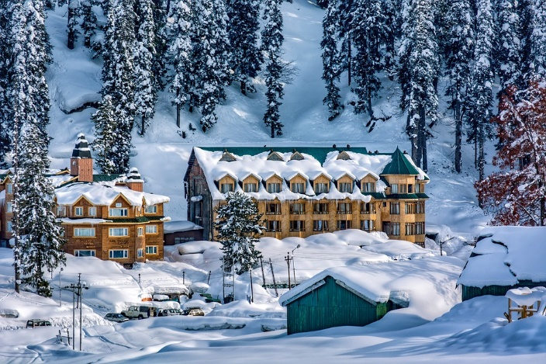
In this part you should describe your business to the investor. You have to make sure he can make it business to the investor.
点击添加标题
In this part you should describe your business to the investor. You have to make sure he can make it business to the investor.

Slide 18



点击添加标题
In this part you should describe your business to the investor. You have to make sure he can make it business to the investor.
In this part you should describe your business to the investor. You have to make sure he can make it business to the investor.
In this part you should describe your business to the investor. You have to make sure he can make it business to the investorIn this part you should describe your business to the investor. You have

Slide 19

点击添加标题
In this part you sould describe your business to the investor. You have to
In this part you should describe your business to the investor. You have to make sure he can make it clearIn this part you should describe your business to the investor. In this part you should describe your business to the investor.

Slide 20
一起去旅行
TRAVEL ALBUM
谢谢观赏
THANKS

