Slide 1
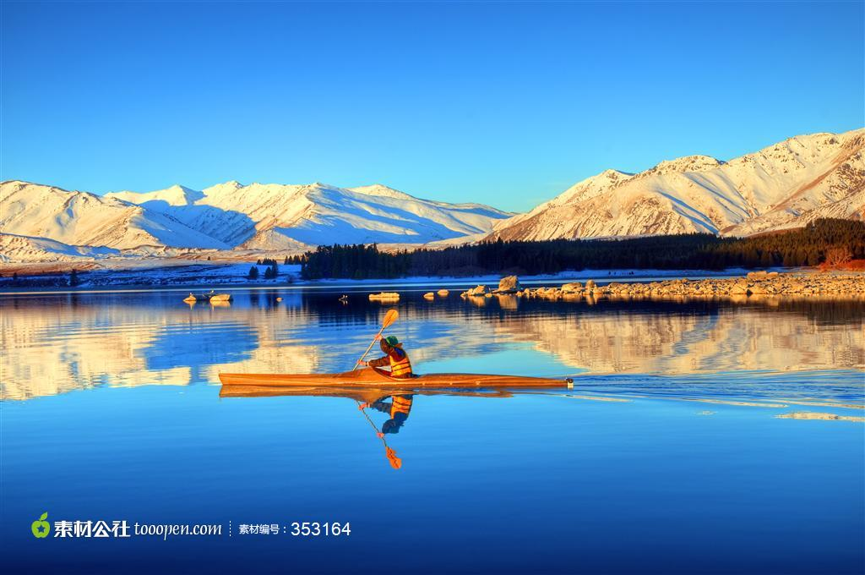
By 演界大咖

Slide 2
Things To Bring
Cities To Travel
Tour Route

Slide 3
Tour route

Slide 4
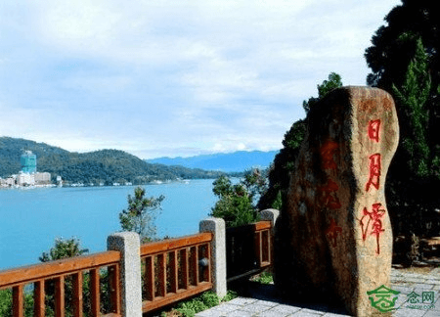
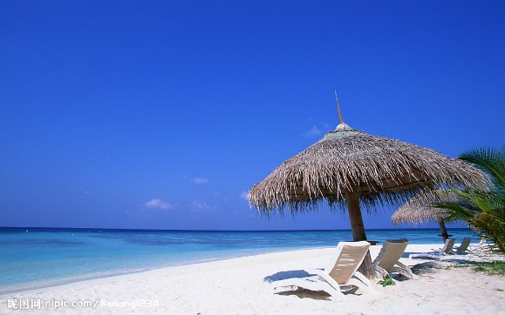
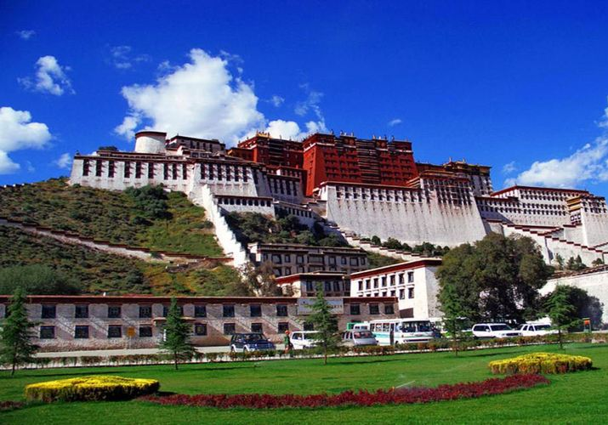
Taiwan
Nepal
Hainan
Tibet

Slide 5
Part 2

Slide 6
1
Taiwan
A brief introduction of Taiwan
A brief introduction of Taiwan
A brief introduction of Taiwan
A brief introduction of Taiwan
A brief introduction of Taiwan
A brief introduction of Taiwan
A brief introduction of Taiwan
A brief introduction of Taiwan

Slide 7
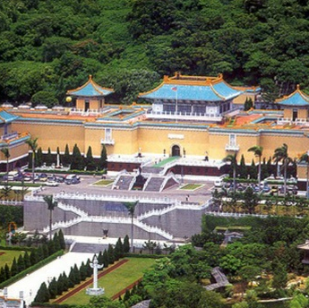
1
Taiwan

Slide 8
2
Hainan
A brief introduction of Hainan
A brief introduction of Hainan
A brief introduction of Hainan
A brief introduction of Hainan
A brief introduction of Hainan
A brief introduction of Hainan
A brief introduction of Hainan
A brief introduction of Hainan

Slide 9
2
Hainan
Sanya
Character of the attraction.
Sansha
Character of the attraction.
Seaside
Character of the attraction.

Slide 10
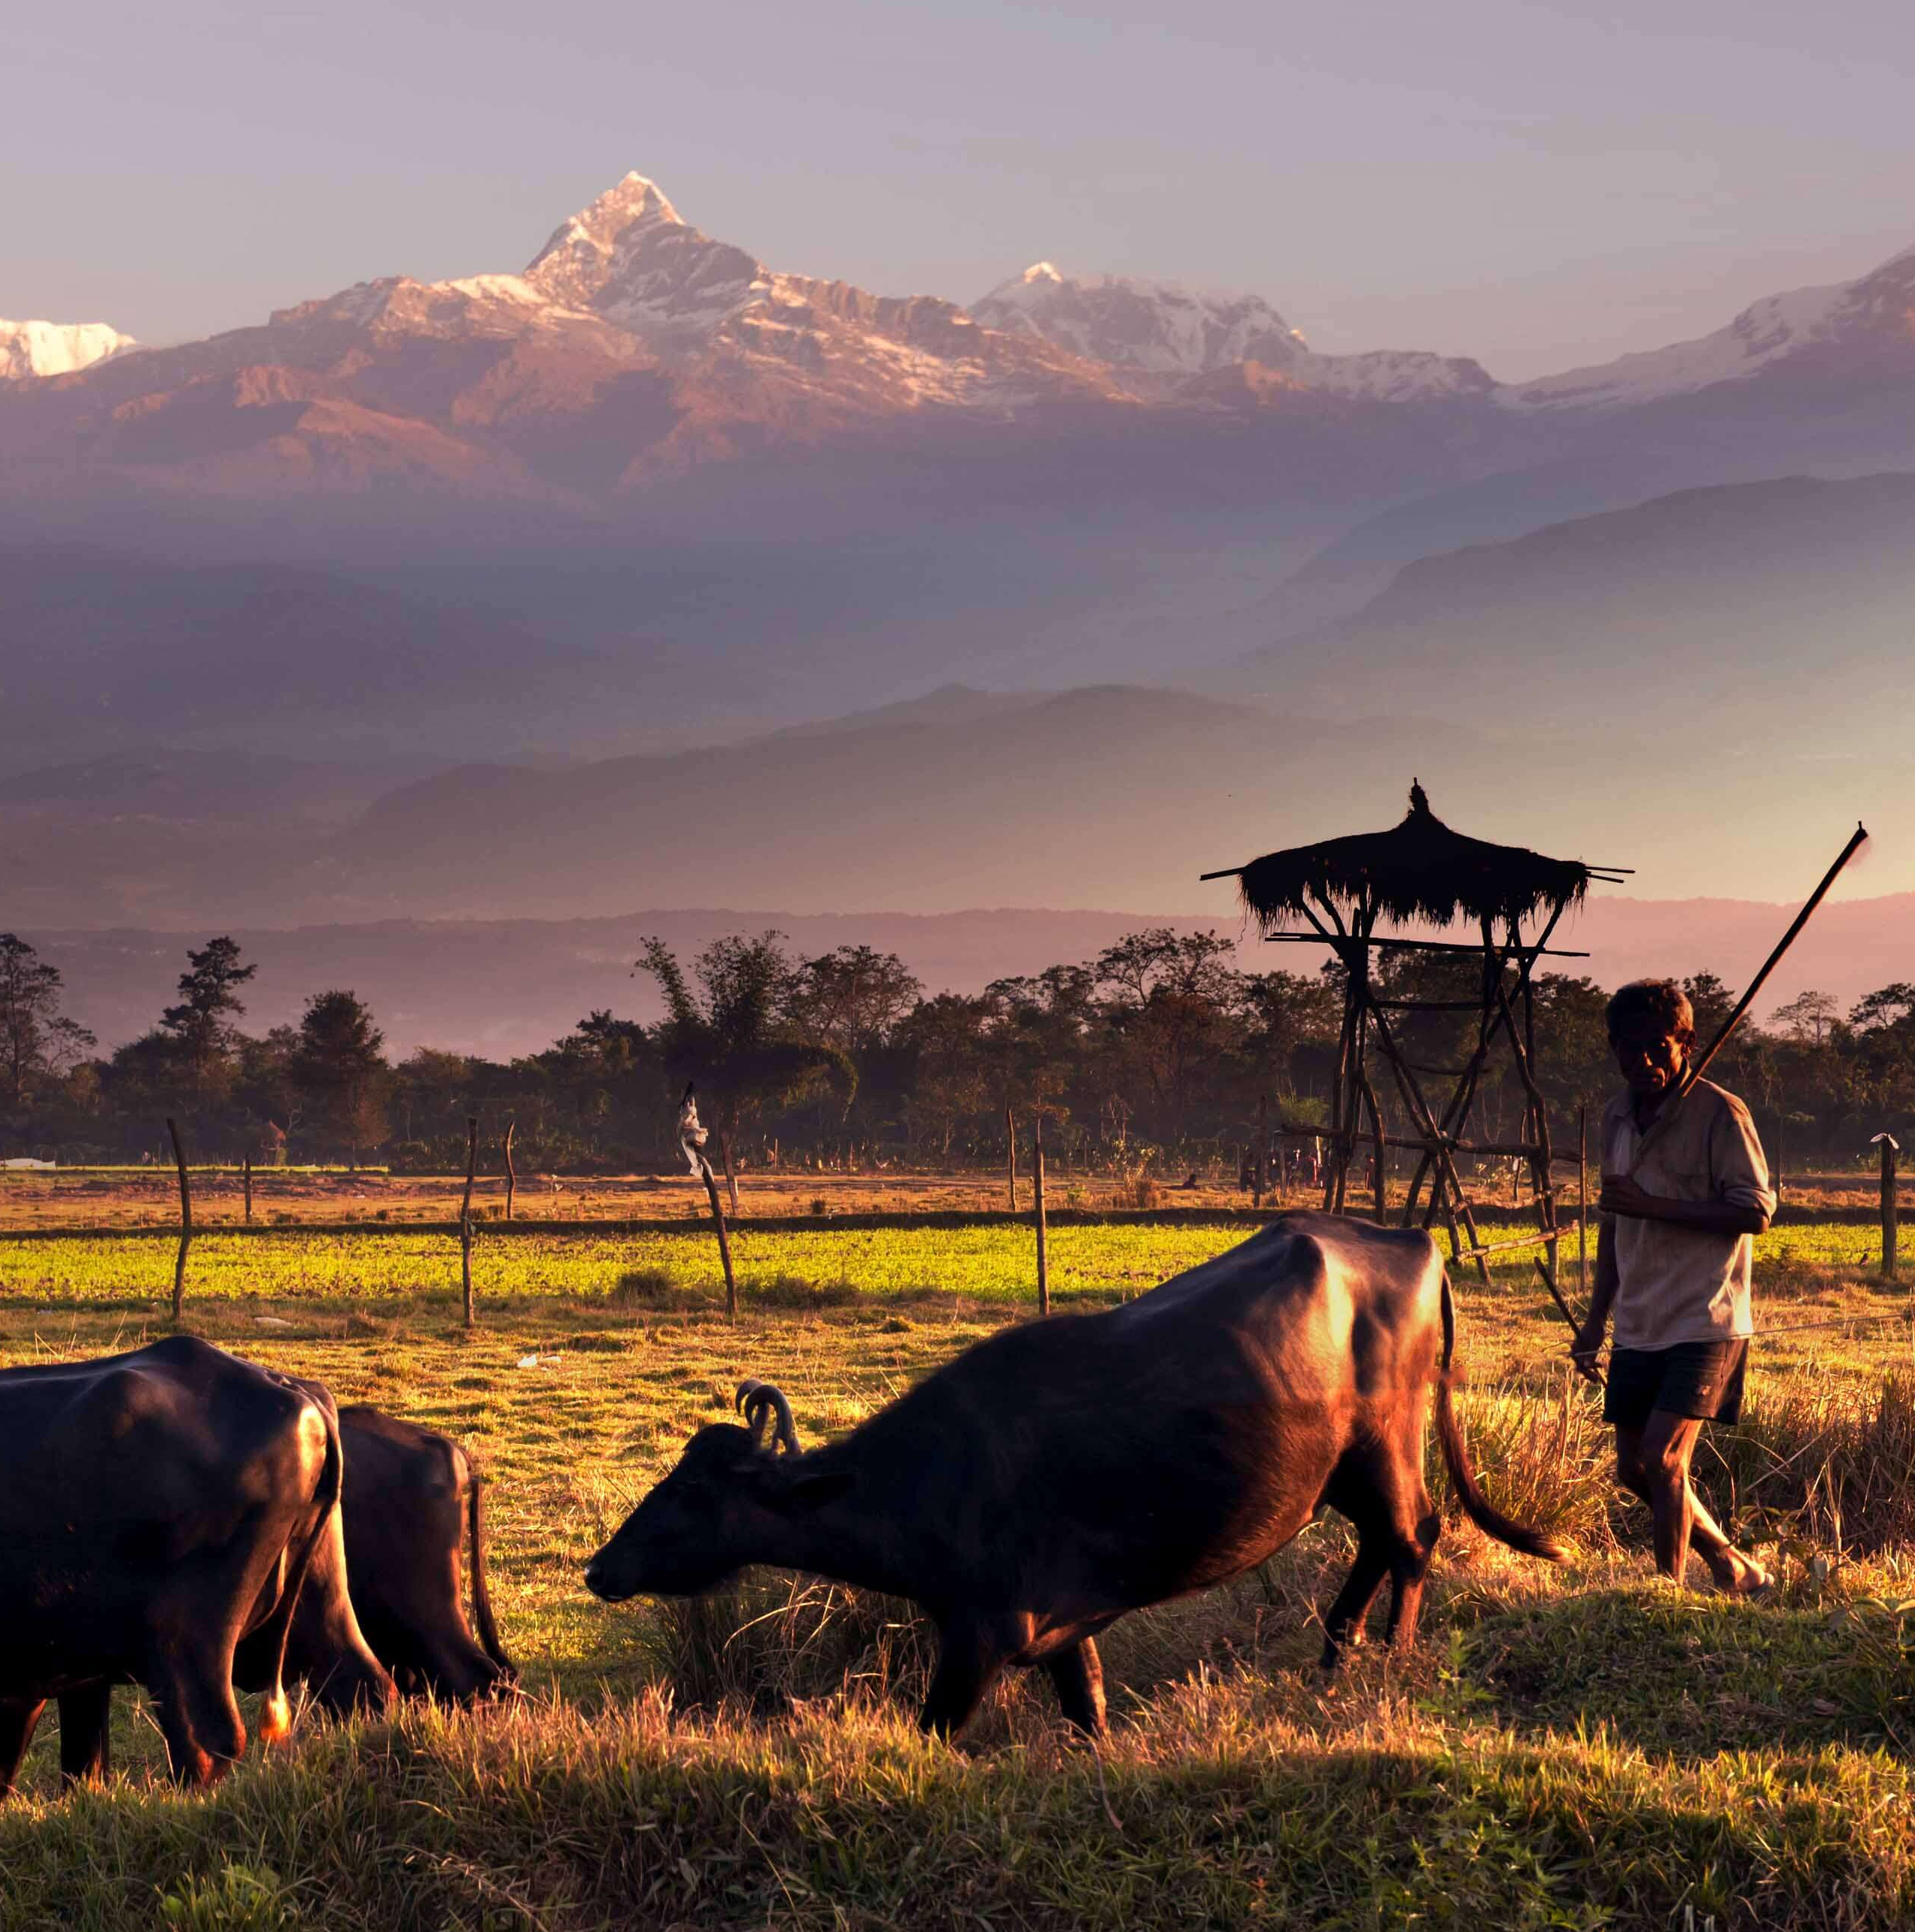
3
Nepal
A brief introduction of Nepal
A brief introduction of Nepal
A brief introduction of Nepal
A brief introduction of Nepal
A brief introduction of Nepal
A brief introduction of Nepal
A brief introduction of Nepal
A brief introduction of Nepal

Slide 11
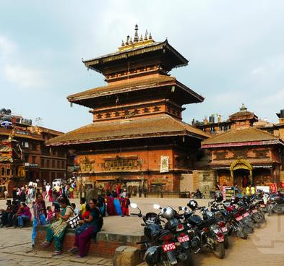
3
Nepal
Kathmandu
Pokhara
Chitwan
About the attraction
About the attraction
About the attraction

Slide 12
4
Tibet
A brief introduction of Tibet
A brief introduction of Tibet
A brief introduction of Tibet
A brief introduction of Tibet
A brief introduction of Tibet
A brief introduction of Tibet
A brief introduction of Tibet
A brief introduction of Tibet
A brief introduction of Tibet

Slide 13
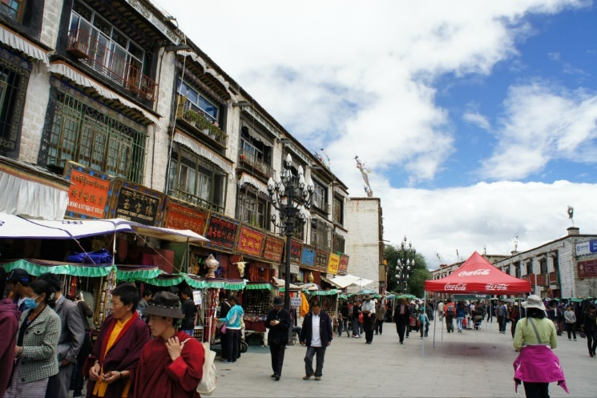
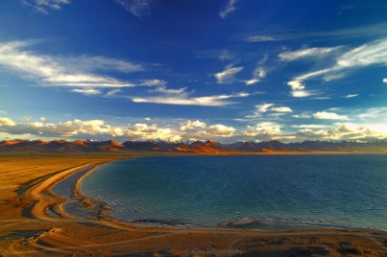
4
Tibet
The Potala Palace
About the attraction
About the attraction
About the attraction
About the attraction
Barkhor Street
Market
About the attraction
About the attraction
About the attraction
About the attraction
The Jokhang Temple
About the attraction
About the attraction
About the attraction
About the attraction
Namsto
About the attraction
About the attraction
About the attraction
About the attraction

Slide 14
Things To Bring

Slide 15
Money
Cellphone
Others

