Slide 1
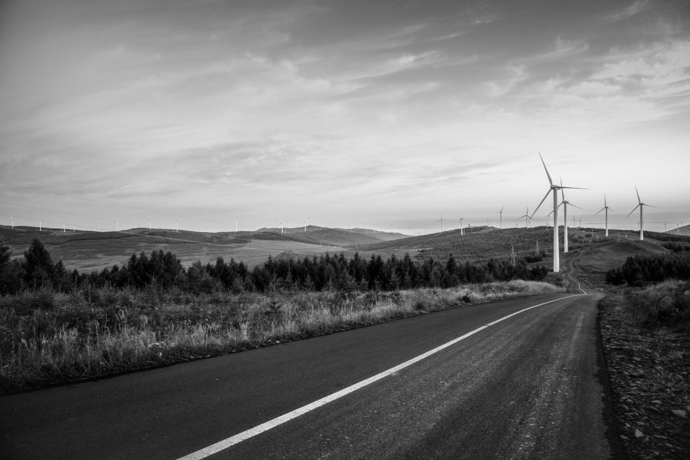
TEMPLATE
BUSINESS PLAN
解决方案
PROJECT
PLANNING
汇报时间：xxxx年xxx月 汇报人：优页PPT

Slide 2
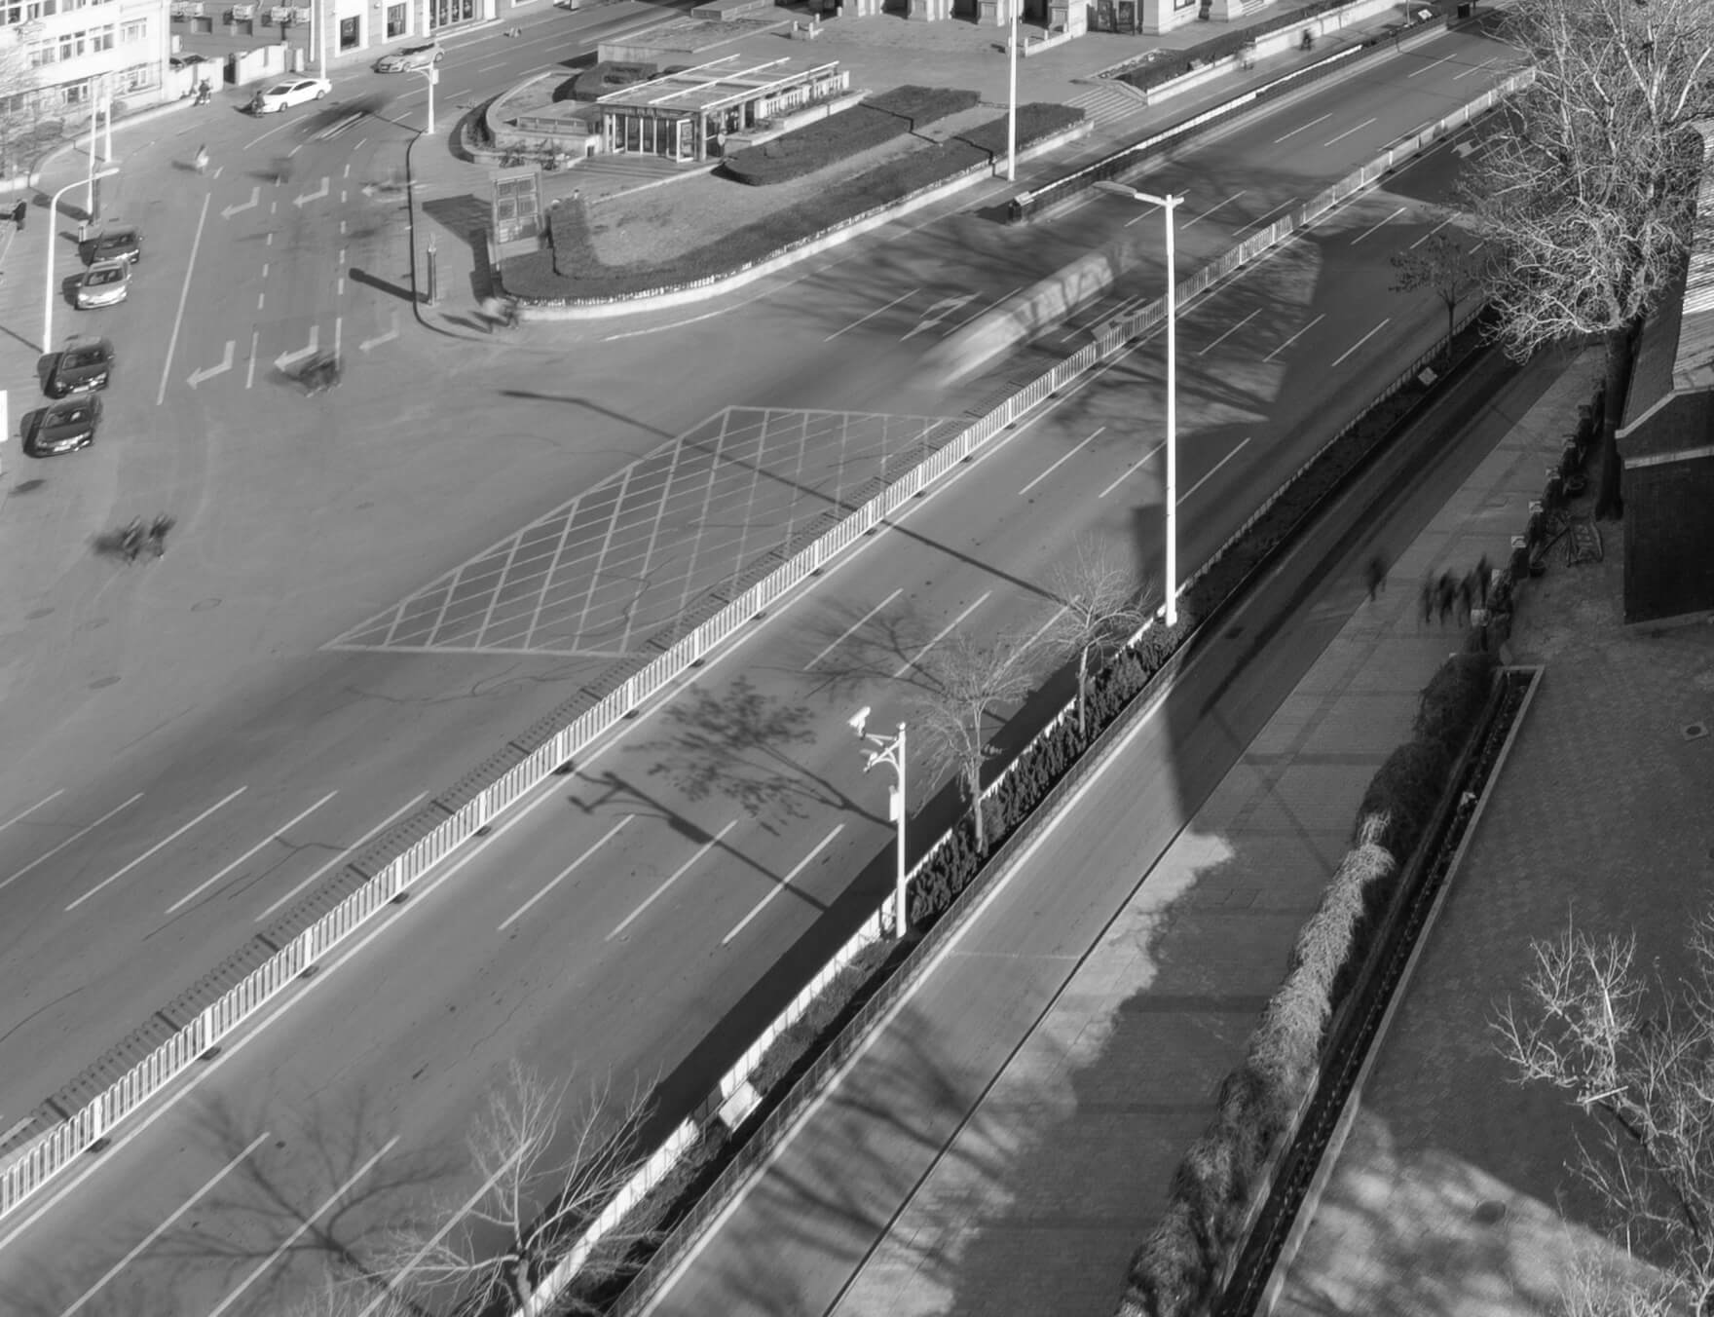
CONTENTS
01
Supporting 标题内容……
02
Supporting 标题内容……
03
Supporting 标题内容……
04
Supporting 标题内容……
04
Supporting 标题内容……

Slide 3
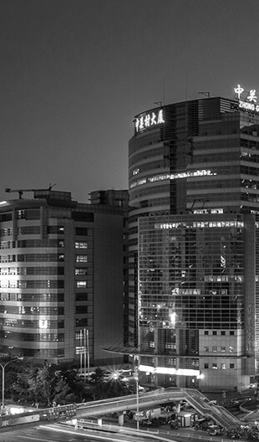
Section Header Here
/01
Supporting text here.
When you copy & paste, choose "keep text only" option.
01
ADD YOUR TEXT

Slide 4

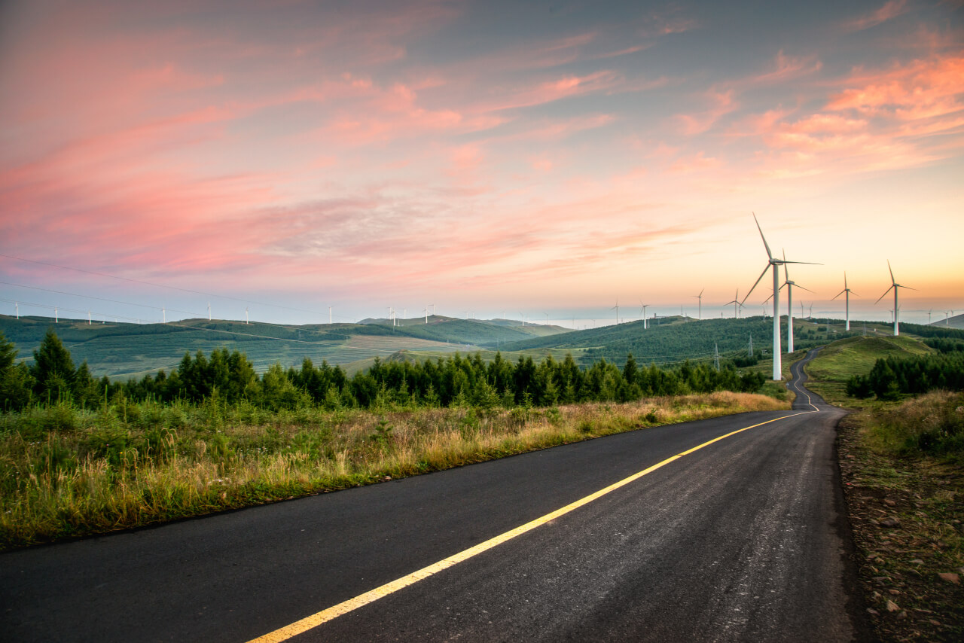
YOUR
TITLE HERE
Far far away, behind the word mountains, far from the countries Vokalia and Consonantia, there live the blind texts. Separated they live in Bookmarksgrove right at the coast of the Semantics, a large language ocean.
A small river named Duden flows by their place and supplies it with the necessary regelialia. It is a paradisematic country.

Slide 5
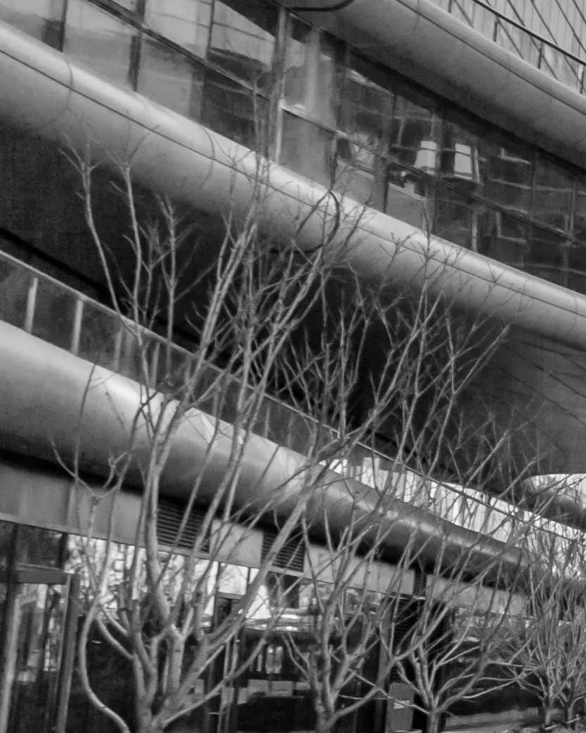
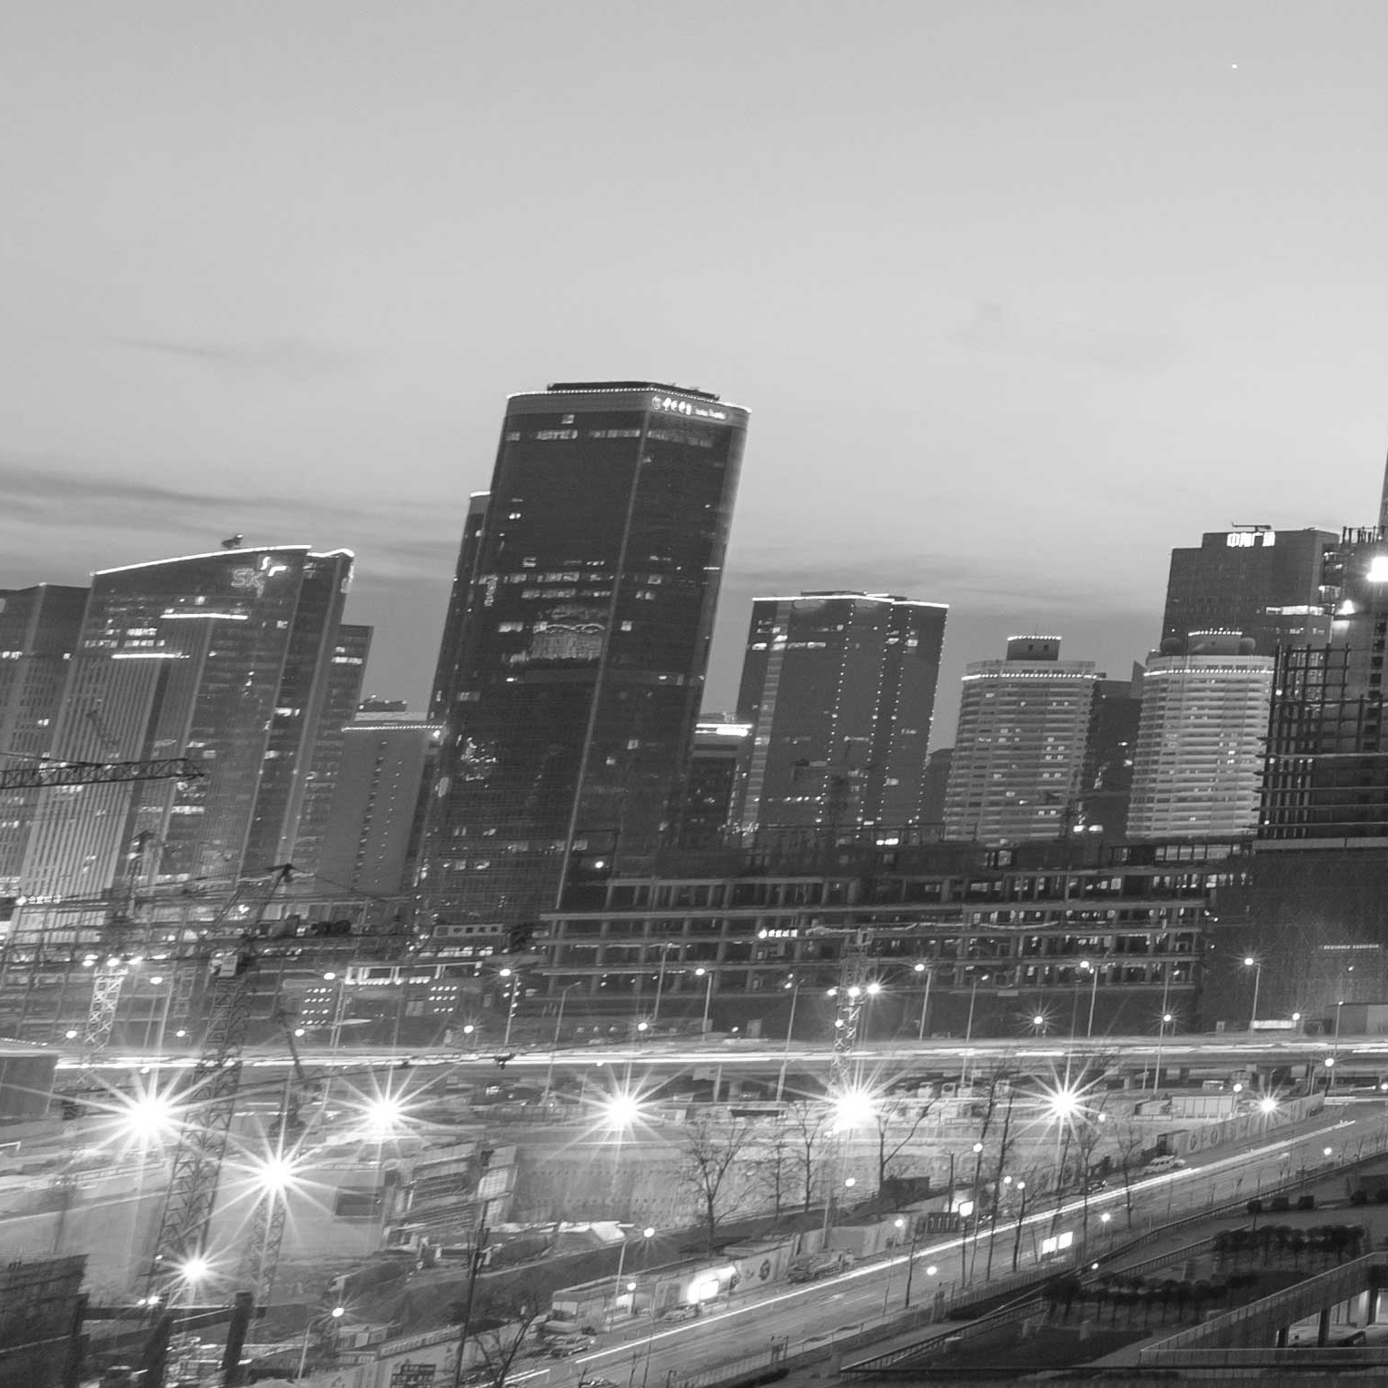

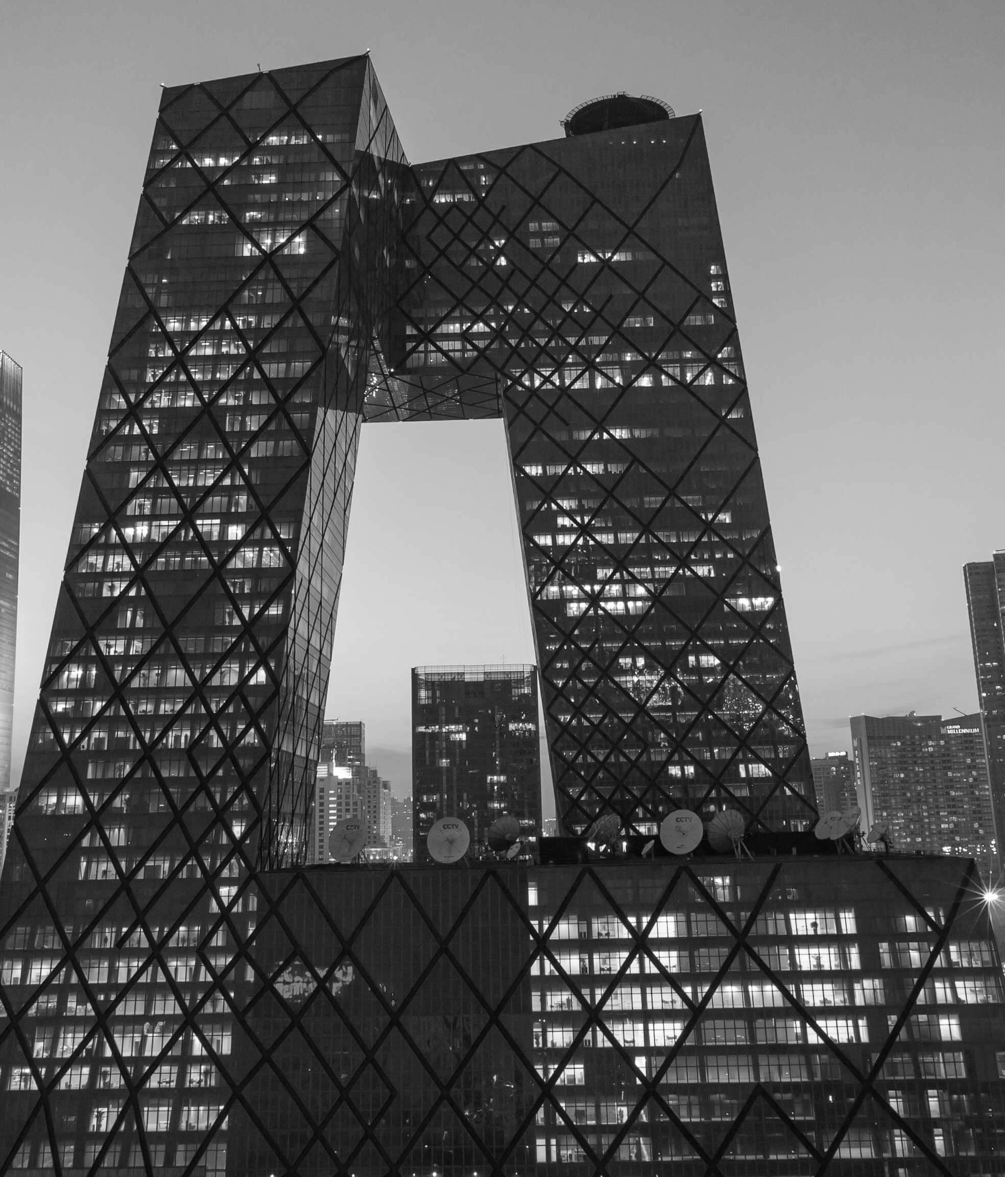
YOUR
TITLE HERE
Sign
Far far away, behind the word mountains, far from the countries Vokalia and Consonantia, there live the blind texts. Separated they live in Bookmarksgrove right at the coast of the Semantics, a large language ocean.

Slide 6
Far far away, behind the word mountains, far from the countries Vokalia and Consonantia, there live the blind texts. Separated they live in Bookmarksgrove right at the coast of the Semantics, a large language ocean.
A small river named Duden flows by their place and supplies it with the necessary regelialia. It is a paradisematic country.
LEFT
PICTURE

Slide 7
YOUR
TITLE HERE
WE ARE
CREATIVE
TEAM
Far far away, behind the word mountains, far from the countries Vokalia and Consonantia, there live the blind texts. Separated they live in Bookmarksgrove right at the coast of the Semantics, a large language ocean.
A small river named Duden flows by their place and supplies it with the necessary regelialia. It is a paradisematic country.
- The Quotes
Far far away, behind the word mountains, far from the countries Vokalia and Consonantia, there live the blind texts. Separated they live in Bookmarksgrove right at the coast of the Semantics, a large language ocean.

Slide 8
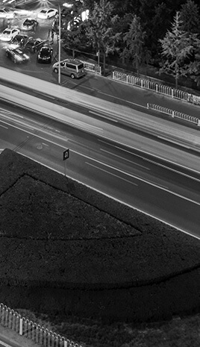
WE ARE
CREATIVE
TEAM
YOUR
TITLE HERE
Far far away, behind the word mountains, far from the countries Vokalia and Consonantia, there live the blind texts. Separated they live in Bookmarksgrove right at the coast of the Semantics, a large language ocean.
A small river named Duden flows by their place and supplies it with the necessary regelialia. It is a paradisematic country.
- The Quotes

Slide 9
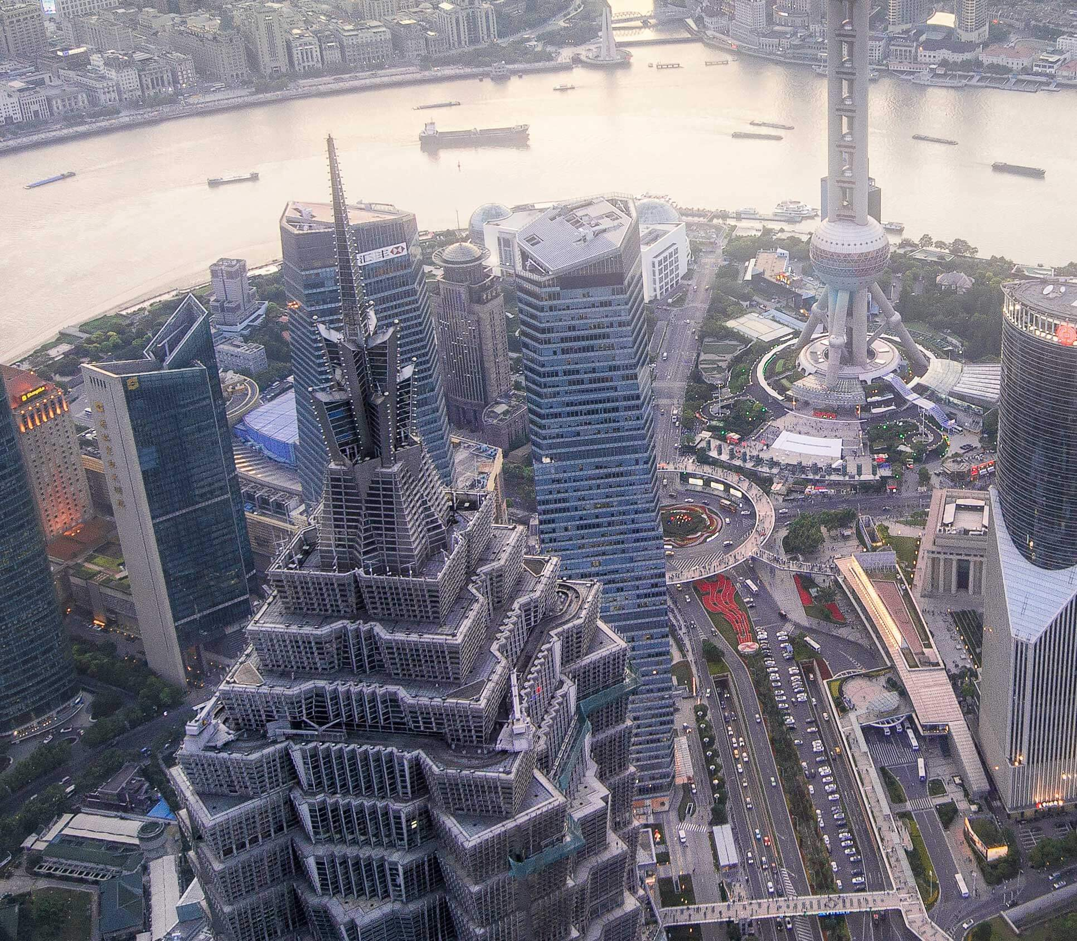
WE ARE
CREATIVE
TEAM
Far far away, behind the word mountains, far from the countries Vokalia and Consonantia, there live the blind texts. Separated they live in Bookmarksgrove right at the coast of the Semantics, a large language ocean.
A small river named Duden flows by their place and supplies it with the necessary regelialia. It is a paradisematic country.

Slide 10
SERVICE NAME
SERVICE NAME
SERVICE NAME
Entrepreneurial activities differ substantially depending on the type of organization and creativity involved.
Entrepreneurial activities differ substantially depending on the type of organization and creativity involved.
Entrepreneurial activities differ substantially depending on the type of organization and creativity involved.

Slide 11
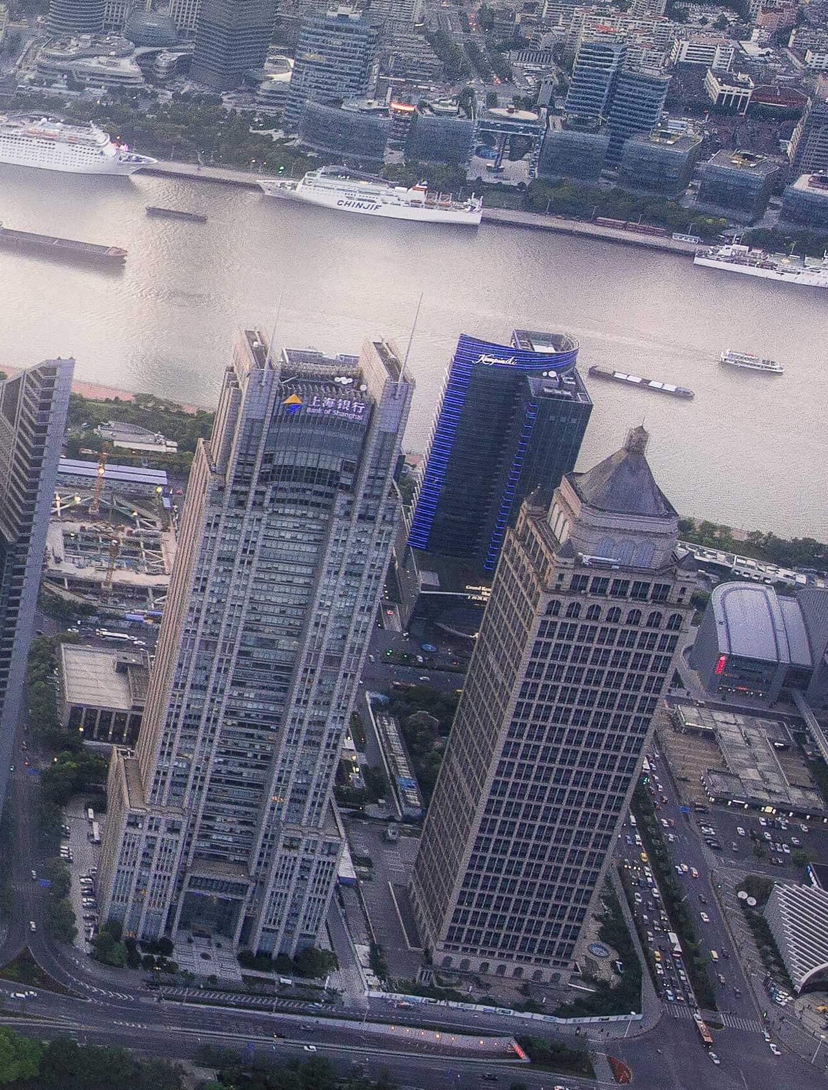
RIGHT
PICTURE
Far far away, behind the word mountains, far from the countries Vokalia and Consonantia, there live the blind texts. Separated they live in Bookmarksgrove right at the coast of the Semantics, a large language ocean.
A small river named Duden flows by their place and supplies it with the necessary regelialia. It is a paradisematic country.

Slide 12
Section Header Here
/01
Supporting text here.
When you copy & paste, choose "keep text only" option.
02
ADD YOUR TEXT

Slide 13
SLIDE
PICTURE
Far far away, behind the word mountains, far from the countries Vokalia and Consonantia, there live the blind texts. Separated they live in Bookmarksgrove right at the coast of the Semantics, a large language ocean.
YOUR TITLE
Far far away, behind the word mountains, far from the countries Vokalia and Consonantia.

Slide 14

TOP BOTTOM
PICTURE

YOUR TITLE
Far far away, behind the word mountains, far from the countries Vokalia and Consonantia, there live the blind texts. Separated they live in Bookmarksgrove right at the coast of the Semantics, a large language ocean.
A small river named Duden flows by their place and supplies it with the necessary regelialia. It is a paradisematic country.

YOUR TITLE

85%
85%
YOUR TITLE
Far far away, behind the word mountains, far from the countries Vokalia and Consonantia, there live the blind texts.
Far far away, behind the word mountains, far from the countries Vokalia and Consonantia, there live the blind texts.

Slide 15
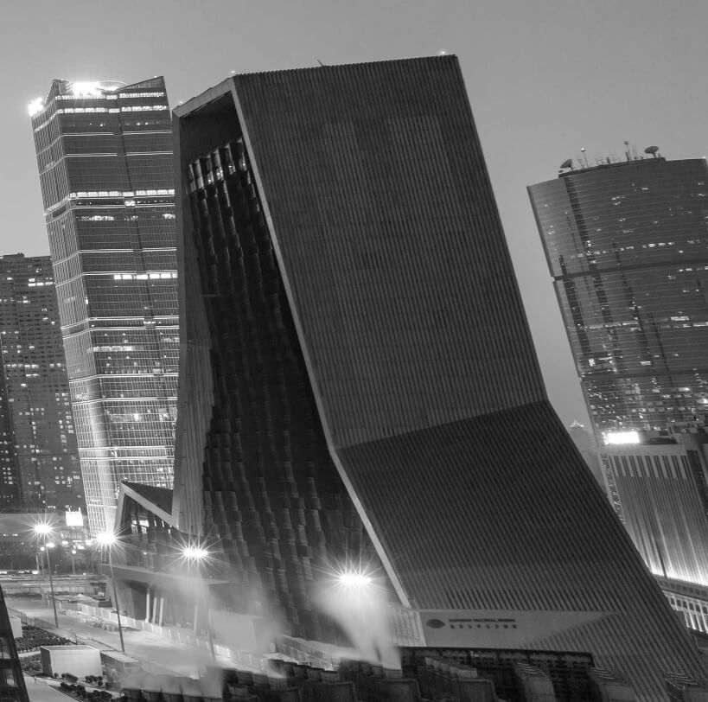
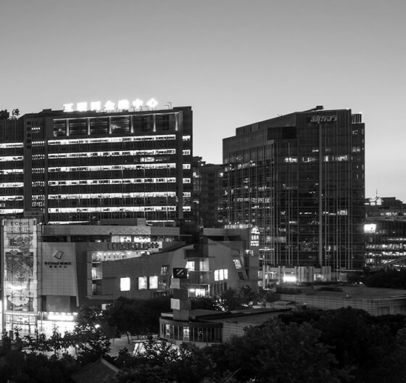
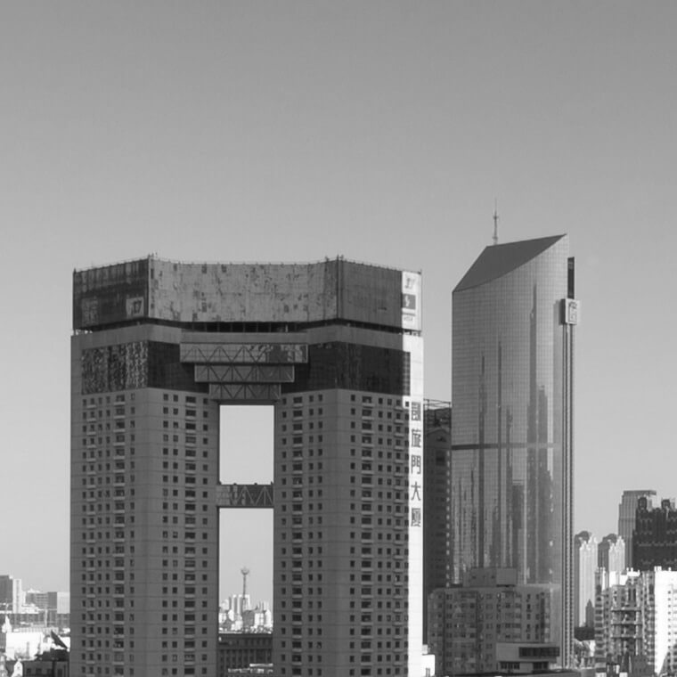
WE ARE
CREATIVE
TEAM
YOUR
TITLE HERE
Far far away, behind the word mountains, far from the countries Vokalia and Consonantia, there live the blind texts. Separated they live in Bookmarksgrove right at the coast of the Semantics, a large language ocean.
Far far away, behind the word mountains, far from the countries Vokalia and Consonantia, there live the blind texts. Separated they live in Bookmarksgrove right at the coast of the Semantics, a large language ocean.

Slide 16
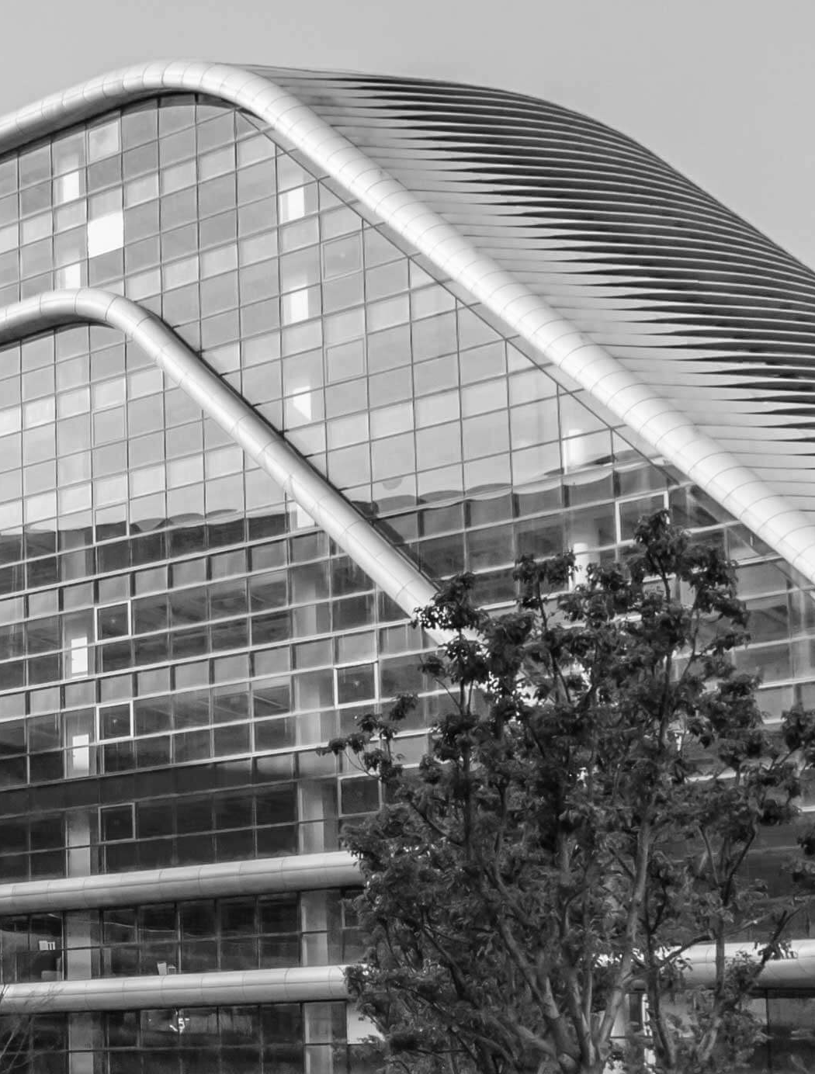
Far far away, behind the word mountains, far from the countries Vokalia and Consonantia, there live the blind texts. Separated they live in Bookmarksgrove right at the coast of the Semantics, a large language ocean.
A small river named Duden flows by their place and supplies it with the necessary regelialia. It is a paradisematic country.
RIGHT
PICTURE

Slide 17
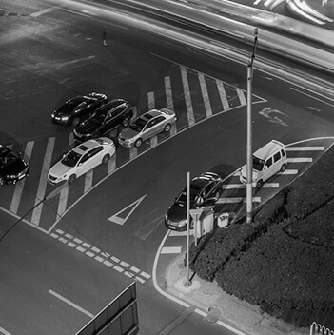
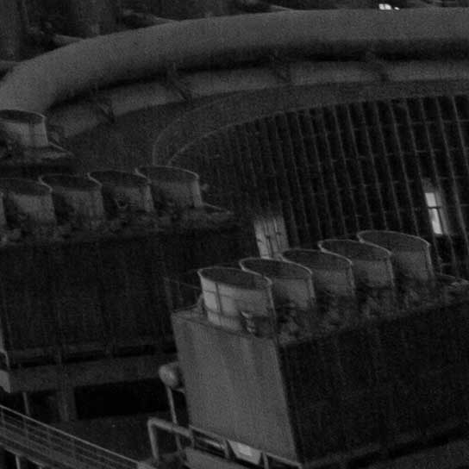
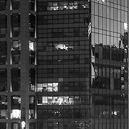
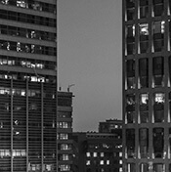
Far far away, behind the word mountains, far from the countries Vokalia and Consonantia, there live the blind texts. Separated they live in Bookmarksgrove right at the coast of the Semantics, a large language ocean.
DIAGONAL
SQUARE PICTURE
Diagonal picture

Slide 18
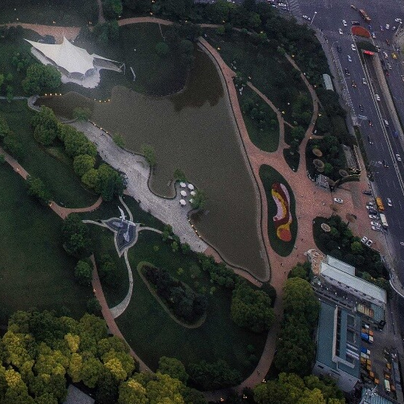
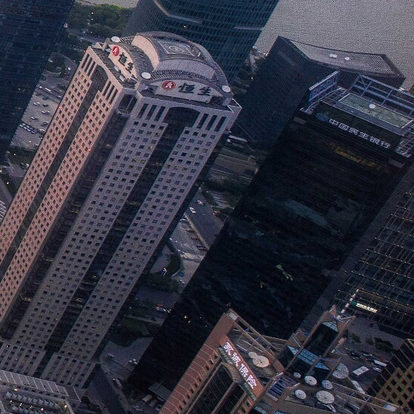
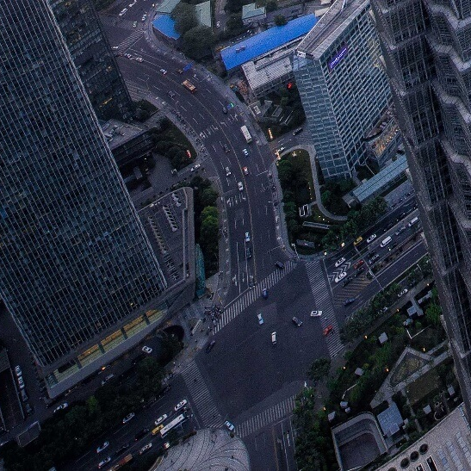
YOUR TITLE
YOUR TITLE
Far far away, behind the word mountains, far from the countries Vokalia and Consonantia, there live the blind texts.
Far far away, behind the word mountains, far from the countries Vokalia and Consonantia, there live the blind texts.
YOUR TITLE
YOUR TITLE
Far far away, behind the word mountains, far from the countries Vokalia and Consonantia, there live the blind texts.
Far far away, behind the word mountains, far from the countries Vokalia and Consonantia, there live the blind texts.

Slide 19
Section Header Here
/01
Supporting text here.
When you copy & paste, choose "keep text only" option.
03
ADD YOUR TEXT

Slide 20
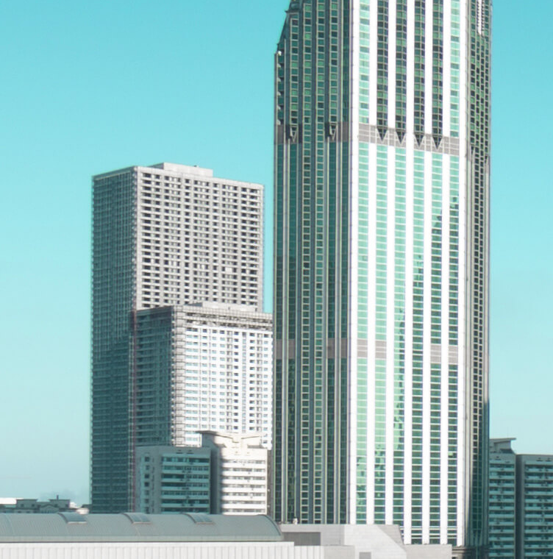
SMALL CENTER
PICTURE
Far far away, behind the word mountains, far from the countries Vokalia and Consonantia, there live the blind texts. Separated they live in Bookmarksgrove right at the coast of the Semantics, a large language ocean.
- The Quotes
Photoshop
85%
Illustrator
70%

Slide 21
SERVICE NAME
SERVICE NAME
SERVICE NAME
Entrepreneurial activities differ substantially depending on the type of
Entrepreneurial activities differ substantially depending on the type of
Entrepreneurial activities differ substantially depending on the type of
SERVICE NAME
SERVICE NAME
SERVICE NAME
Entrepreneurial activities differ substantially depending on the type of
Entrepreneurial activities differ substantially depending on the type of
Entrepreneurial activities differ substantially depending on the type of

Slide 22

Entrepreneurial activities differ substantially depending on the type of organization and creativity. Entrepreneurial activities differ substantially depending on the type of organization and creativity.
HERE SOME THING

Slide 23
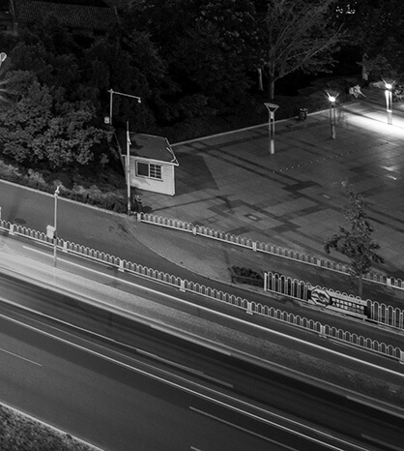
WRITE SOMETHING HERE
PROJECT NAME
PROJECT TITLE
WRITE HERE
Entrepreneurial activities differ substantially depending on the type of
Entrepreneurial activities differ substantially depending on the type of
Entrepreneurial activities differ substantially depending on the type of

Slide 24
Thanks
and your slogan here
speaker name and title

