Slide 1
我和动物们在一起
我和动物们在一起
leave night , Not a sound from the pavement Has the moon lost her memory

Slide 2
CONTENTS
CONTENTS
目录
YOUR TITTLE HERE
YOUR TITTLE HERE
Your Tittle Here, Your Tittle Here
Your Tittle Here, Your Tittle Here
YOUR TITTLE HERE
YOUR TITTLE HERE
Your Tittle Here, Your Tittle Here
Your Tittle Here, Your Tittle Here

Slide 3
https://www.youyedoc.com/
PART 01
PART 01
YOUR TITTLE HERE

Slide 4
YOUR TITTLE HERE
leave night , Not a sound from the pavement Has the moon lost her memory
leave night , Not a sound from the pavement Has the moon lost her memory
leave night , Not a sound from the pavement Has the moon lost her memory
leave night , Not a sound from the pavement Has the moon lost her memory

Slide 5
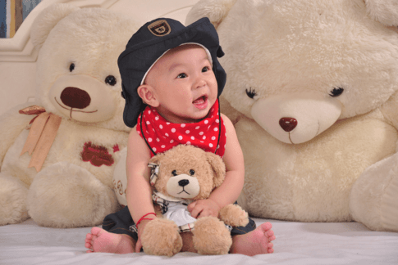
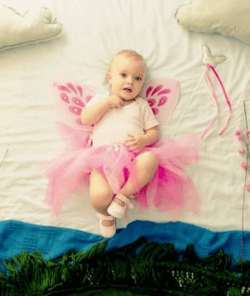
YOUR TITTLE HERE
YOUR TITTLE HERE
leave night , Not a sound from the pavement Has the moon lost her memory
leave night , Not a sound from the pavement Has the moon lost her memory
leave night , Not a sound from the pavement Has the moon lost her memory

Slide 6
YOUR TITTLE HERE
YOUR TITTLE HERE
leave night , Not a sound from the pavement Has the moon lost her memory She is smiling alone In the lamplight leave night
leave night , Not a sound from the pavement Has the moon lost her memory She is smiling alone In the lamplight leave night

Slide 7
YOUR TITTLE HERE
01
leave night , Not a sound from the pavement Has the moon lost her memory She is smiling alone In the lamplight leave night
leave night , Not a sound from the pavement Has the moon lost her memory She is smiling alone In the lamplight leave night
02
leave night , Not a sound from the pavement Has the moon lost her memory She is smiling alone In the lamplight leave night
03

Slide 8
PART 02
PART 02
YOUR TITTLE HERE

Slide 9
YOUR TITTLE HERE
YOUR TITTLE HERE
YOUR TITTLE HERE
leave night , Not a sound from the pavement Has the moon lost her memory， She is smiling alone In the lamplight leave night
leave night , Not a sound from the pavement Has the moon lost her memory， She is smiling alone In the lamplight leave night

Slide 10
YOUR TITTLE HERE
YOUR TITTLE HERE
leave night , Not a sound from the pavement Has the moon lost her memory She is smiling alone In the lamplight leave night
leave night , Not a sound from the pavement Has the moon lost her memory She is smiling alone In the lamplight leave night
leave night , Not a sound from the pavement Has the moon lost her memory She is smiling alone In the lamplight leave night

Slide 11
YOUR TITTLE HERE
YOUR TITTLE HERE
leave night , Not a sound from the pavement Has the moon lost her memory， She is smiling alone In the lamplight leave night

Slide 12
PART 03
PART 03
YOUR TITTLE HERE

Slide 13
YOUR TITTLE HERE
YOUR TITTLE HERE
leave night , Not a sound from the pavement Has the moon lost her memory， She is smiling alone In the lamplight leave night
YOUR TITTLE HERE
leave night , Not a sound from the pavement Has the moon lost her memory， She is smiling alone In the lamplight leave night

Slide 14
YOUR TITTLE HERE
YOUR TITTLE HERE
leave night , Not a sound from the pavement Has the moon lost her memory， She is smiling alone In the lamplight leave night

Slide 15
YOUR TITTLE HERE
TITTLE HERE
leave night , Not a sound from the pavement Has the moon lost her memory

Slide 16
PART 04
PART 04
YOUR TITTLE HERE

Slide 17
YOUR TITTLE HERE
YOUR TITTLE HERE
leave night , Not a sound from the pavement Has the moon lost her memory， She is smiling alone In the lamplight leave night
leave night , Not a sound from the pavement Has the moon lost her memory， She is smiling alone In the lamplight leave night

Slide 18
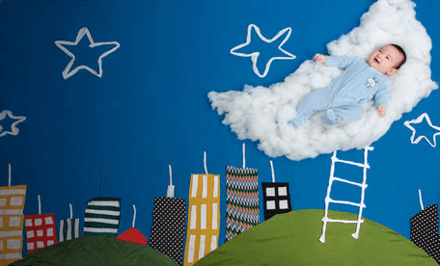
YOUR TITTLE HERE
TITTLE HERE
leave night , Not a sound from the pavement Has the moon lost her memory ,leave night , Not a sound from the pavement Has the moon lost her memory

Slide 19
YOUR TITTLE HERE
YOUR TITTLE HERE
leave night , Not a sound from the pavement Has the moon lost her memory
YOUR TITTLE HERE
leave night , Not a sound from the pavement Has the moon lost her memory
YOUR TITTLE HERE
leave night , Not a sound from the pavement Has the moon lost her memory

Slide 20
YOUR TITTLE HERE
TITTLE HERE
TITTLE HERE
leave night , Not a sound from the pavement Has the moon lost her memory ,leave night ,
leave night , Not a sound from the pavement Has the moon lost her memory ,leave night , Not a sound from the pavement Has the moon lost her memory

Slide 21
YOUR TITTLE HERE
YOUR TITTLE HERE
leave night , Not a sound from the pavement Has the moon lost her memory
leave night , Not a sound from the pavement Has the moon lost her memory
leave night , Not a sound from the pavement Has the moon lost her memory

Slide 22
YOUR TITTLE HERE
TITTLE HERE
leave night , Not a sound from the pavement Has the moon lost her memory ,leave night , Not a sound from the pavement Has the moon lost her memory
TITTLE HERE
leave night , Not a sound from the pavement Has the moon lost her memory ,leave night , Not a sound from the pavement Has the moon lost her memory

Slide 23
THANKS
THANKS
leave night , Not a sound from the pavement Has the moon lost her memory

